Slide 1
New Members
for January 2024

Slide 2
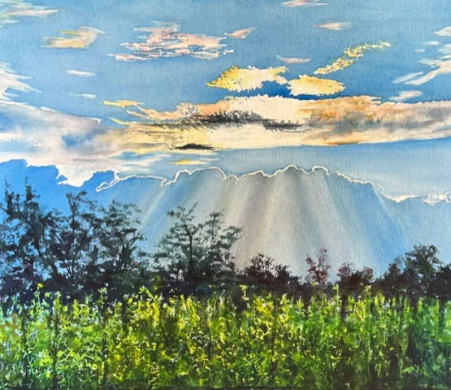
Deborah Bruce

Slide 3
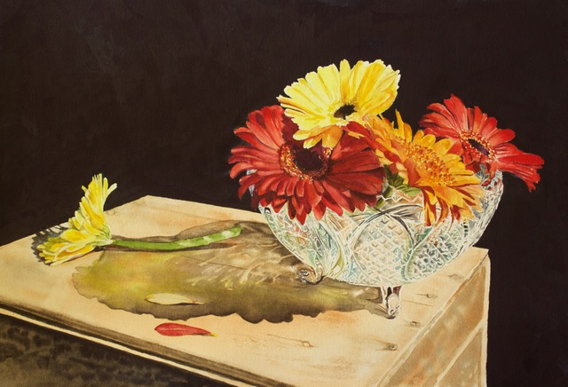
Deborah Bruce

Slide 4
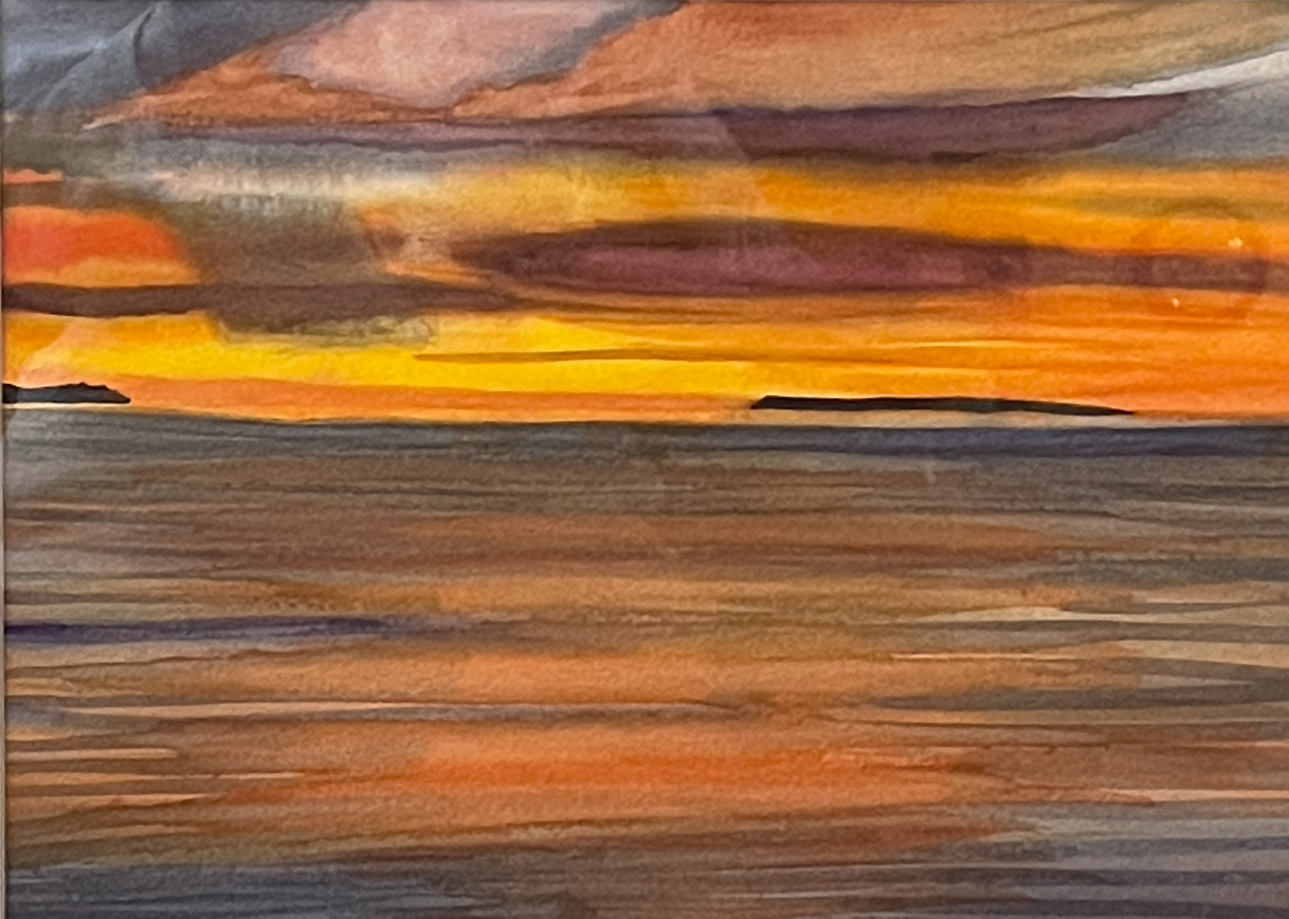
Harriett Mittelberger

Slide 5
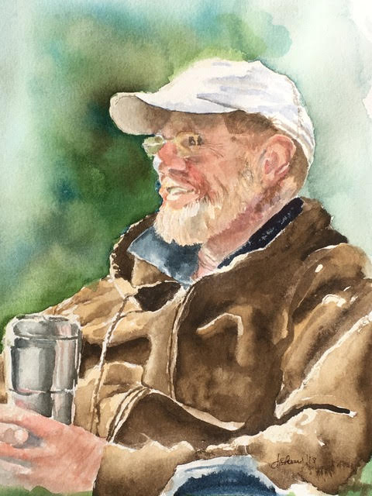
Jacqui Shaw

Slide 6
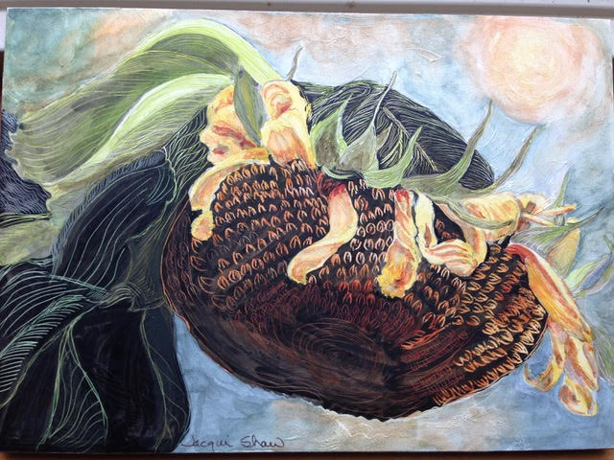
Jacqui Shaw

Slide 7
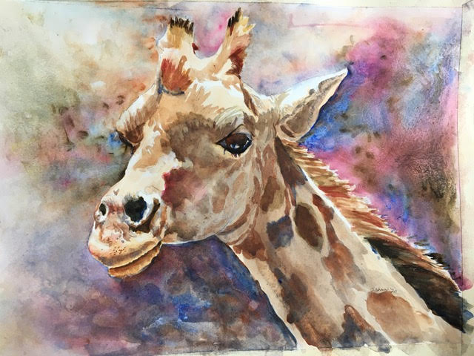
Jacqui Shaw

Slide 8
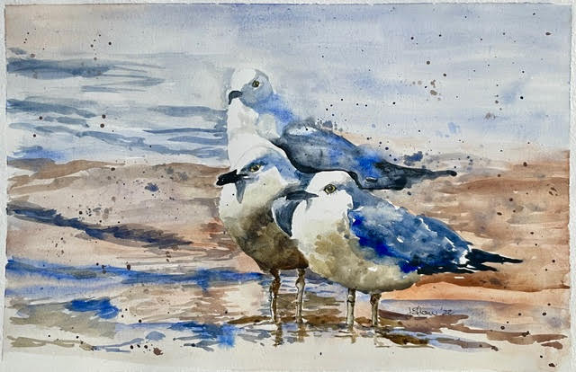
Jacqui Shaw

