Slide 1
Challenge Paintings
for January 2024
Winter Scene

Slide 2
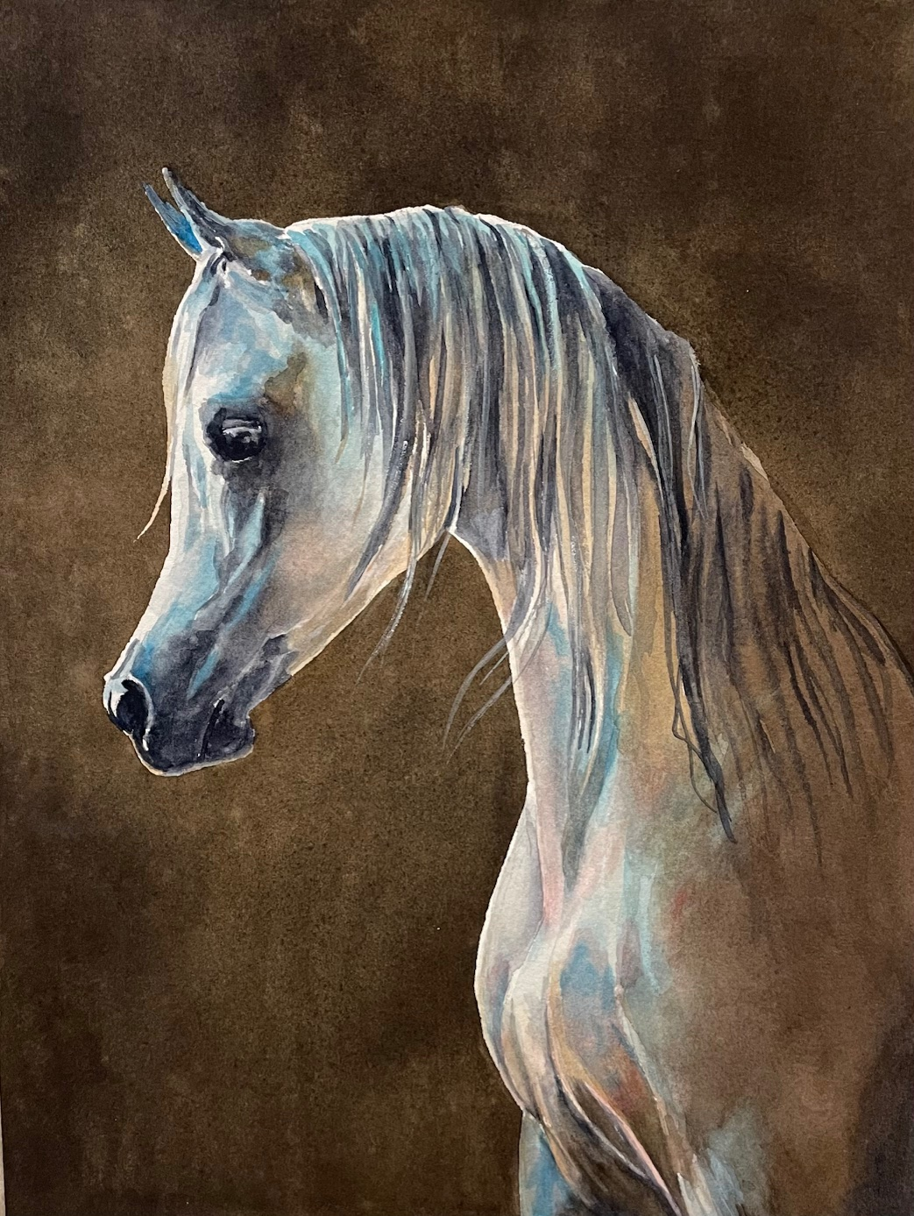
Kelly Burk, SWS

Slide 3
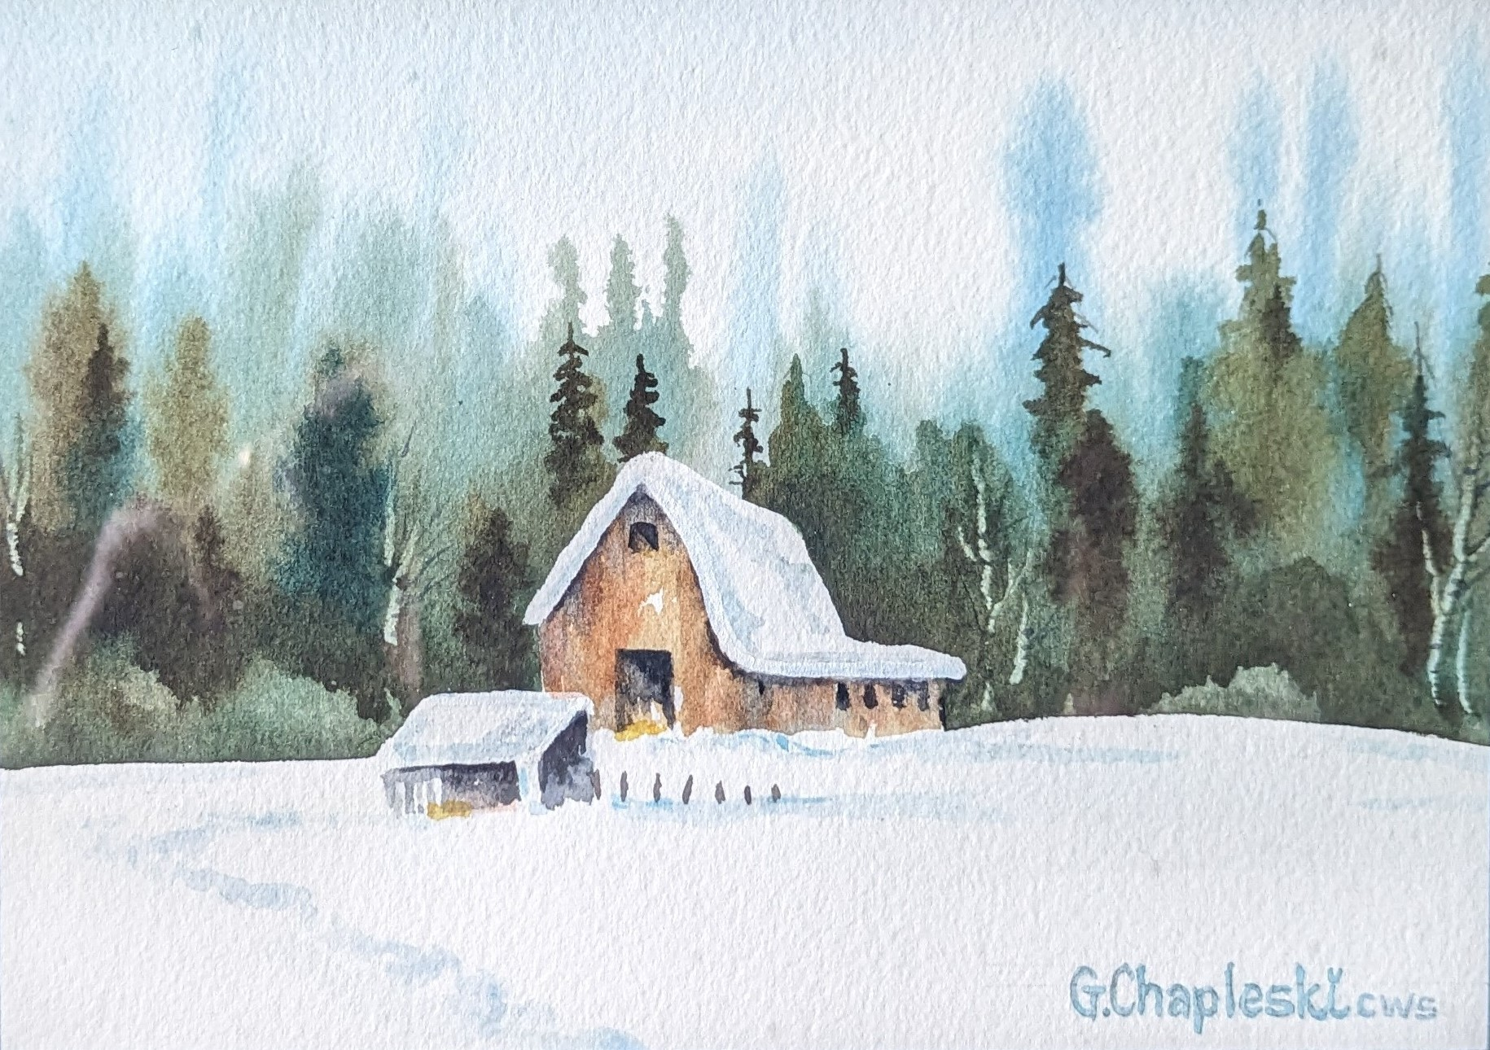
Greg Chapleski

Slide 4
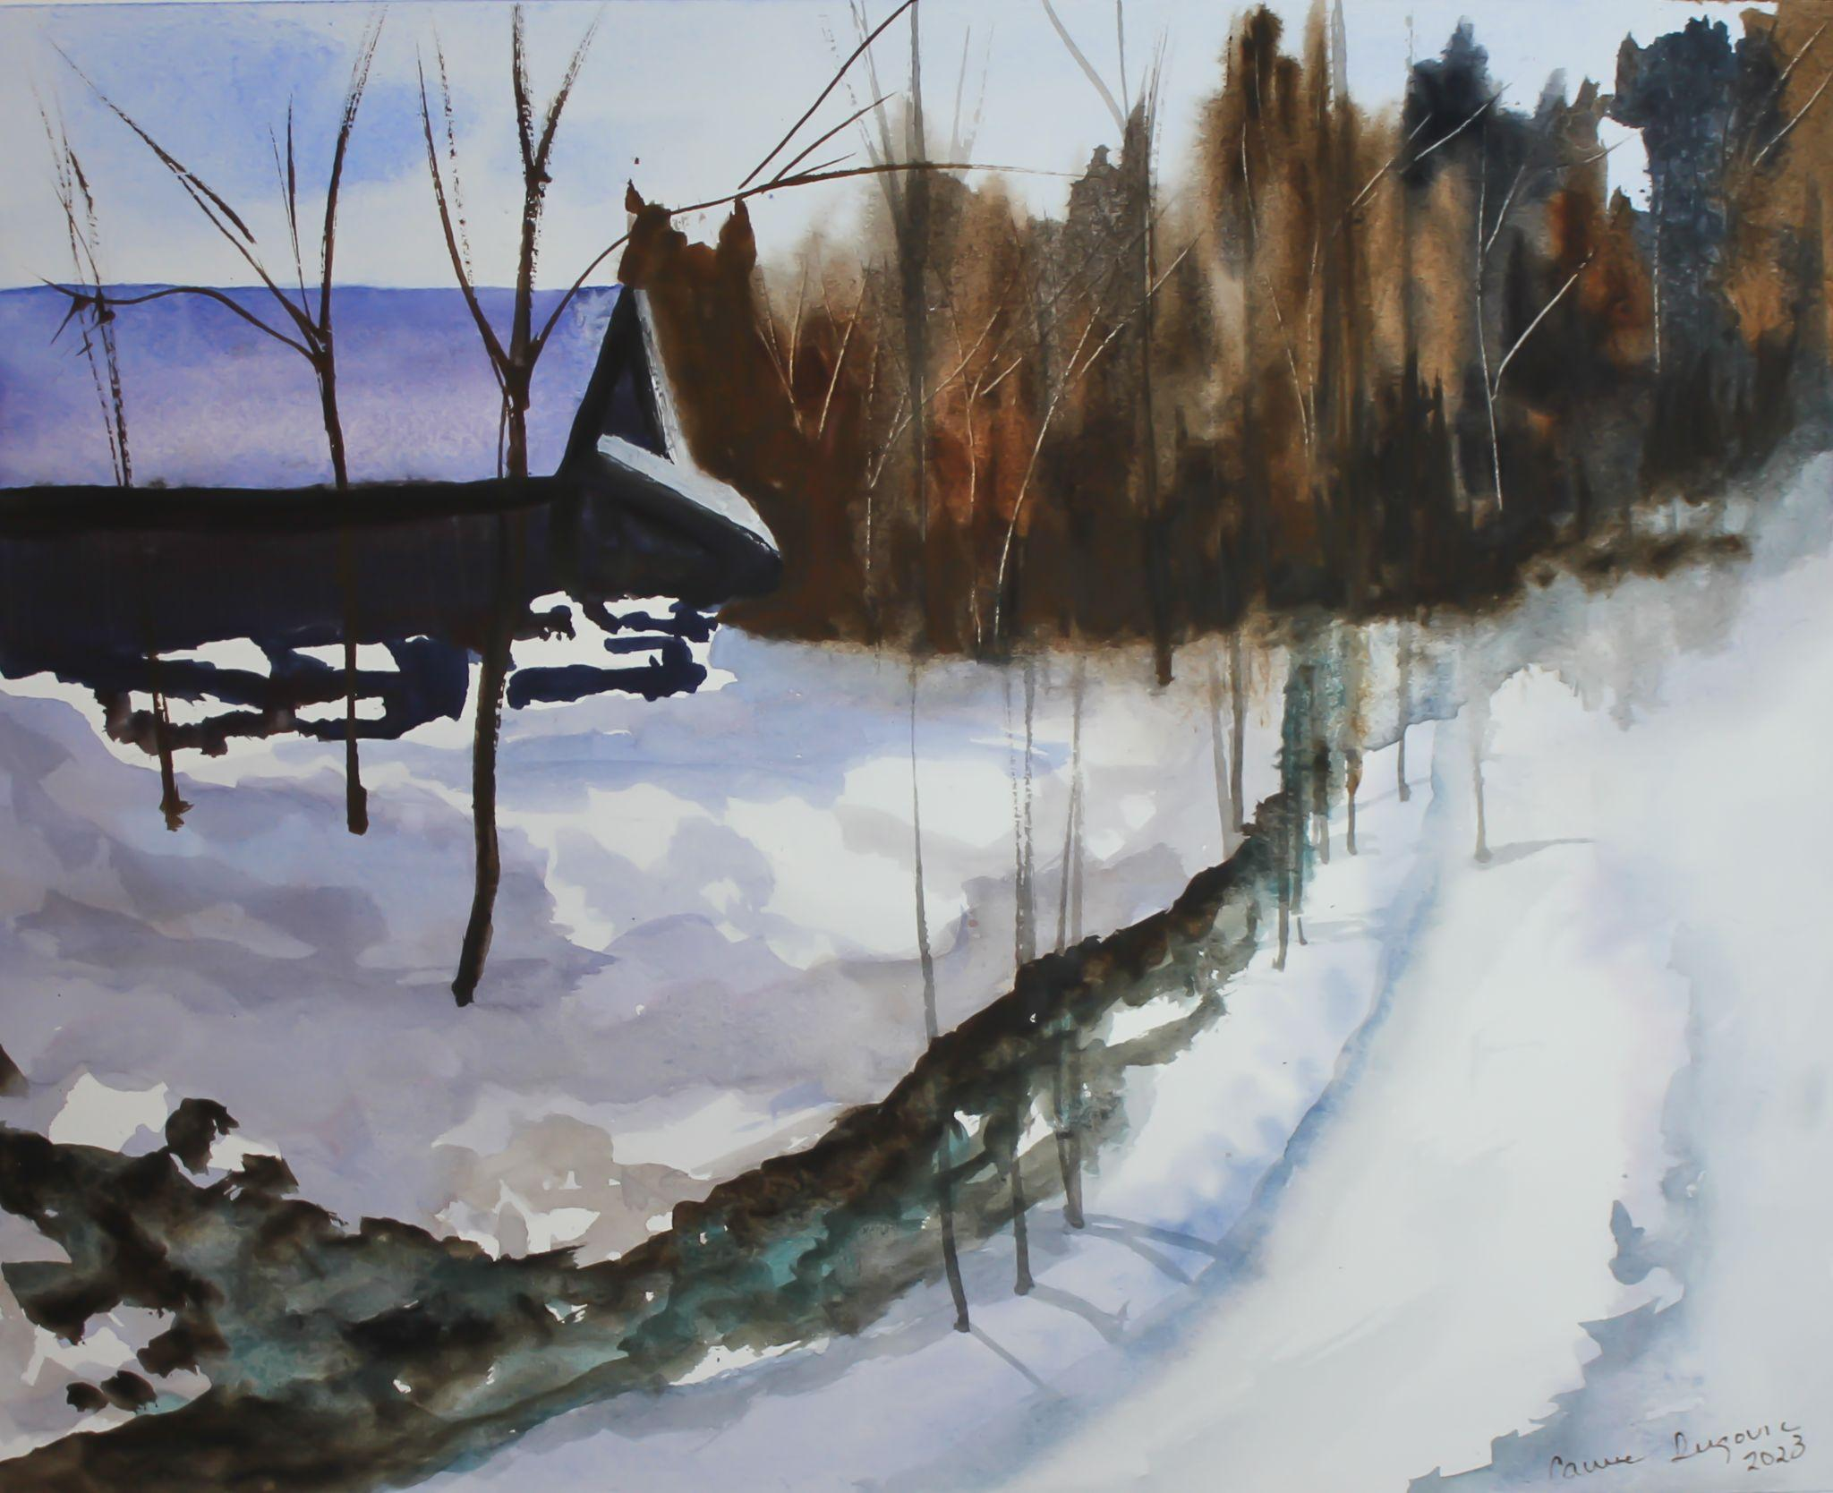
Carrie Dugovic

Slide 5
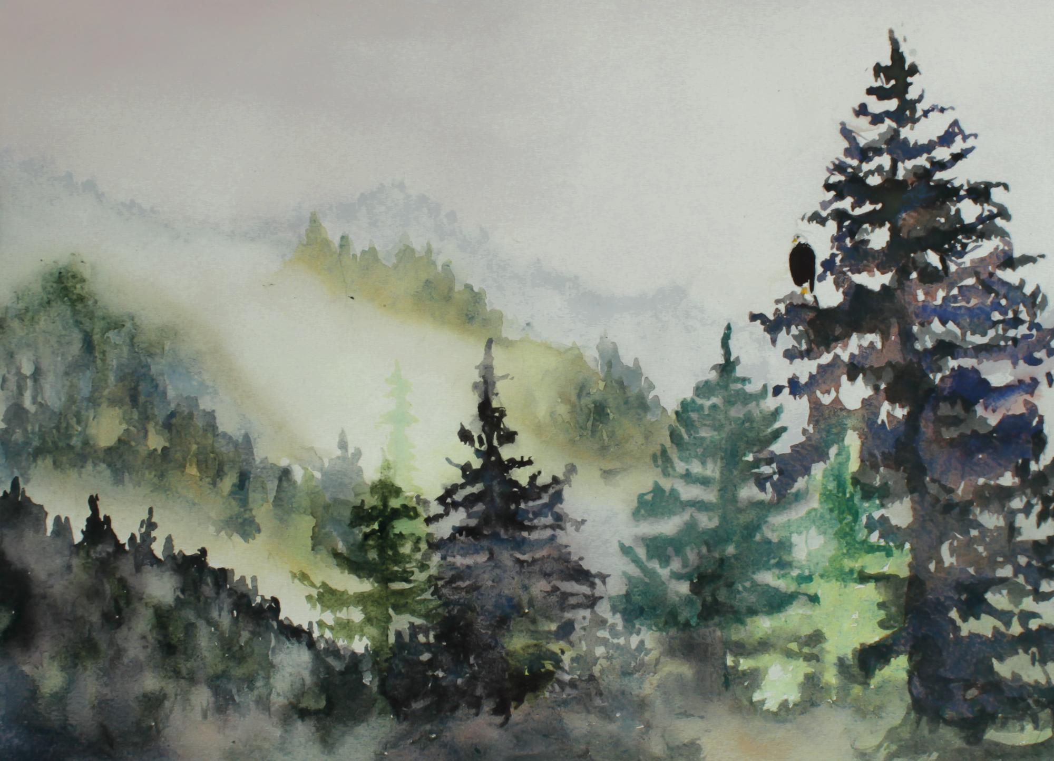
Carrie Dugovic

Slide 6
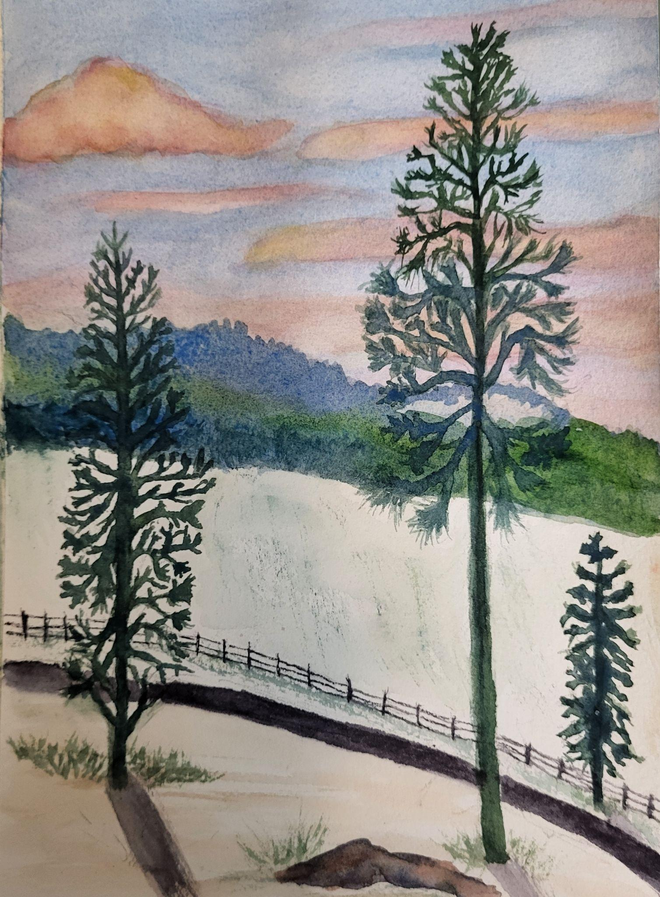
Kathi Eckerich

Slide 7
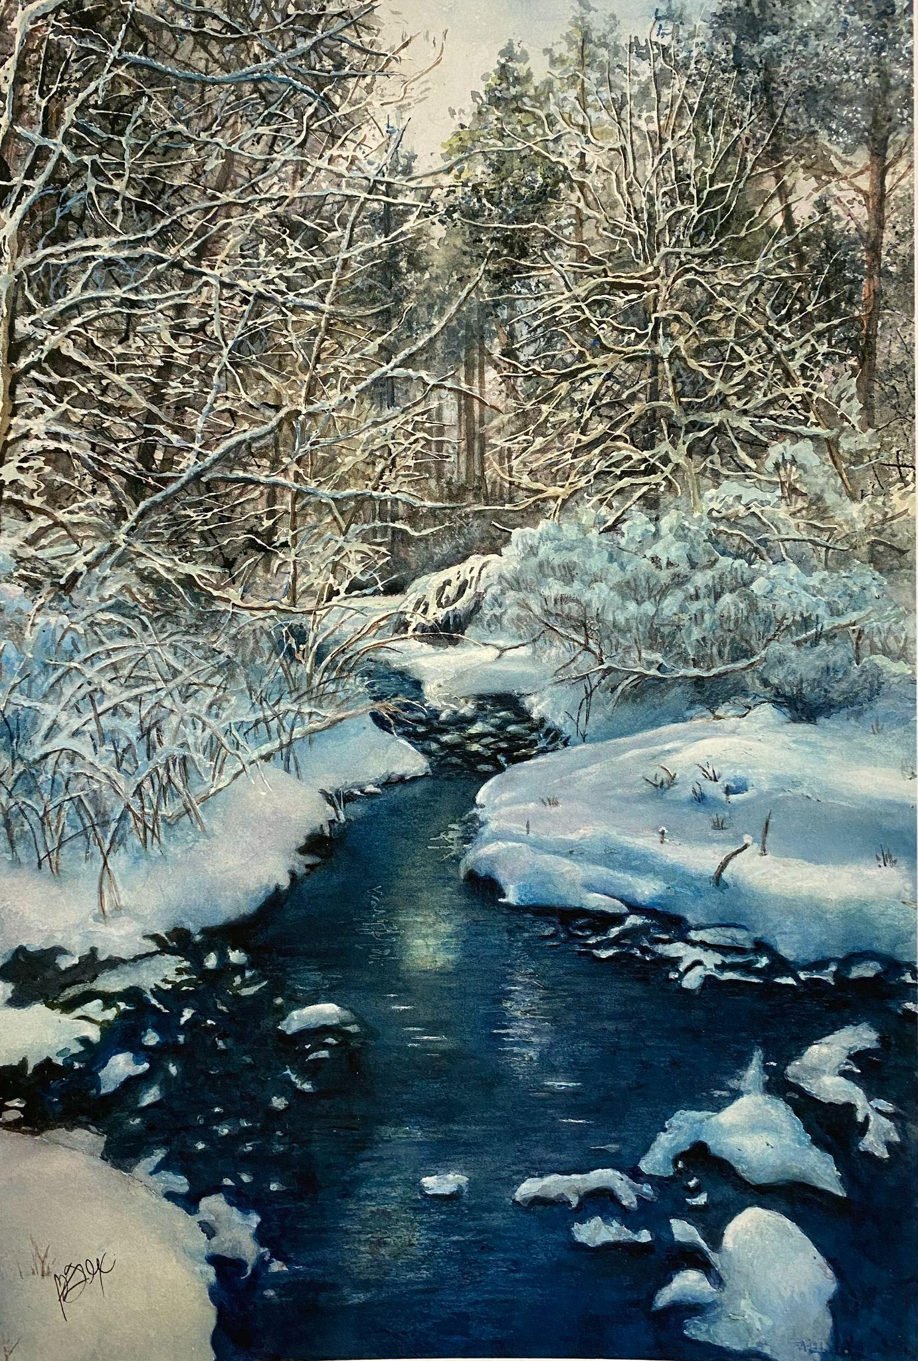
Gloria Fox, SWS

Slide 8
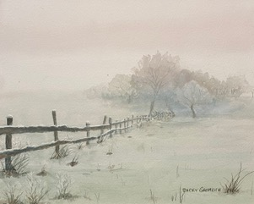
Becky Gromlich, SWS

Slide 9
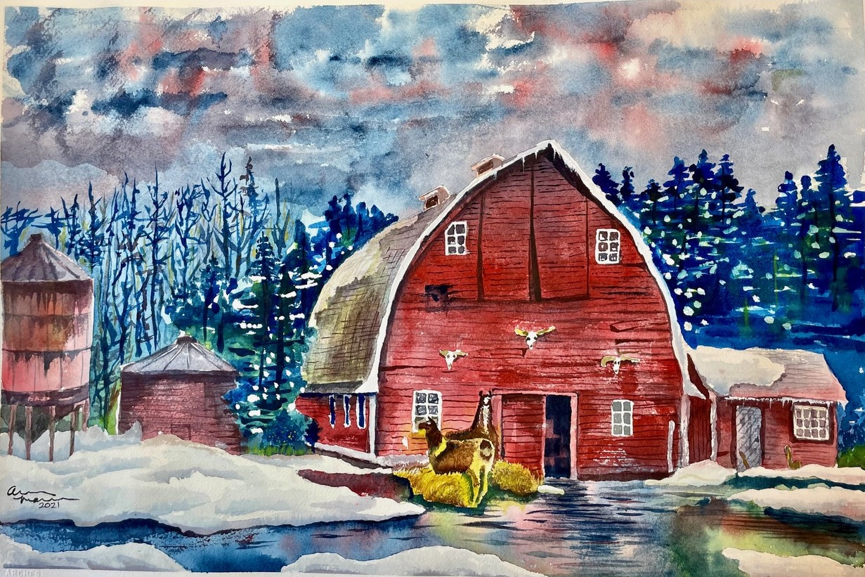
Aaron Mann

Slide 10
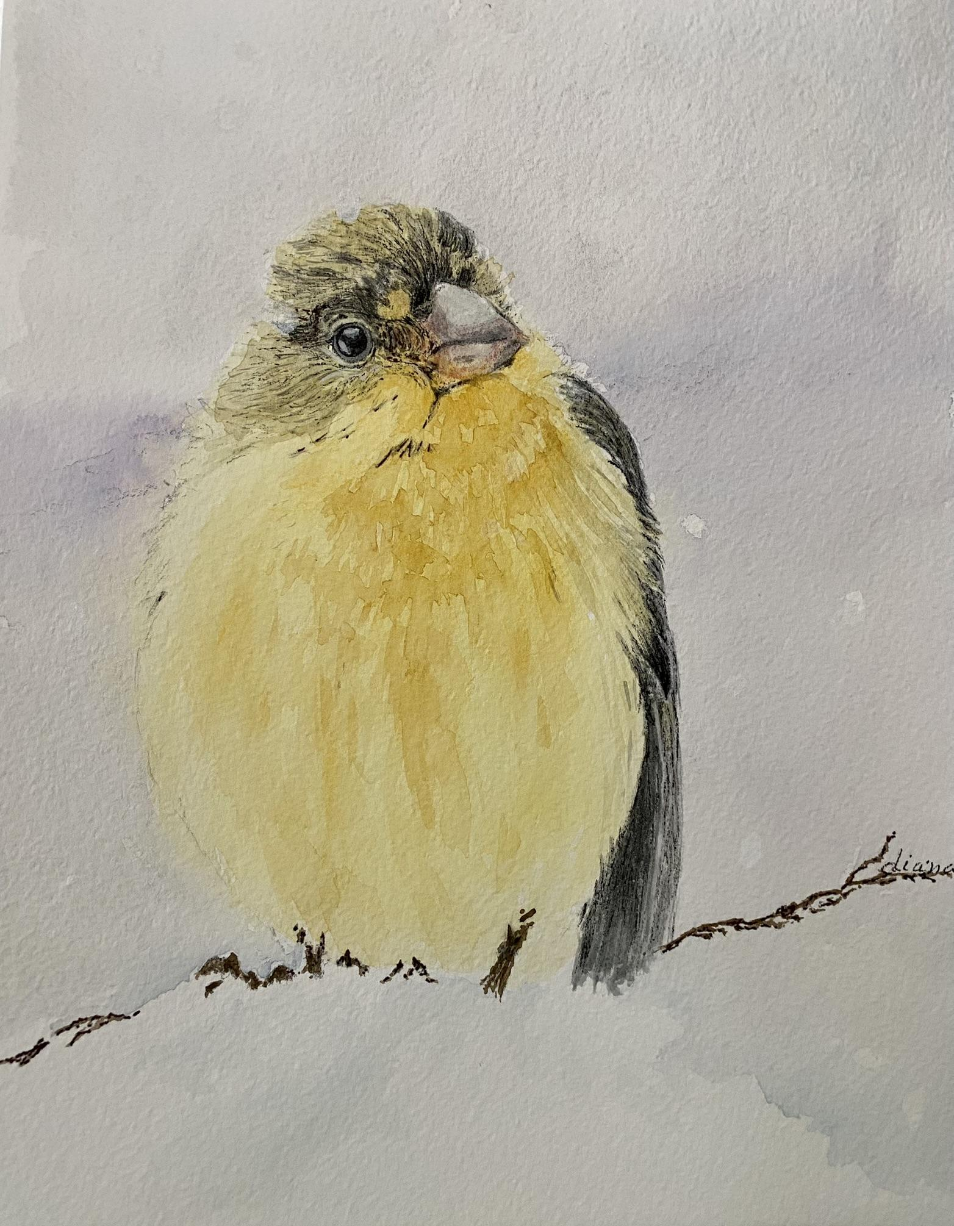
Diane Postlewait

Slide 11
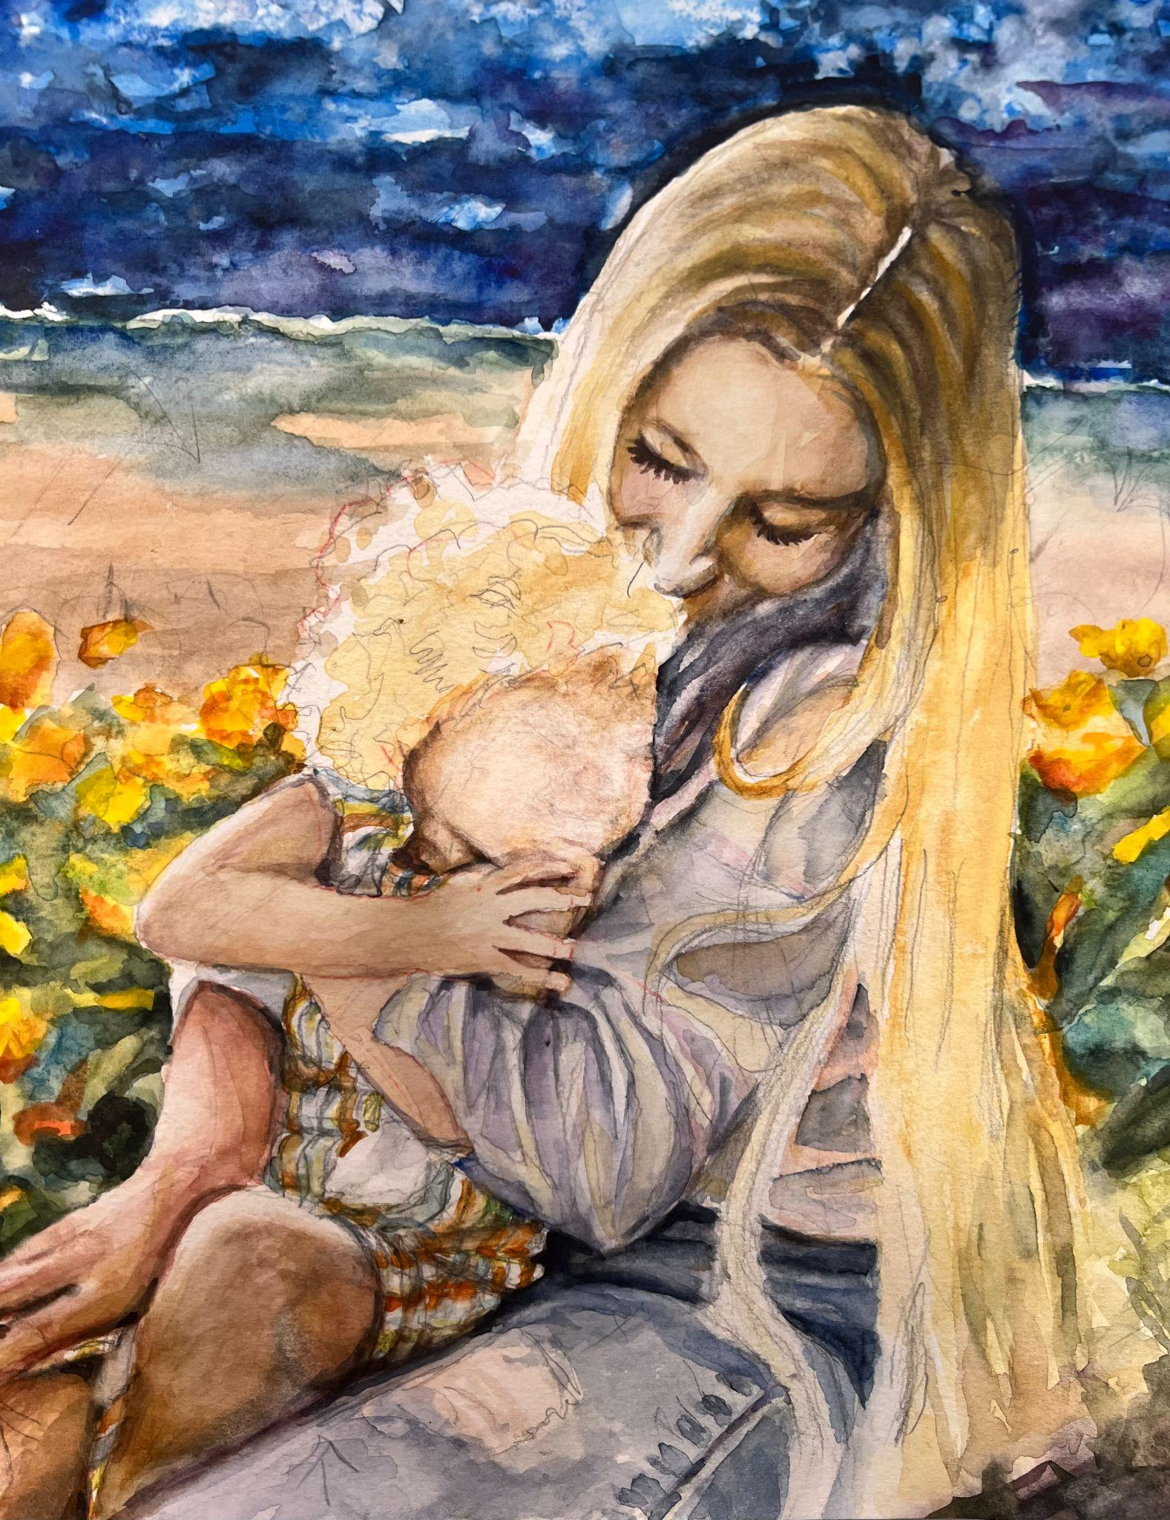
Mimi Ross

Slide 12
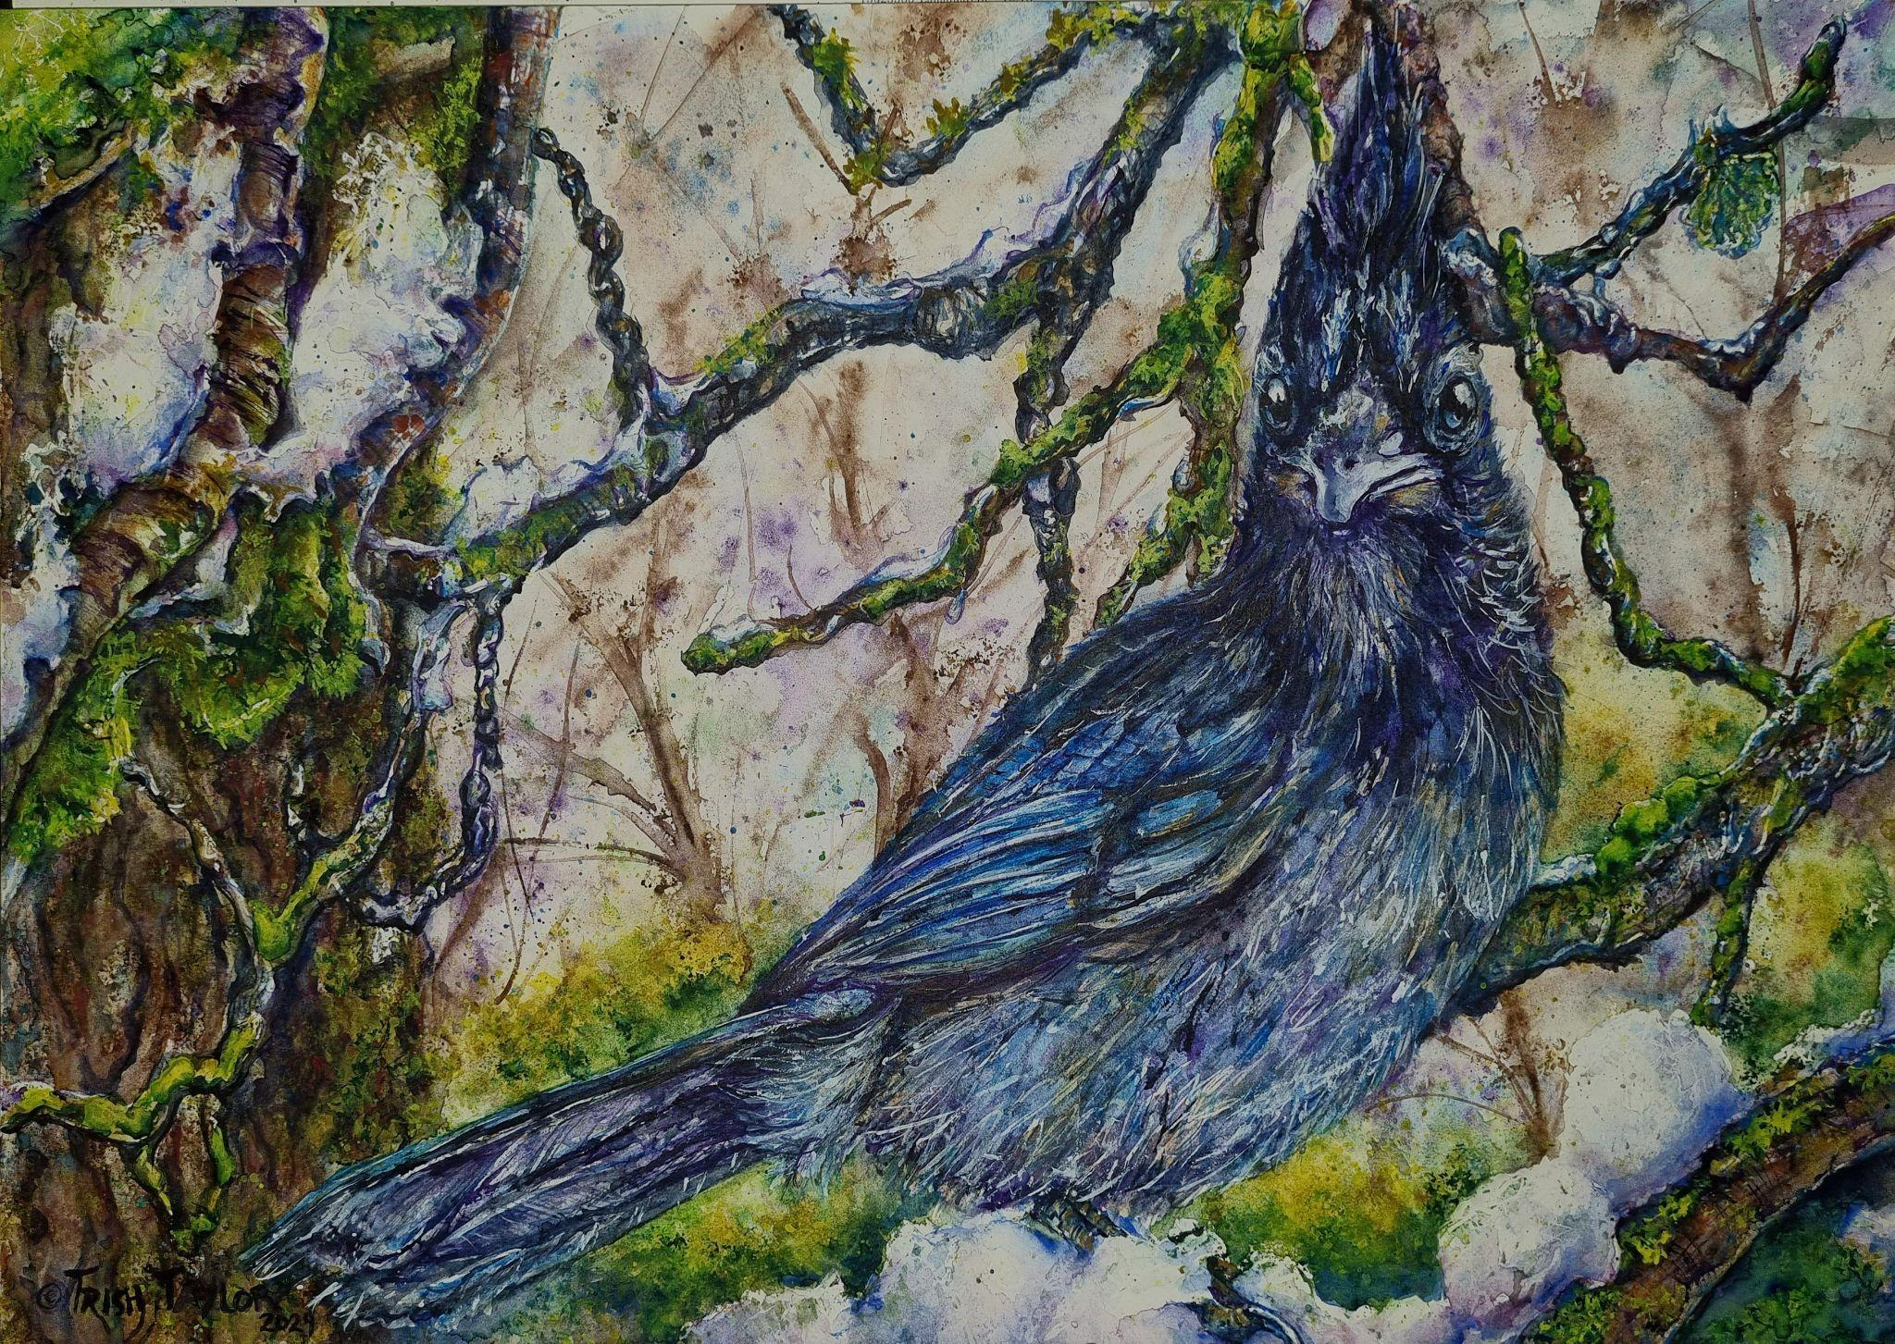
Patricia Taylor

Slide 13
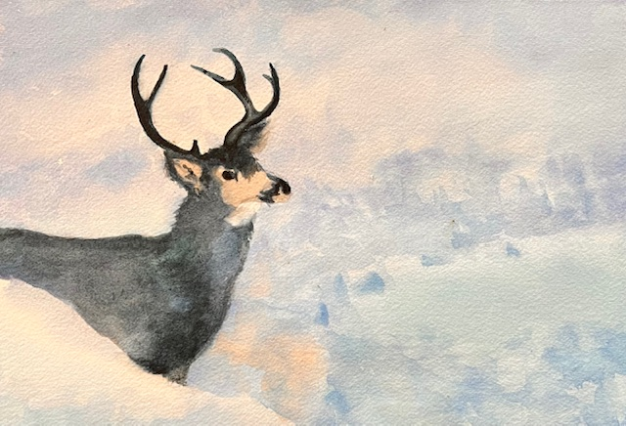
Sheri Thies, SWS

Slide 14
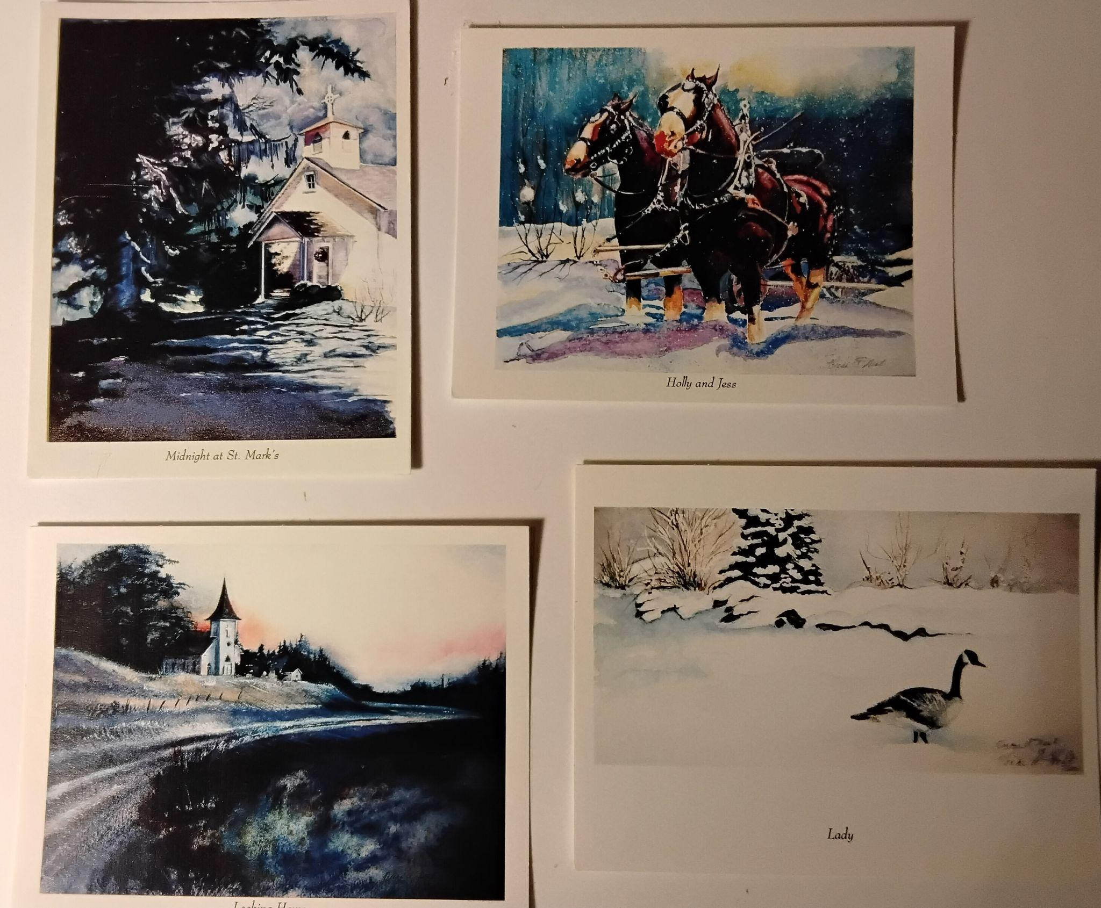
Vicki West, SWS

Slide 15
Challenge Paintings
for February
Something with the color RED, the subject is the artist’s choice

