Slide 1
Challenge Paintings
for May 2023
A Still Life or an Object

Slide 2
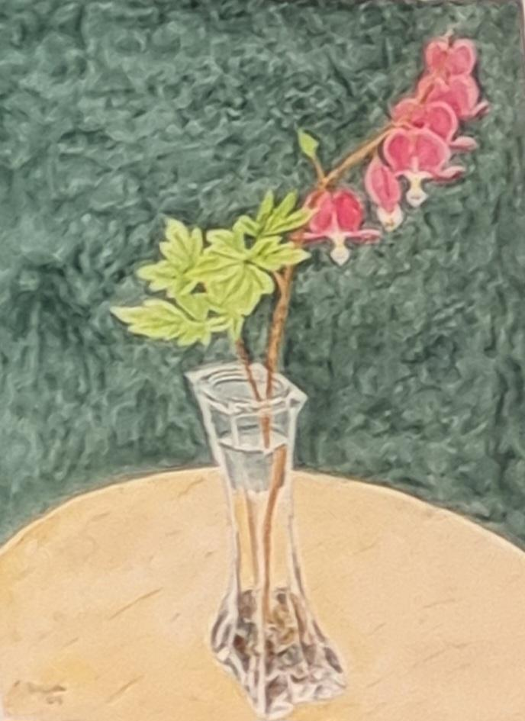
T. Bauer

Slide 3
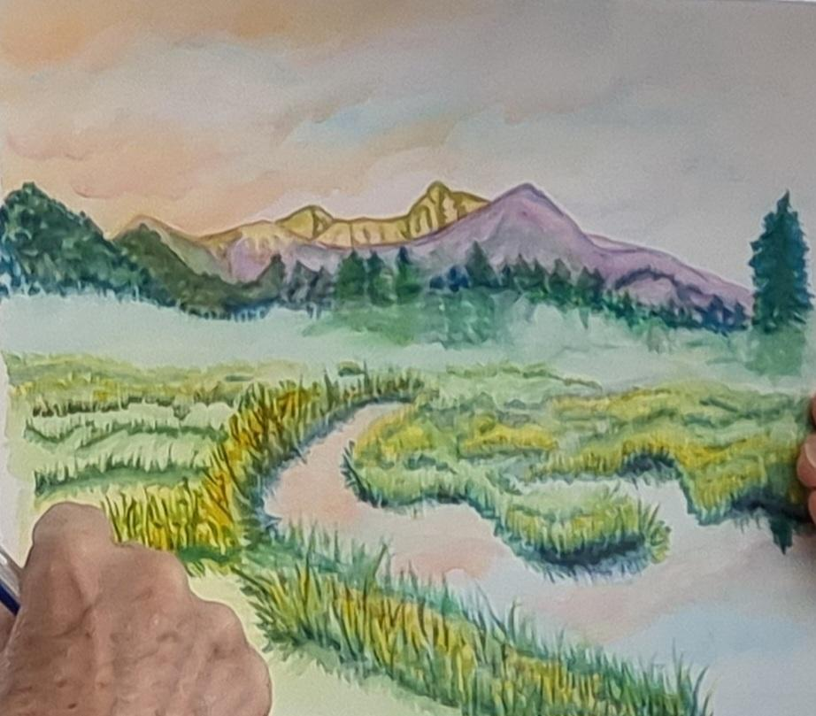
Beth Camp

Slide 4
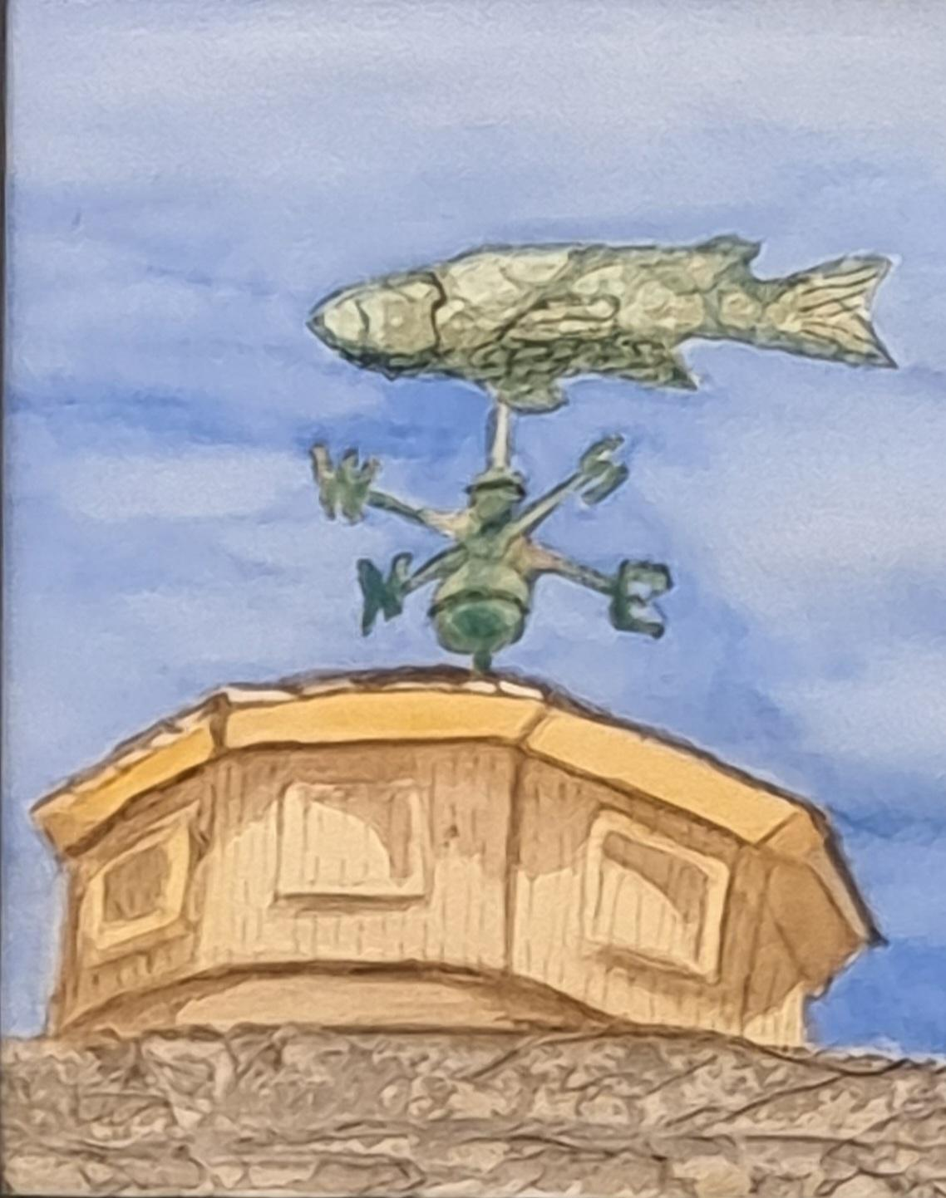
Kathi Eckerich

Slide 5
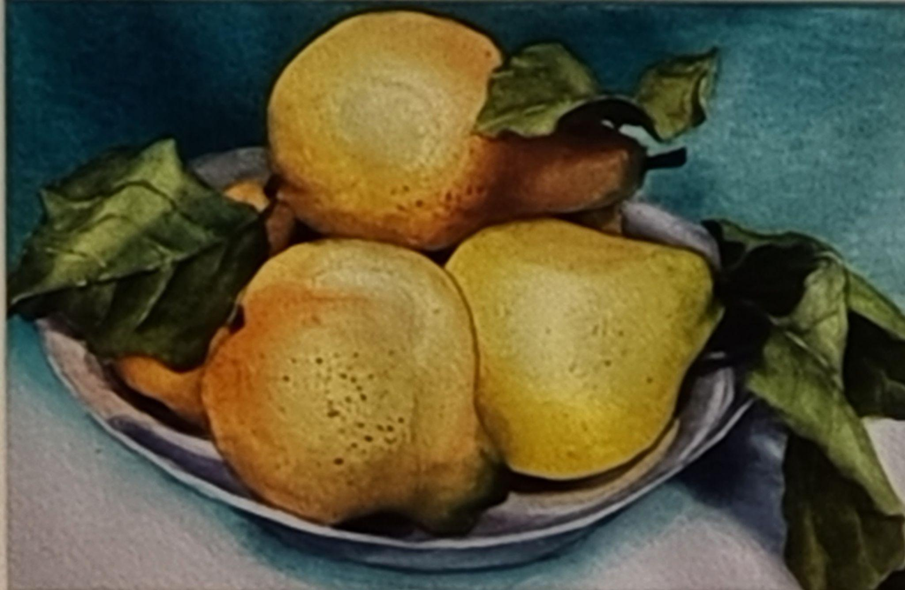
Kim Gardell, SWS

Slide 6
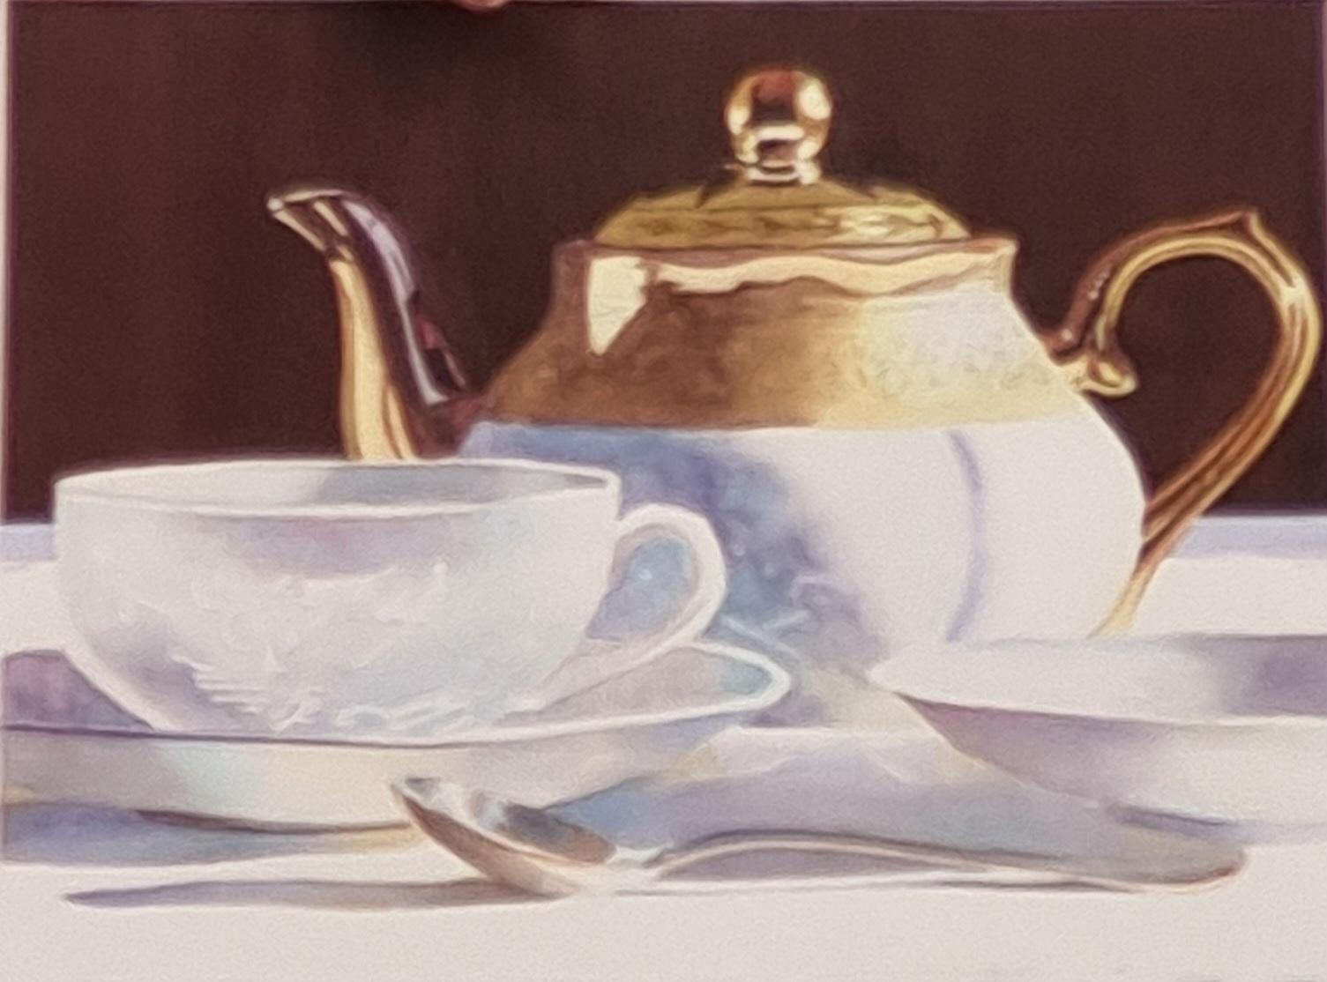
Kelly Knouff-Burk, SWS

Slide 7
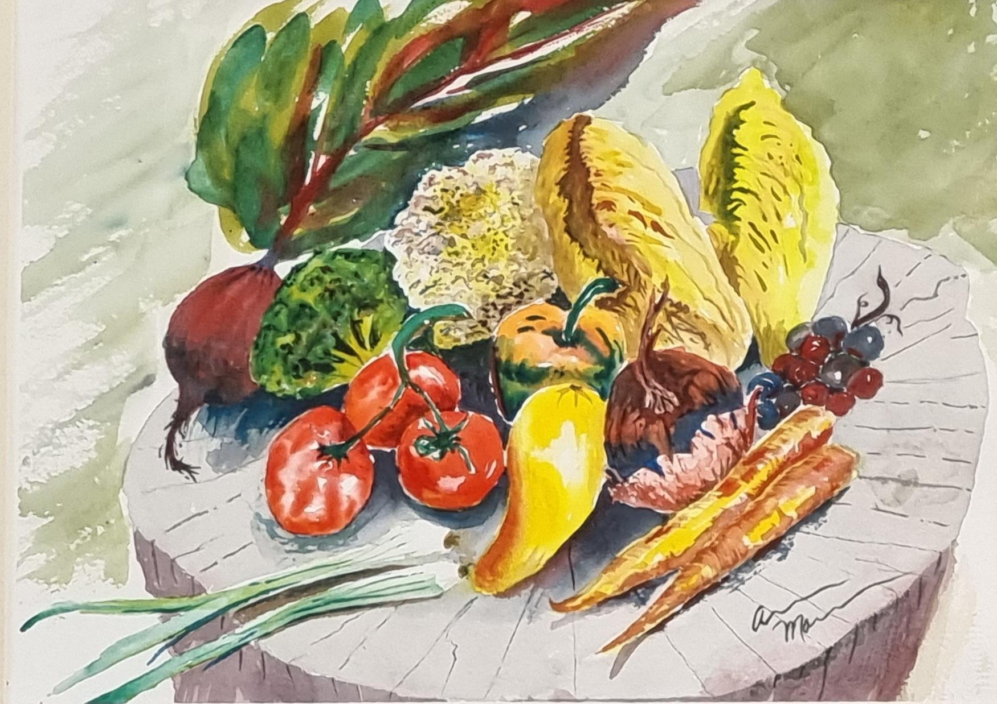
Aaron Mann

Slide 8
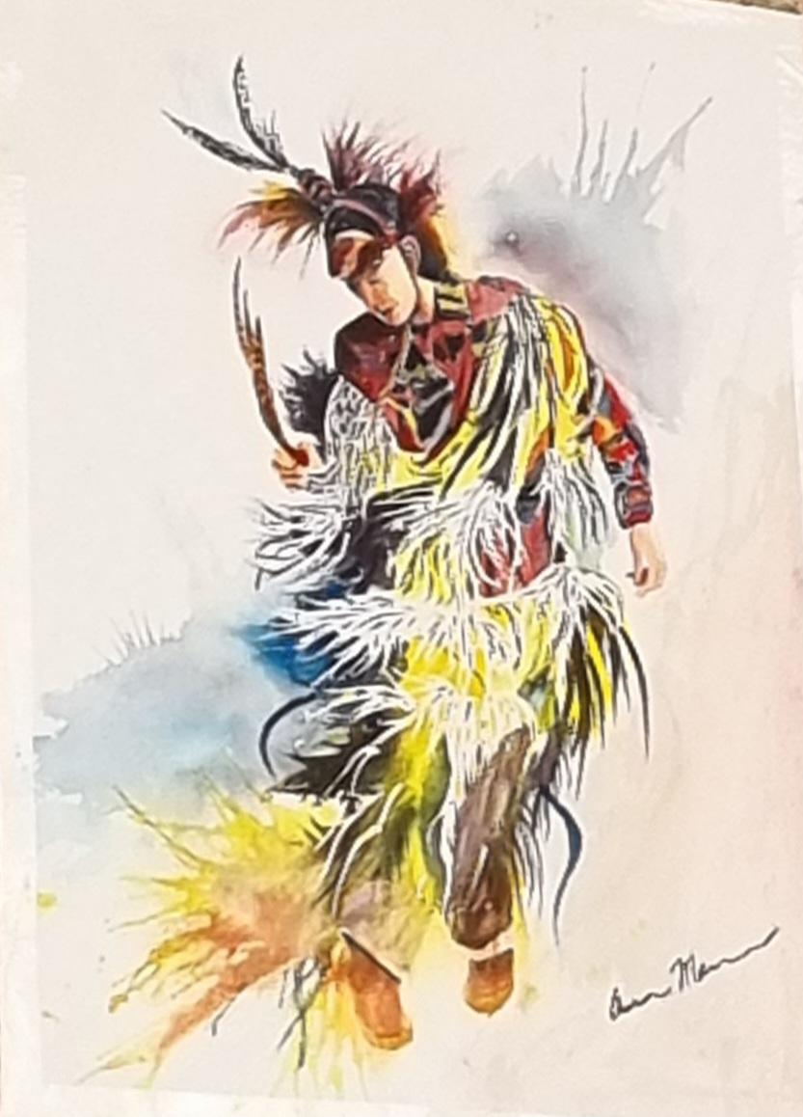
Aaron Mann

Slide 9
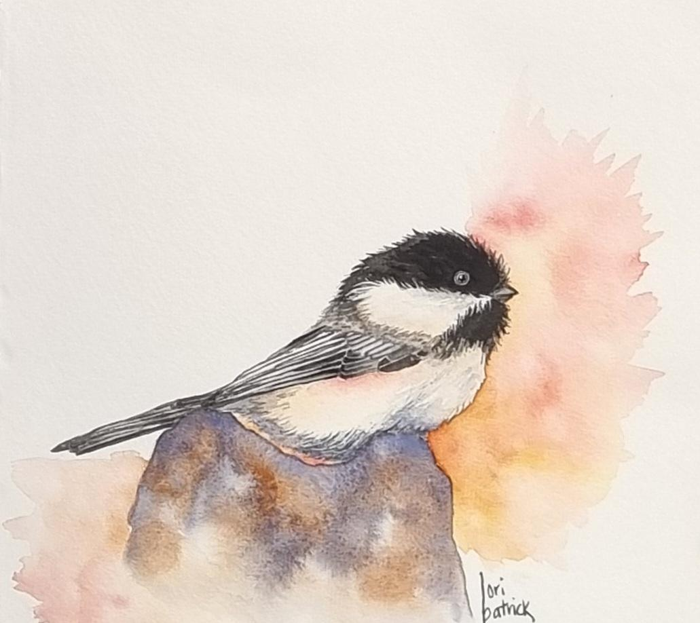
Lori Patrick

Slide 10
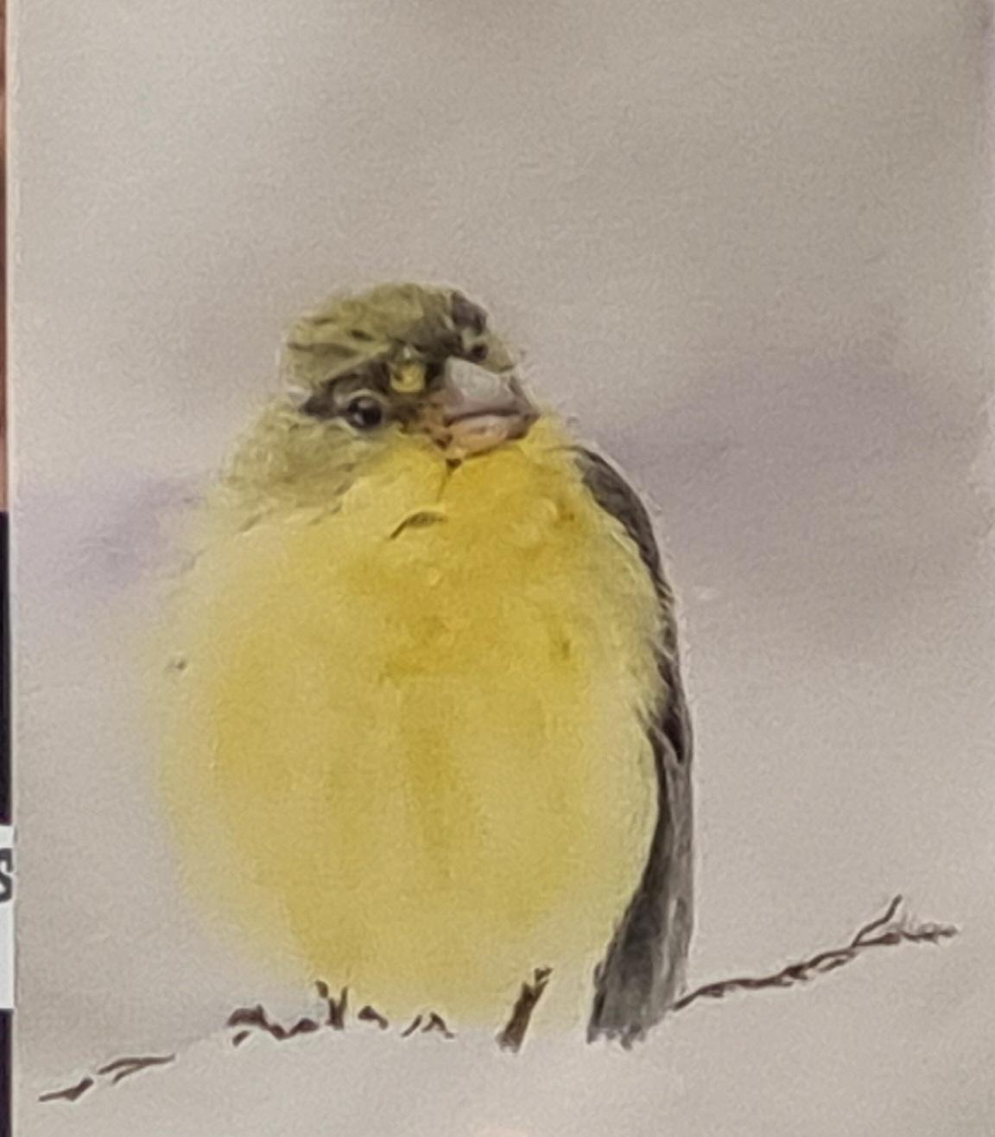
Diana Postelwaite

Slide 11
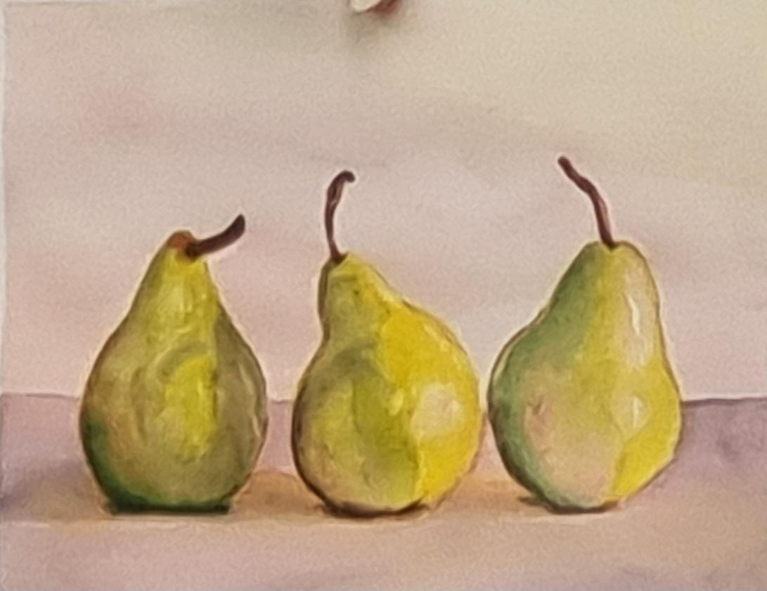
Diana Postelwaite

Slide 12
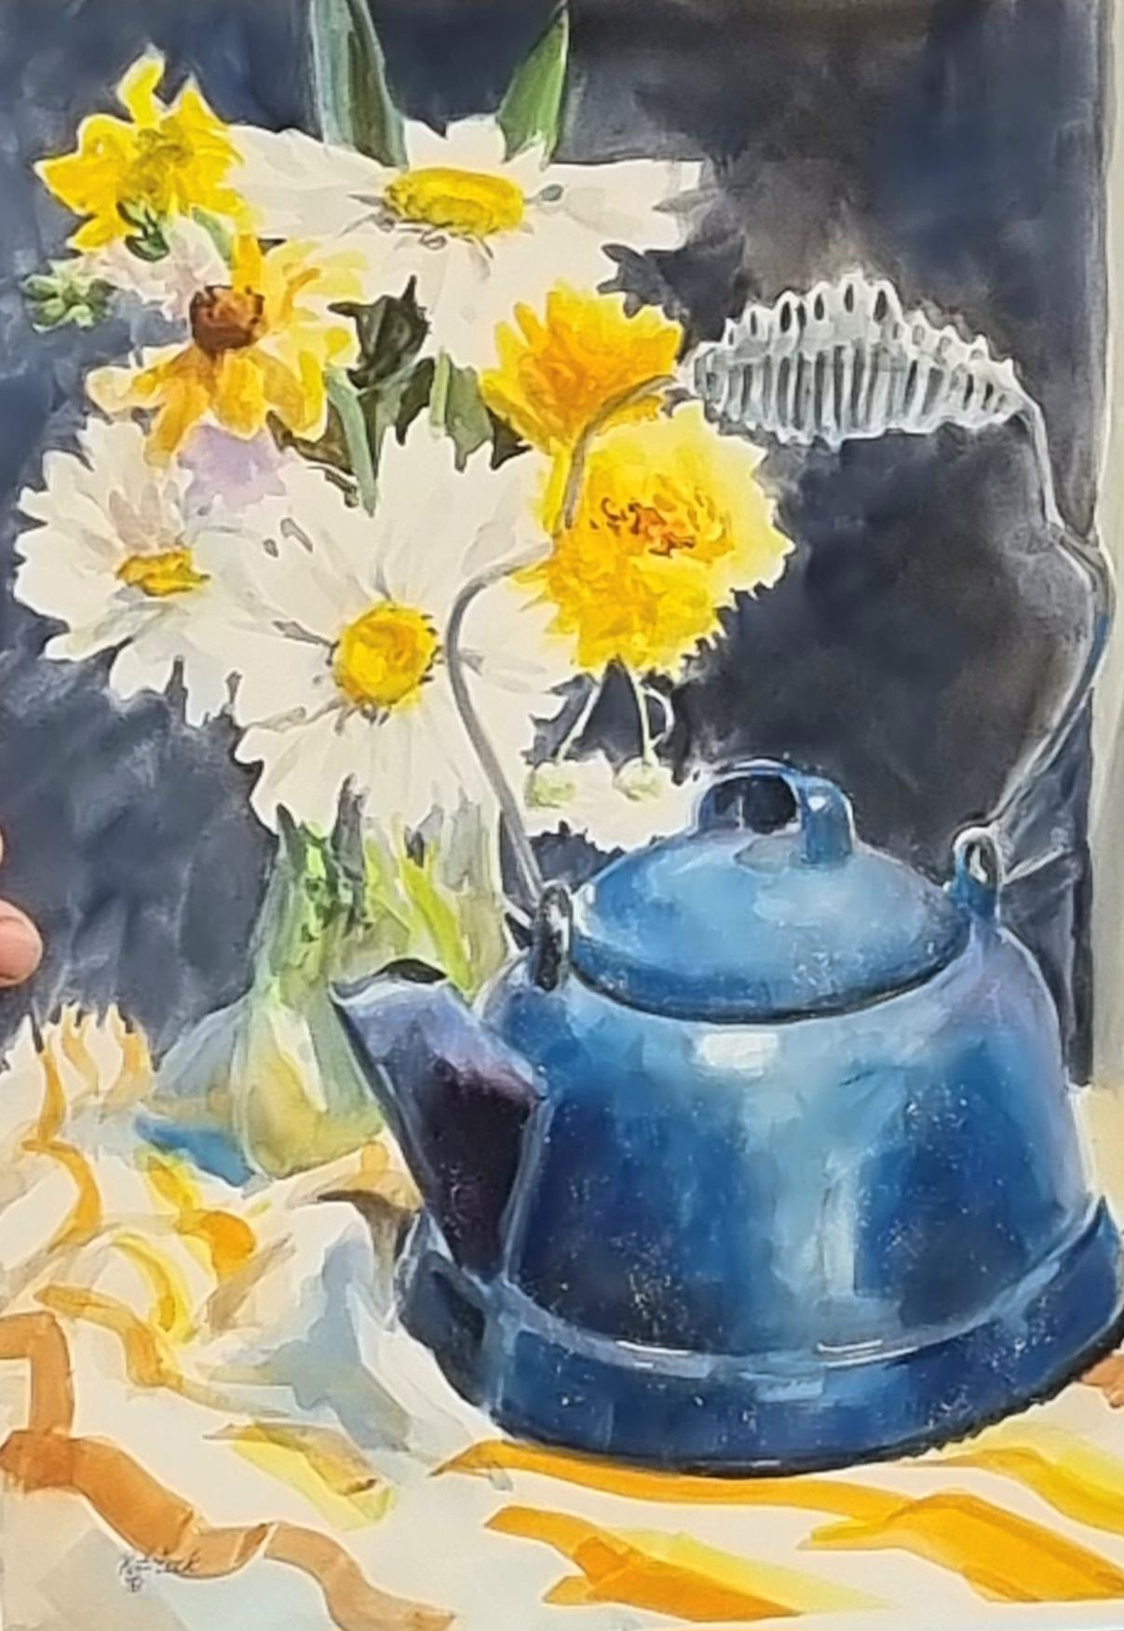
Sue Rohrback, SWS

Slide 13
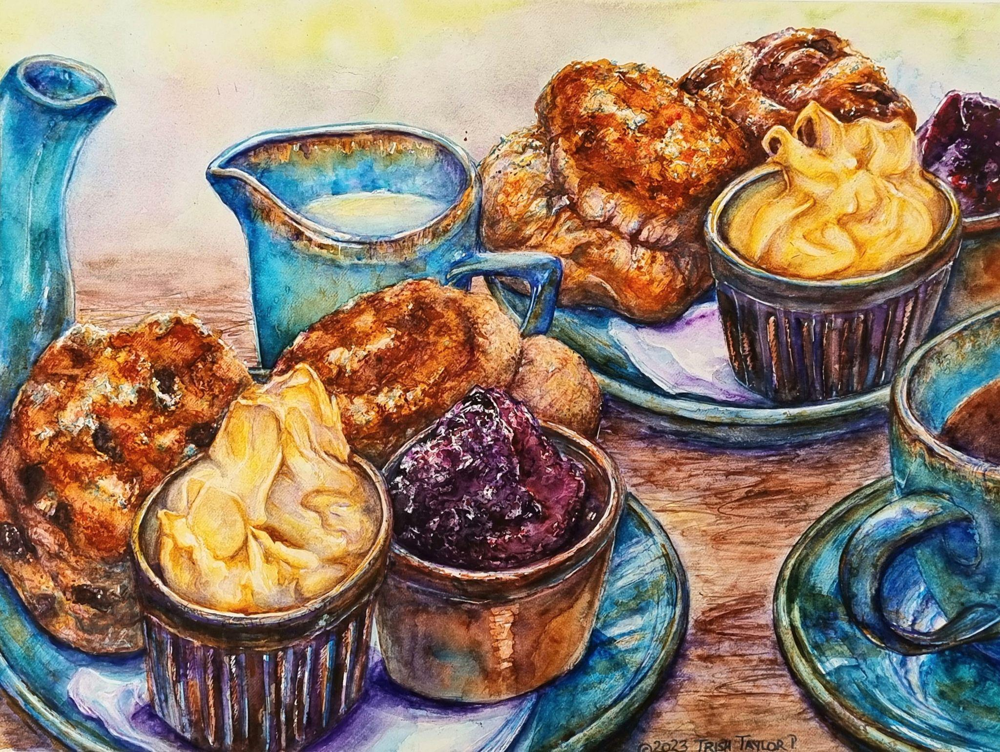
Trish Taylor

Slide 14
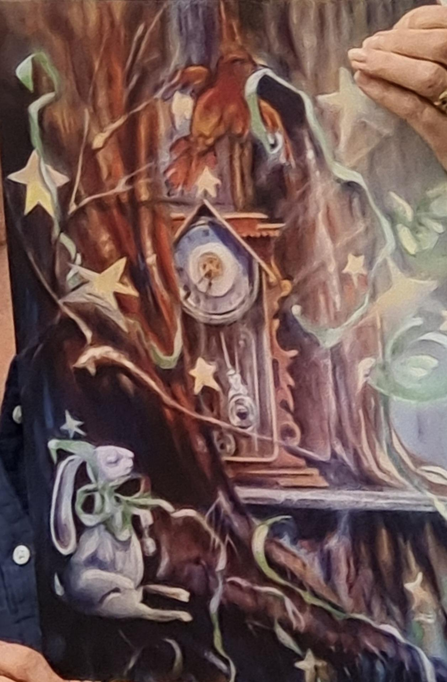
Vicki West, SWS

Slide 15
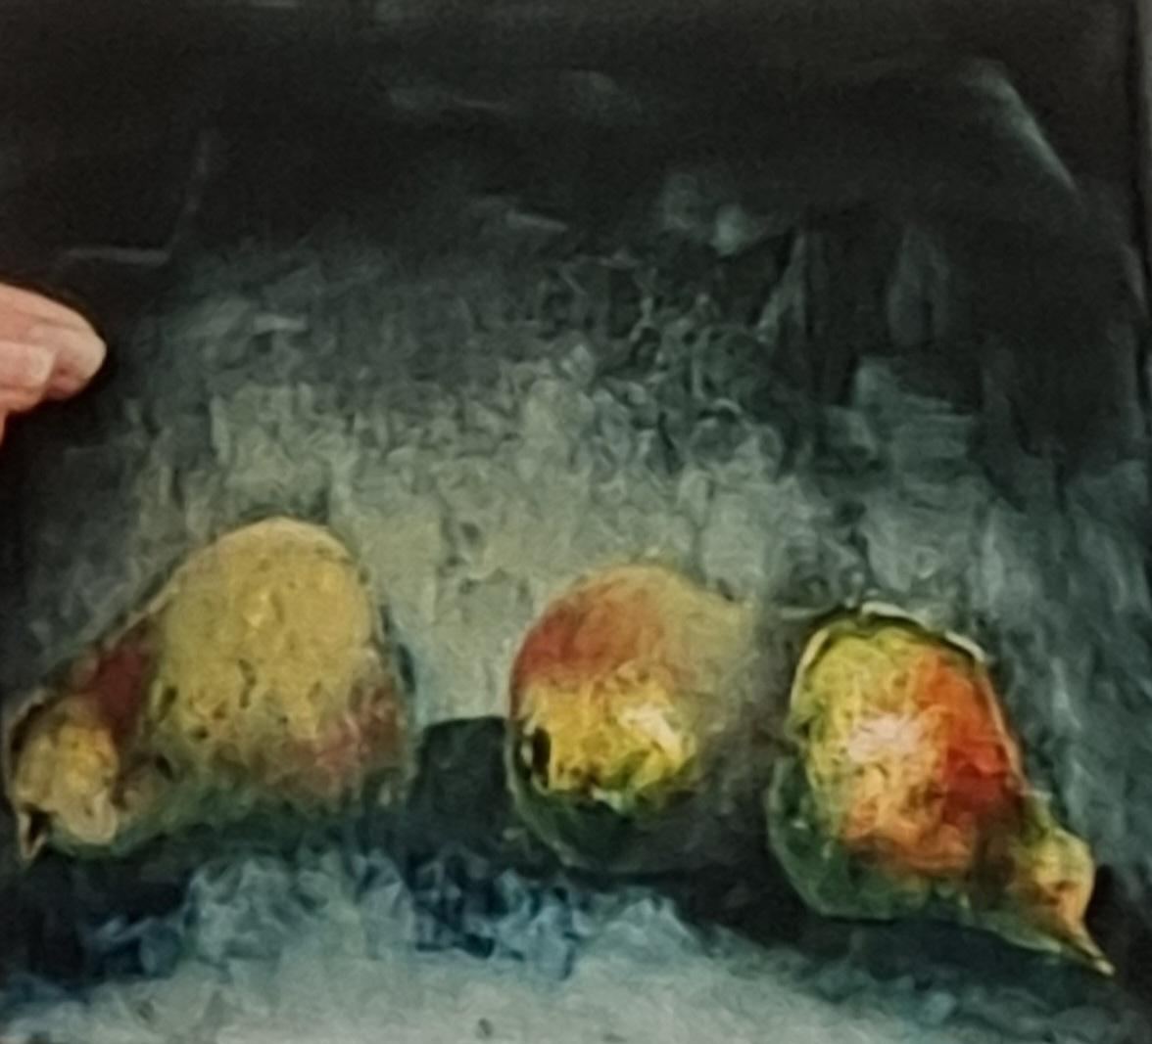
Vicki West, SWS

Slide 16
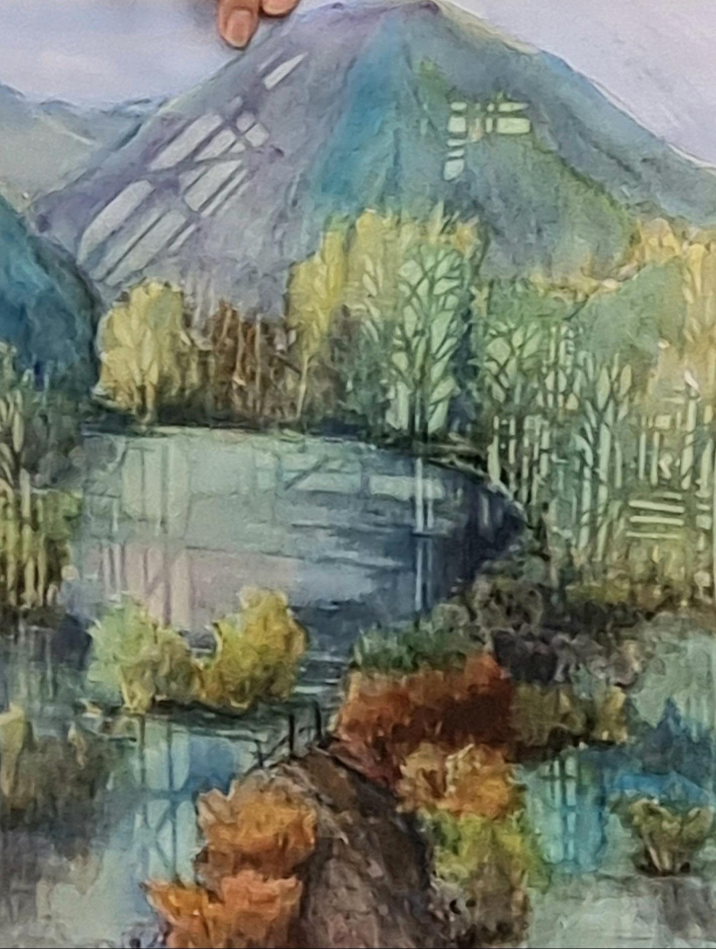
Bonnie Williams

Slide 17
Challenge Paintings
for June2023
Plein Air

