Slide 1
NEW MEMBERS
Introduced in January
1. Martha Rogers (Bainbridge Island, WA)
2. Chris Lehwalder (Chewelah, WA)
Introduced in February
1. Ron Kasprisin (Langley, WA)
2. Austin Nelson (Spokane, WA)
3. Mikel Reuter (Spokane, WA)
Introduced in March
1. Edward Baker (Post Falls, ID)
2. Sherry Grainger (Tulsa, OK)
3. Marianne Ophardt (Spokane, WA)
Currently we have 81 members with 26 Signature Members

Slide 2
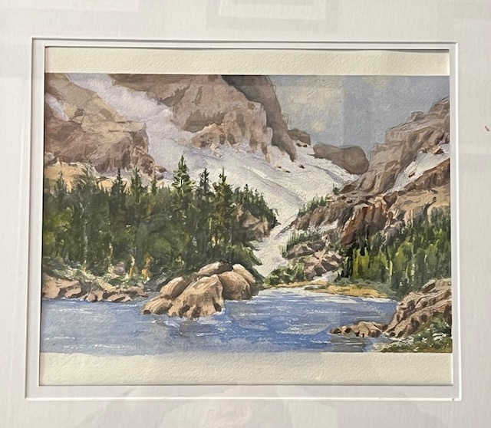
Edward Baker

Slide 3
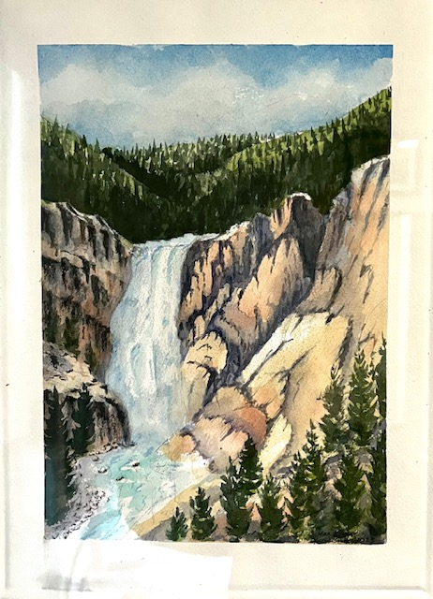
Edward Baker

Slide 4
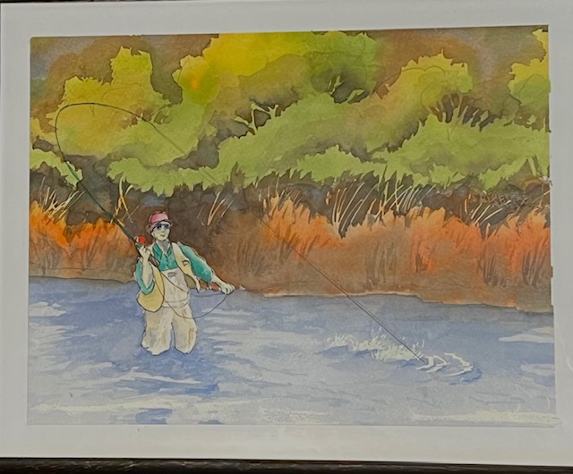
Edward Baker

Slide 5
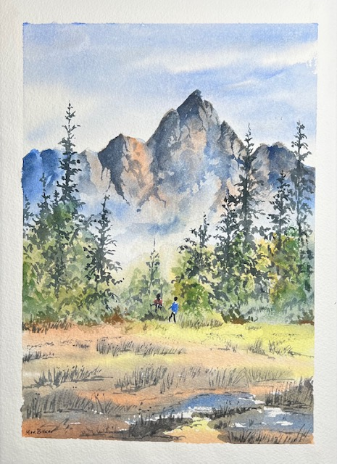
Edward Baker

Slide 6
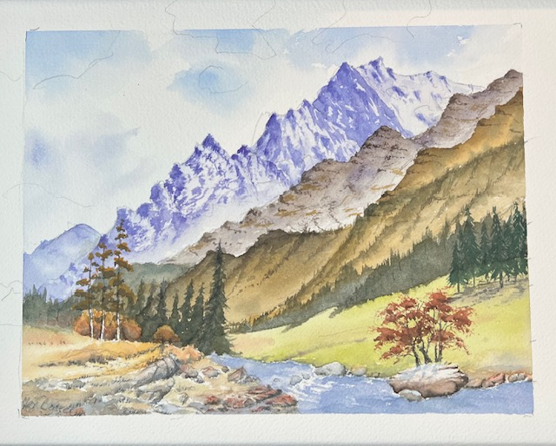
Edward Baker

Slide 7
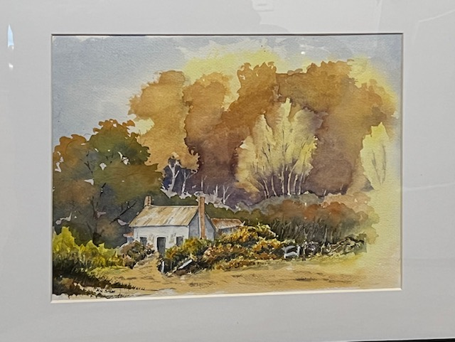
Edward Baker

Slide 8
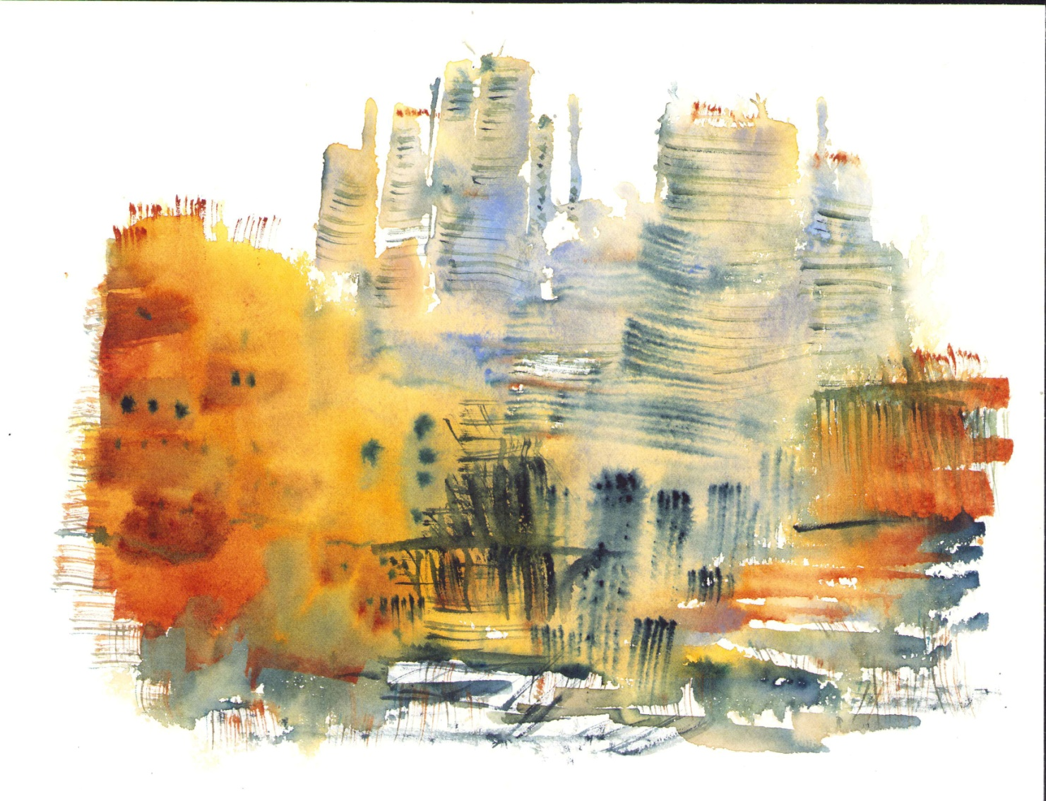
Sherry Grainger

Slide 10
LAST SLIDE

