Slide 1
Challenge Paintings
for March 2023
A Person or Animal Portrait

Slide 2
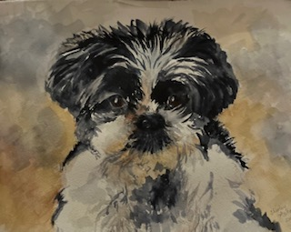
Shirley Antak, SWS

Slide 3
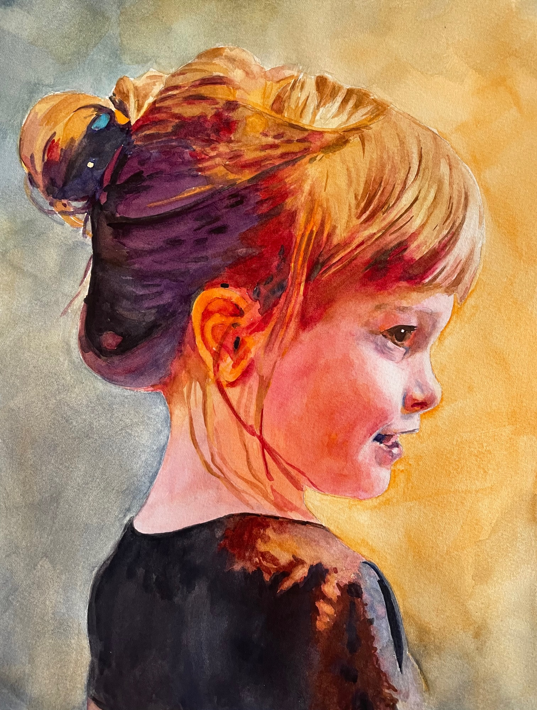
Kelly Burk, SWS

Slide 4
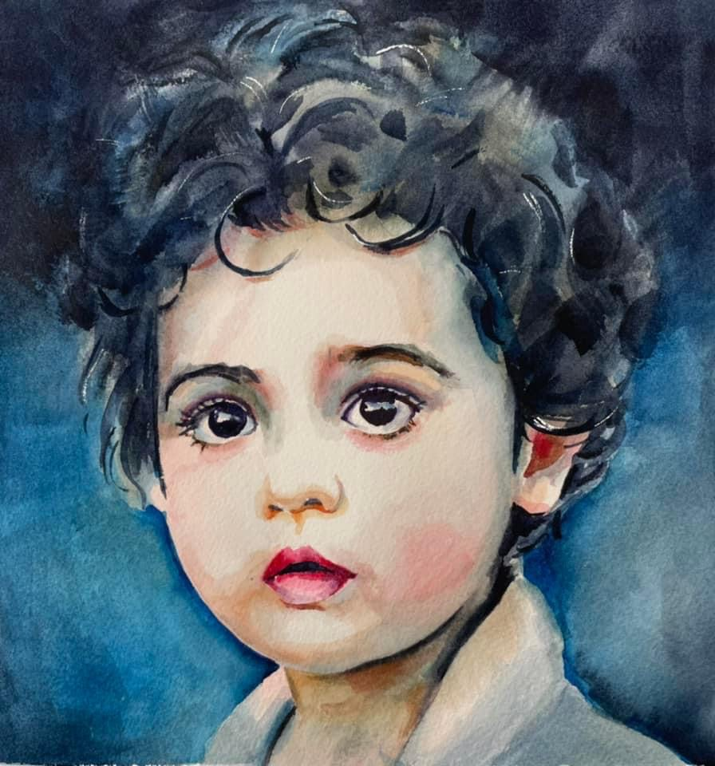
Kelly Burk, SWS

Slide 5
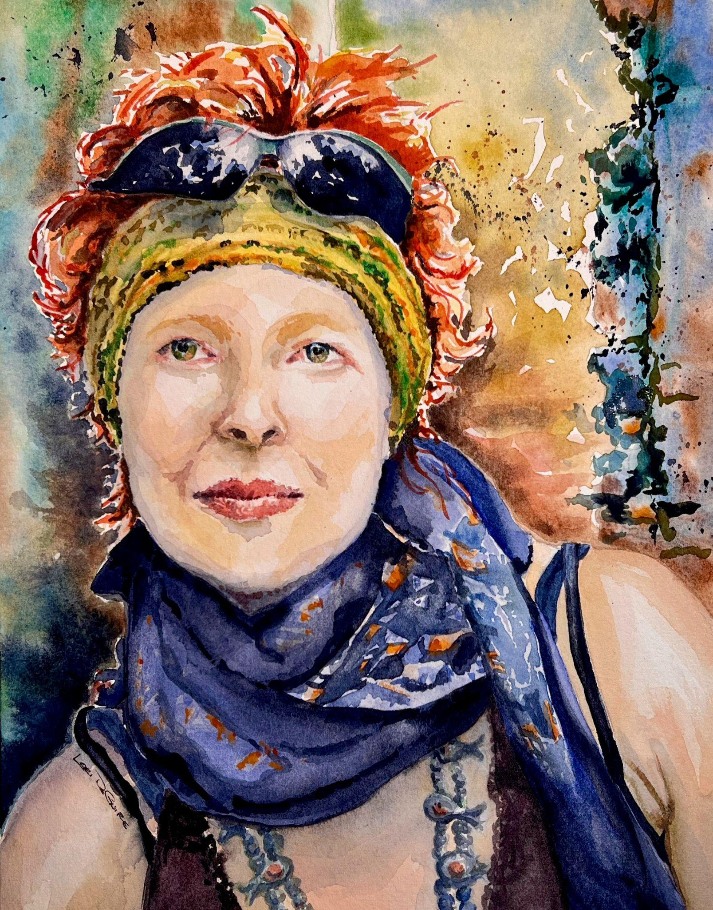
Lori DeGuire

Slide 6
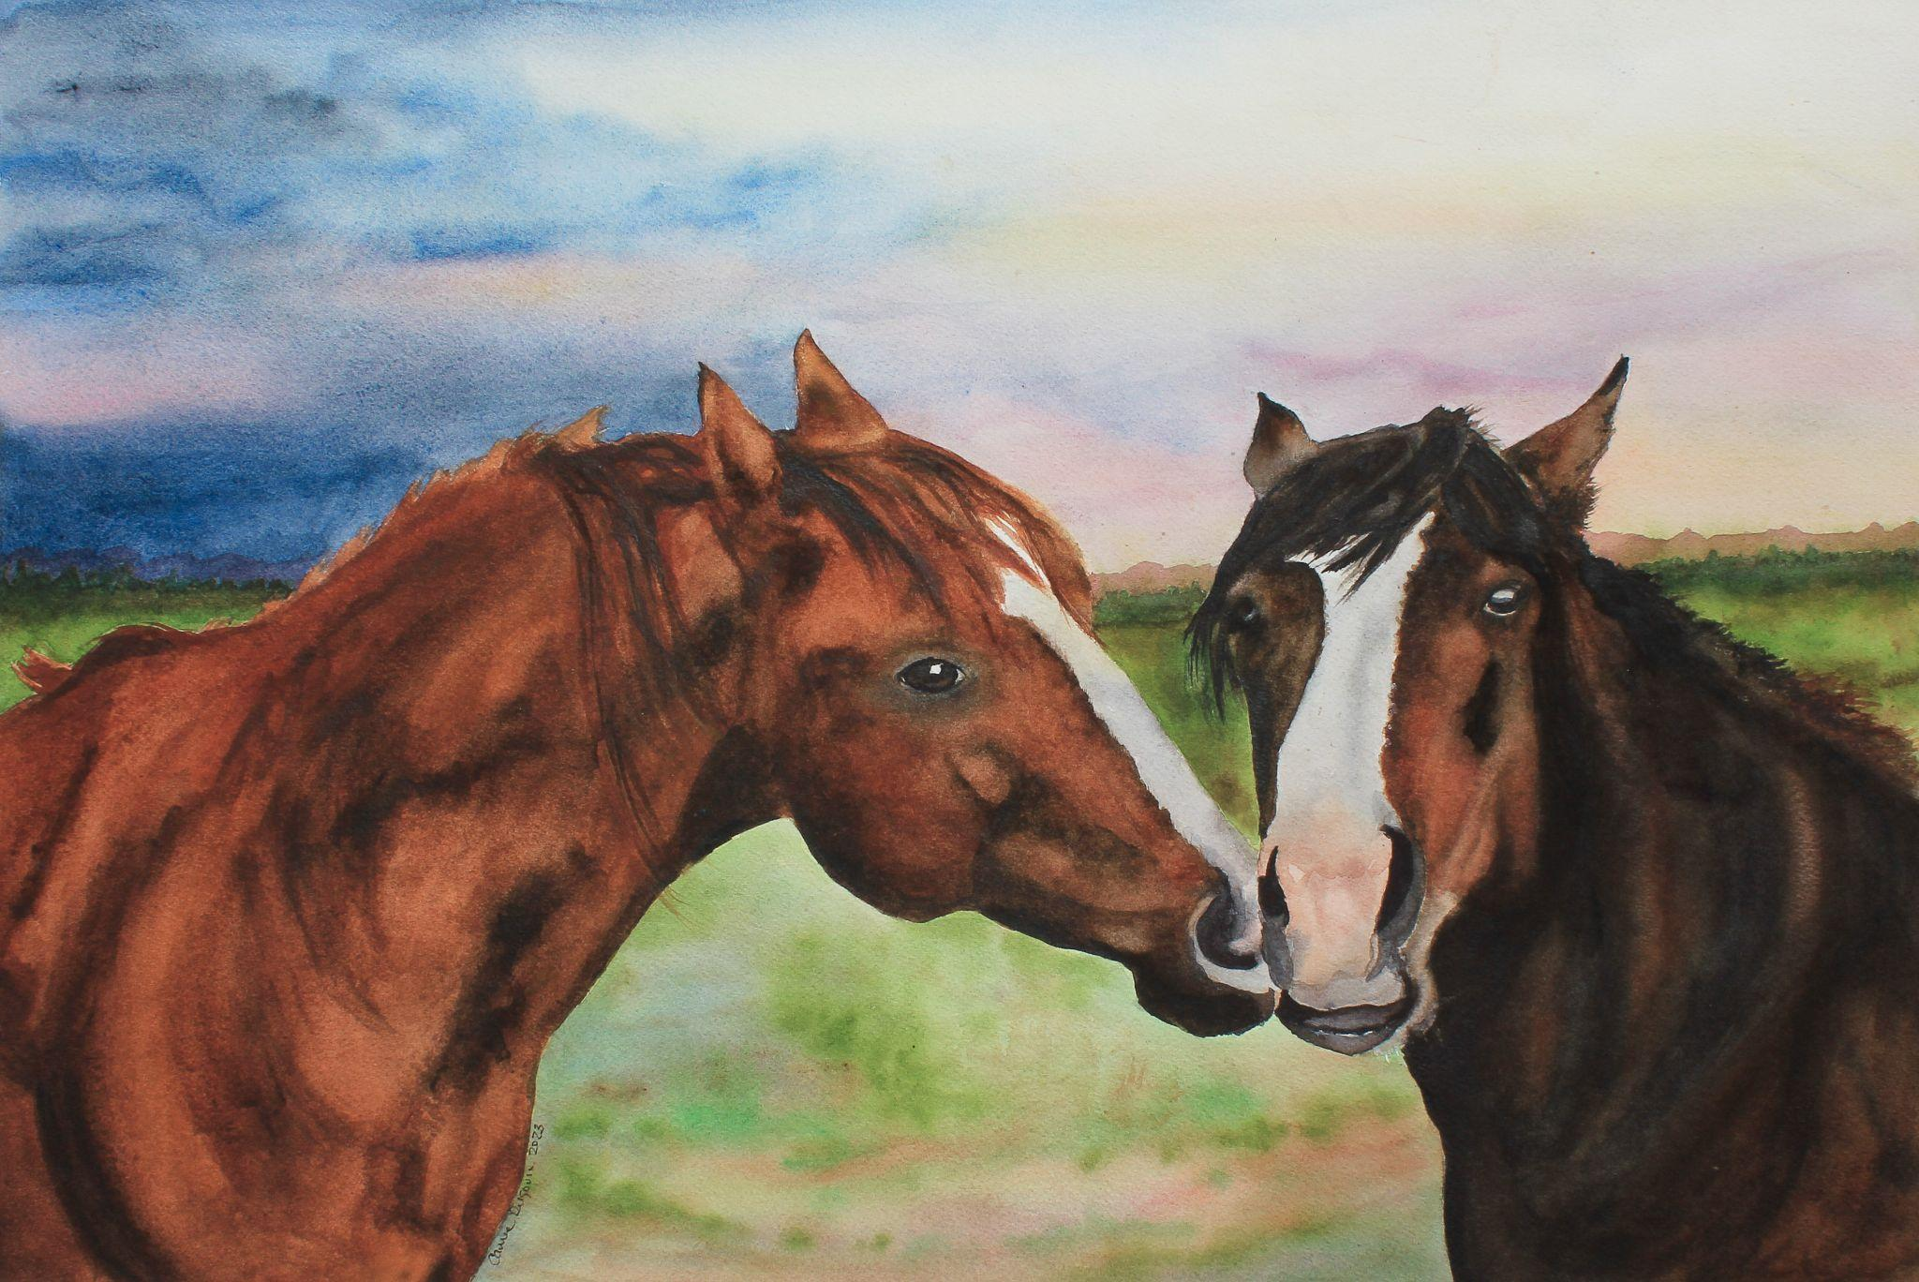
Carrie Dugovic

Slide 7
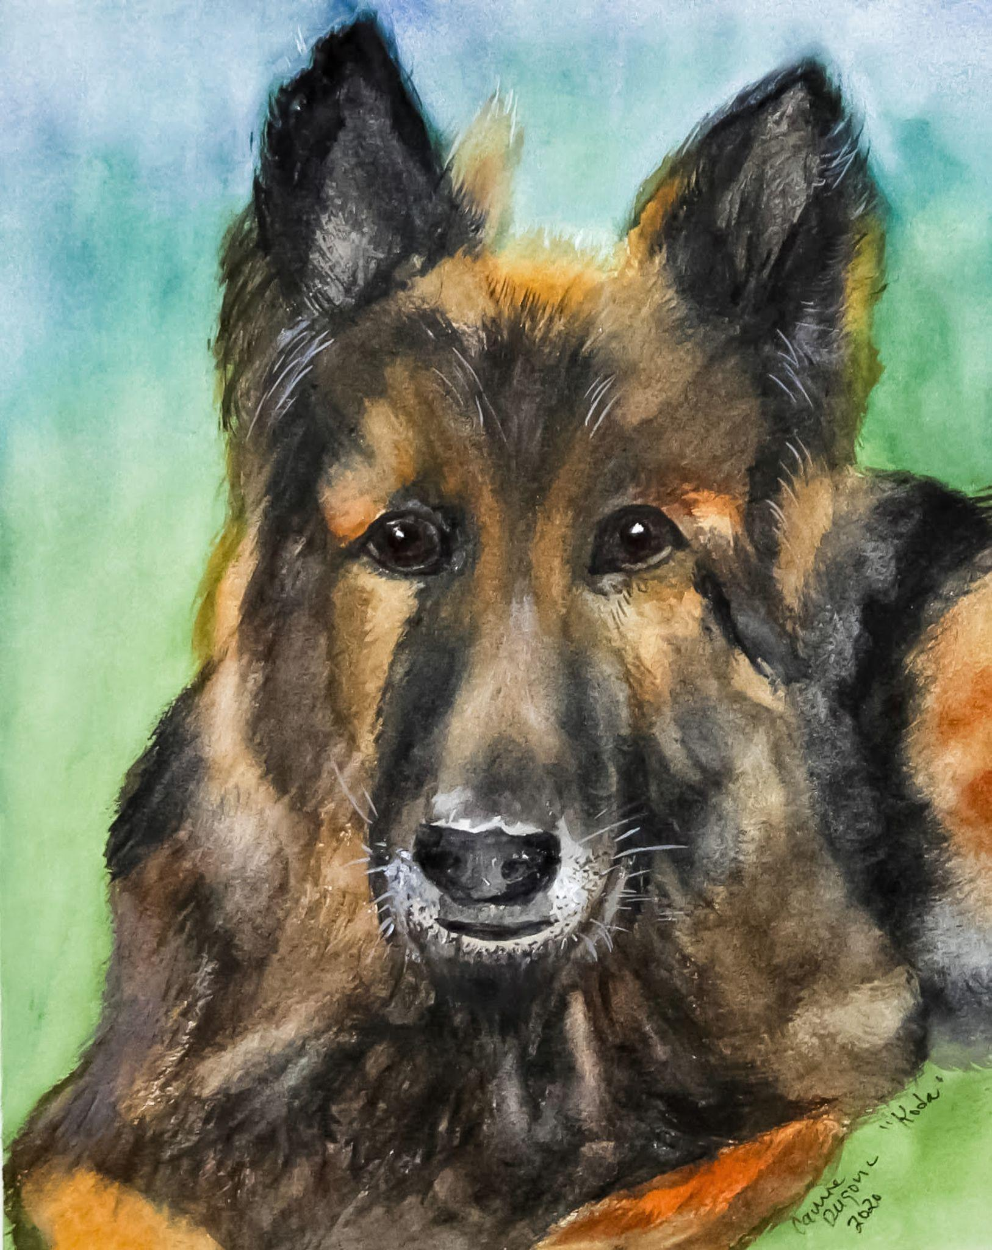
Carrie Dugovic

Slide 8
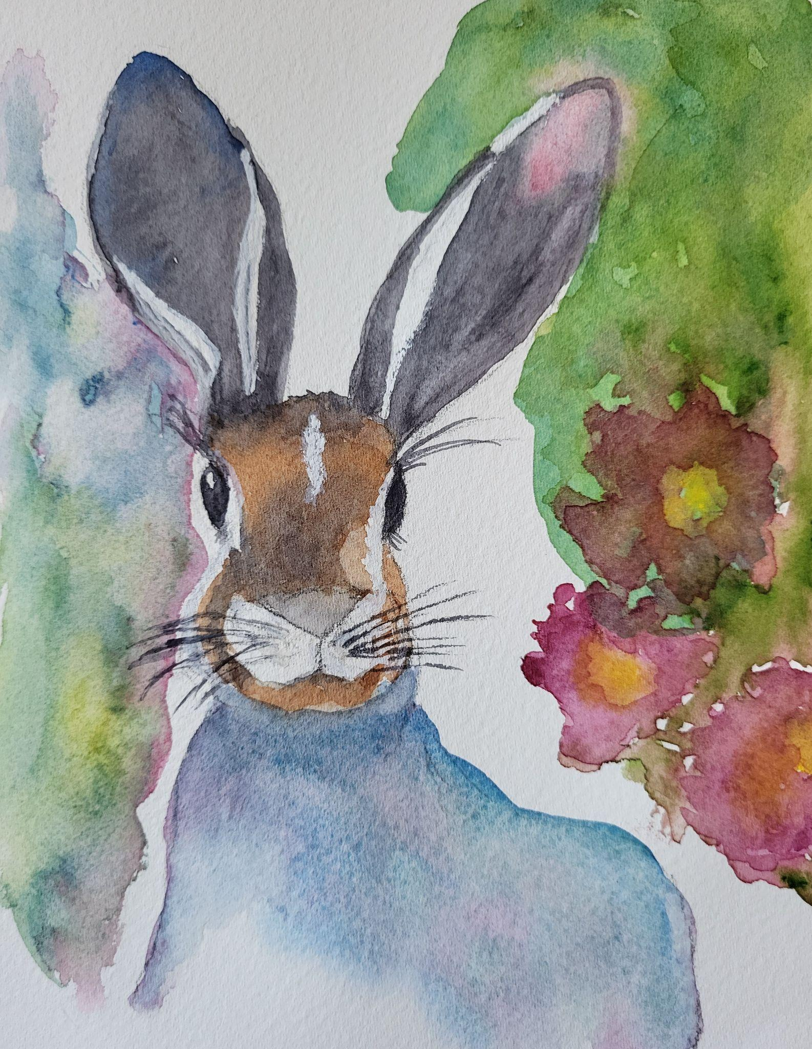
Kathy Eckerich

Slide 9
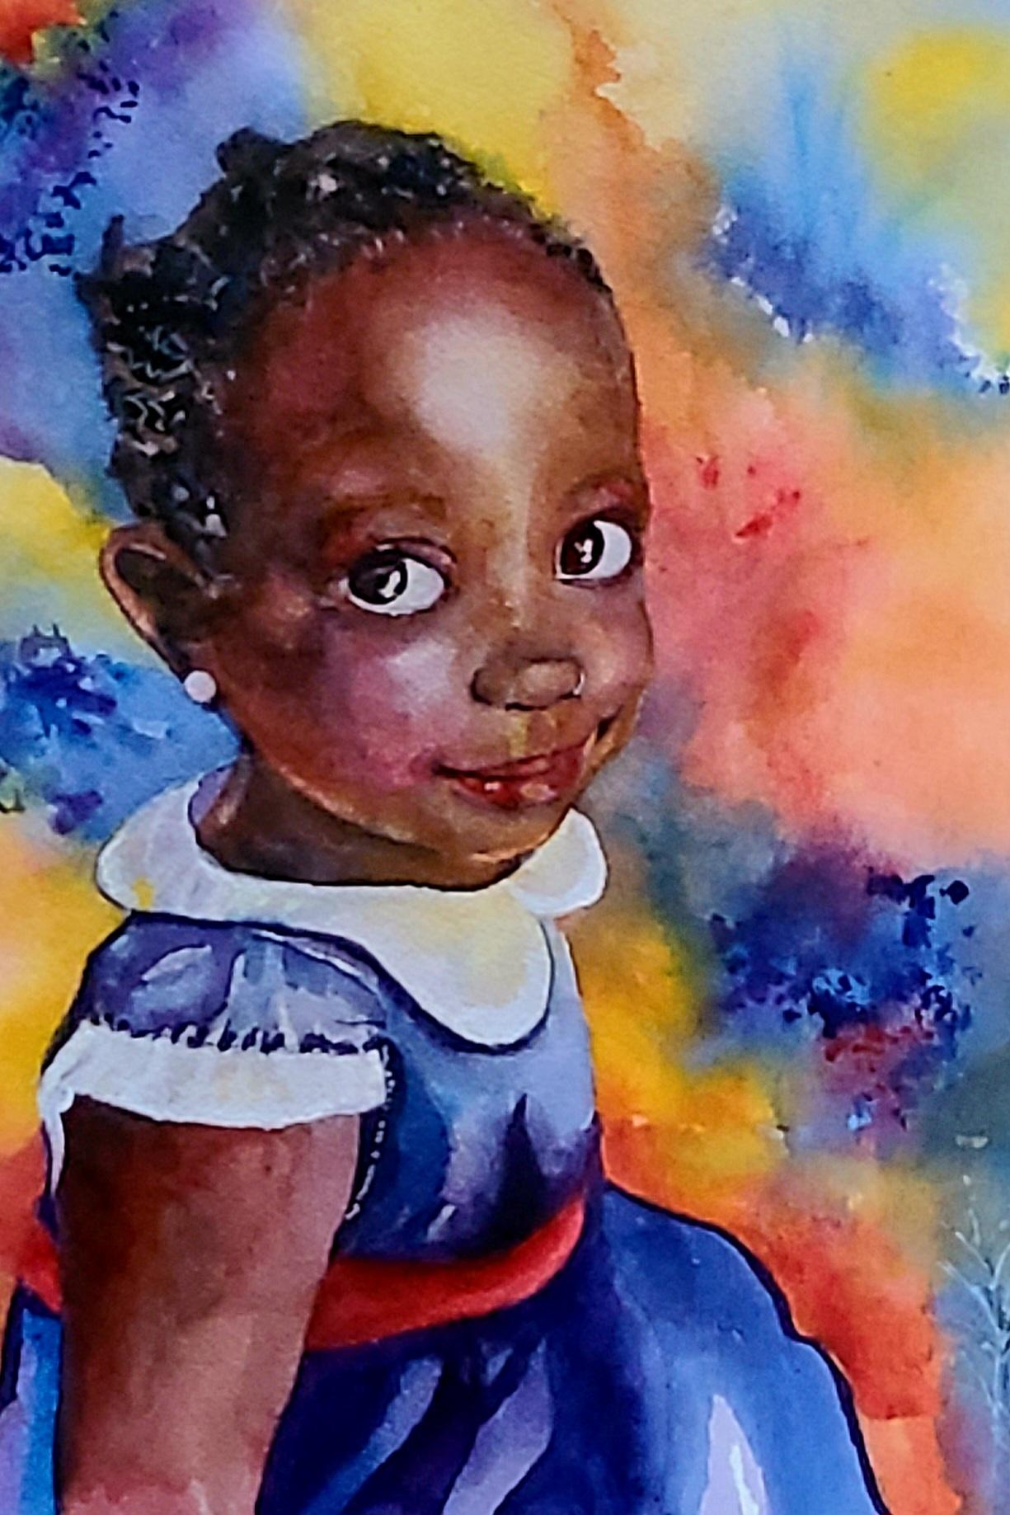
Janie Edwards

Slide 10
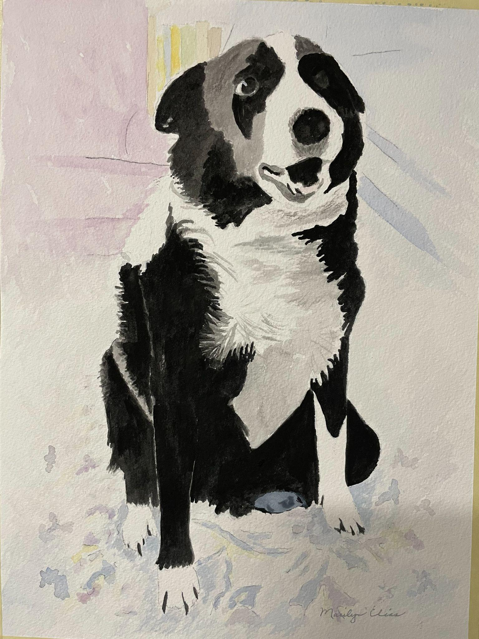
Marilyn Elias

Slide 11
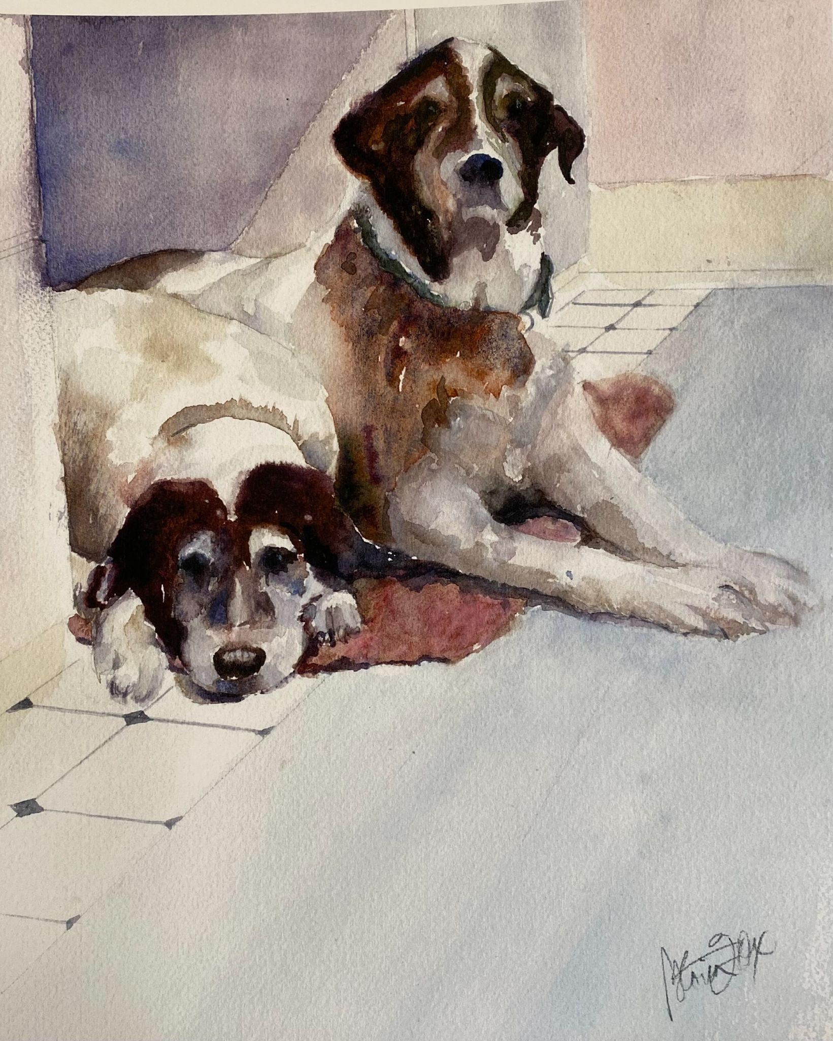
Gloria Fox, SWS

Slide 12
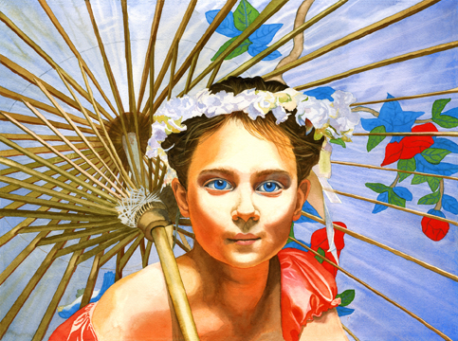
Jeannine Marx Fruci, SWS

Slide 13
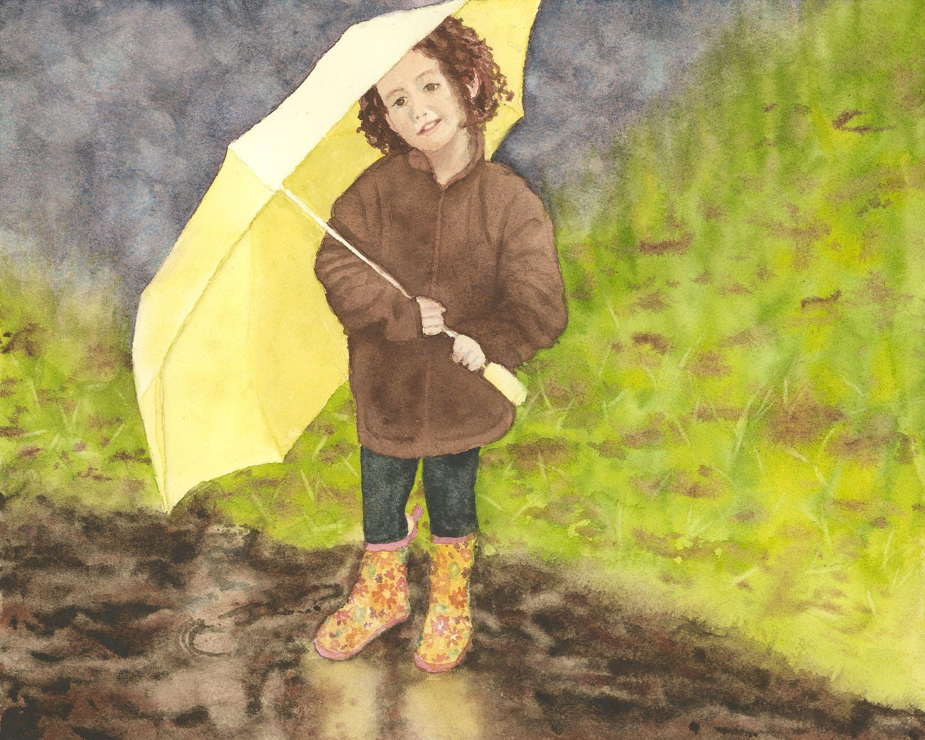
Jeannine Marx Fruci, SWS

Slide 14
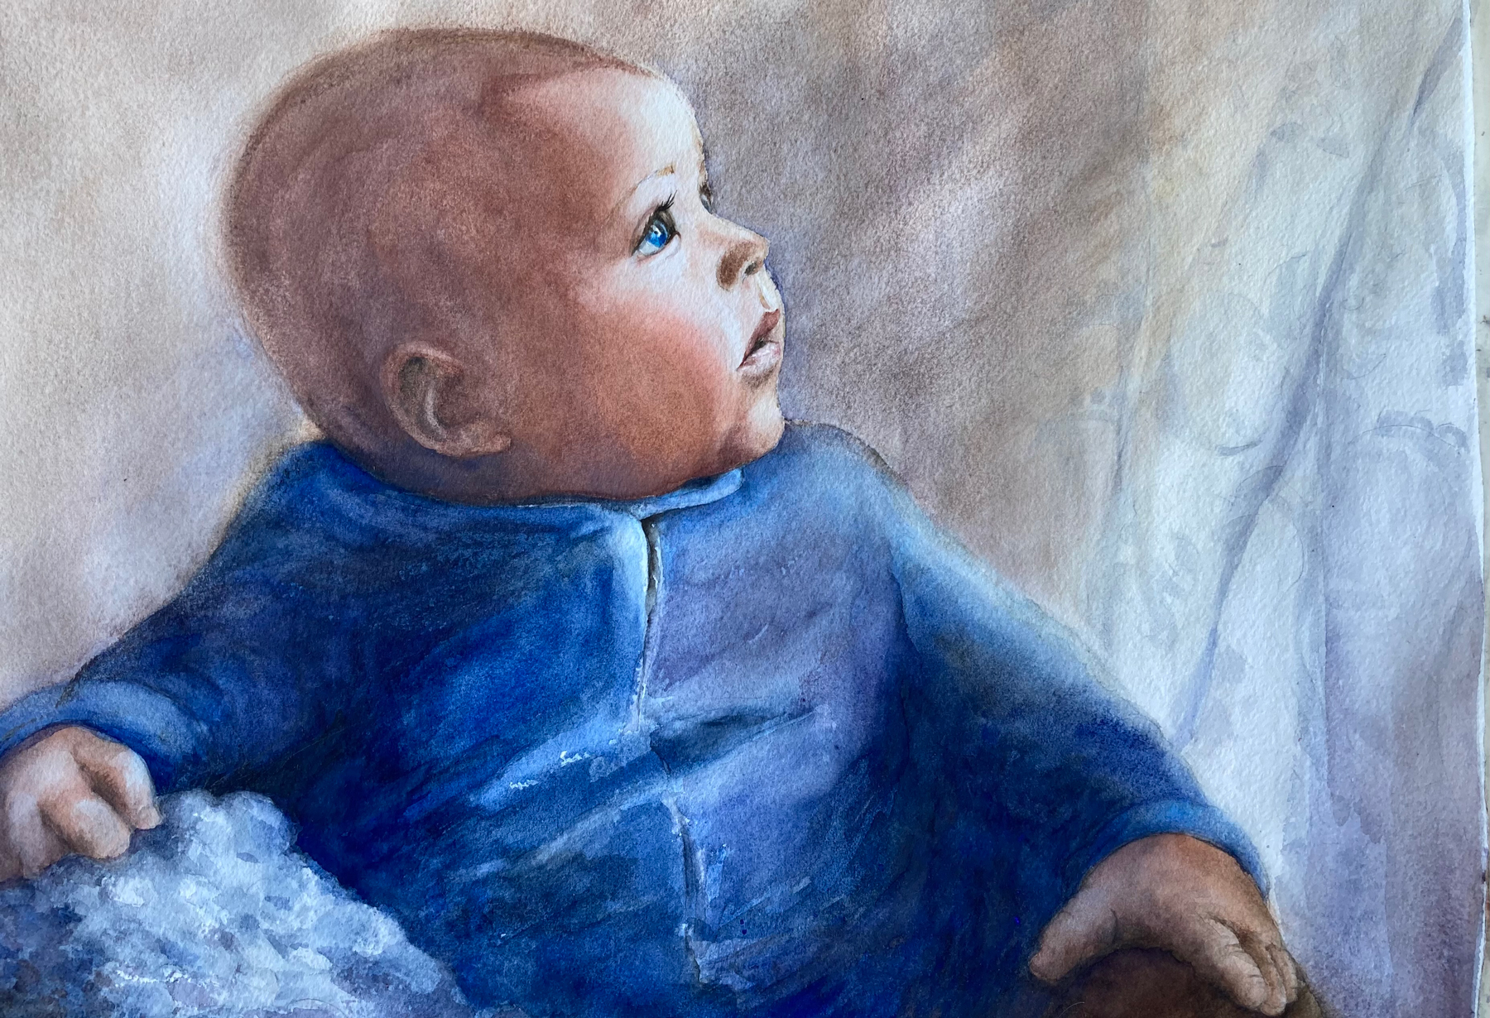
Kim Gardell
Kim Gardell

Slide 15
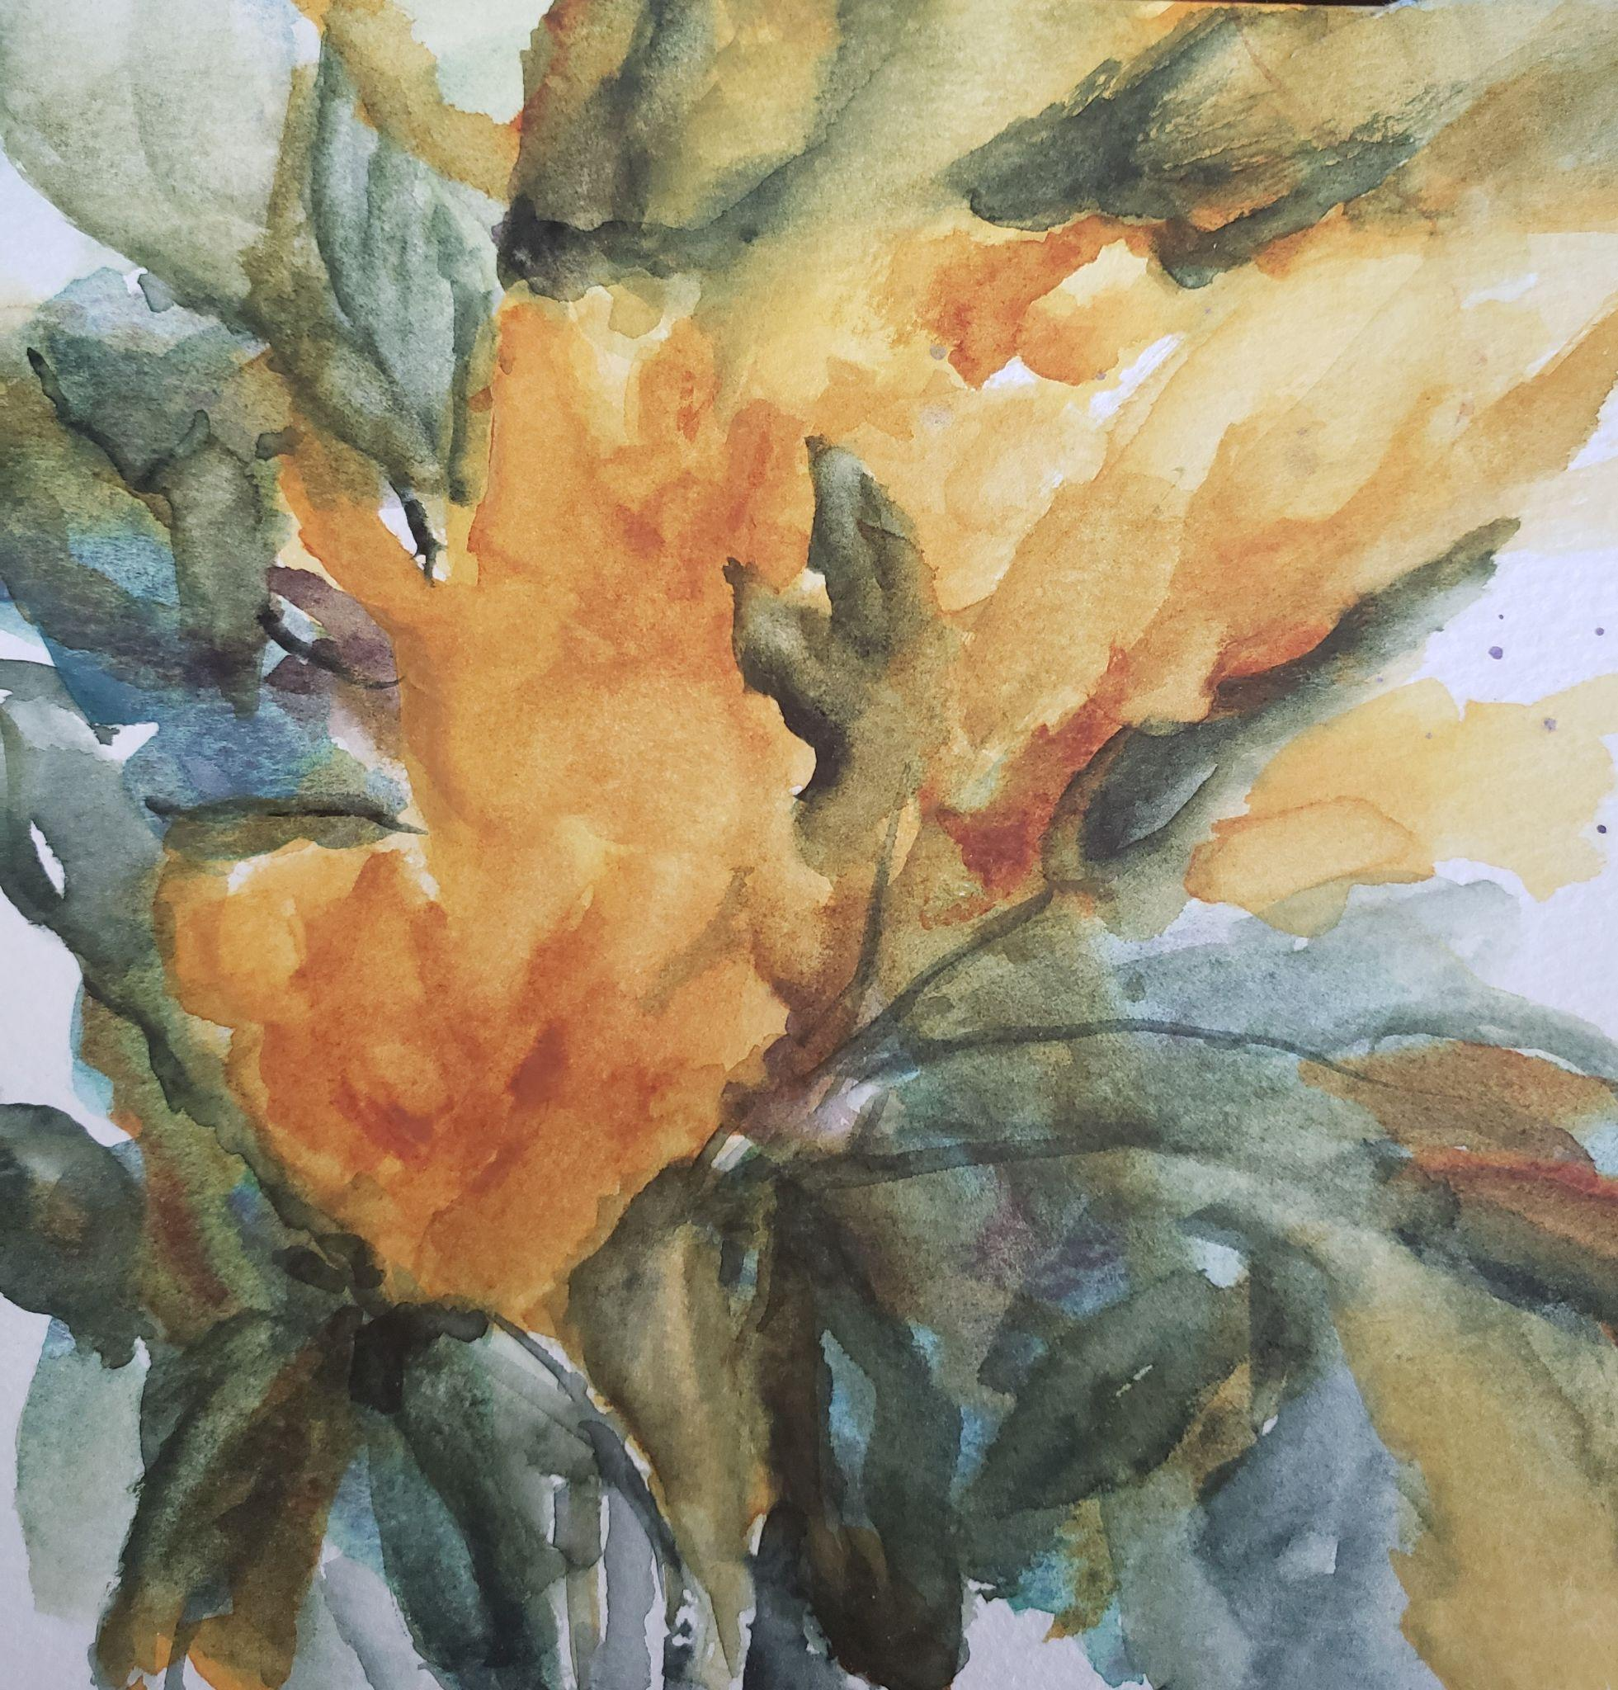
Gina Jackson

Slide 16
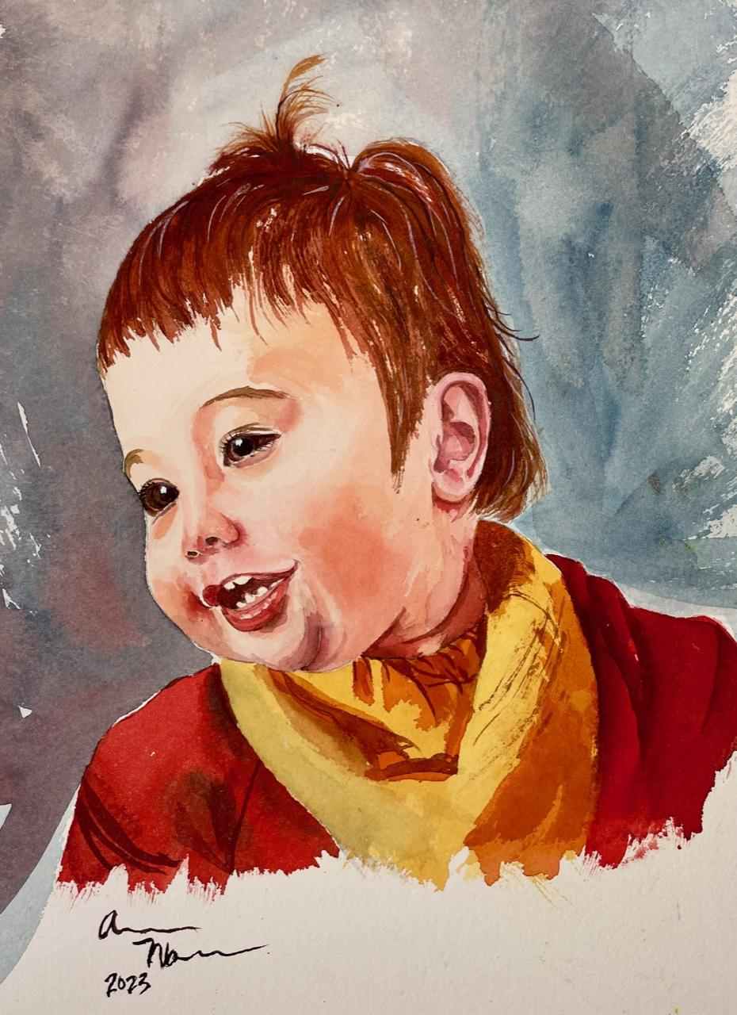
Aaron Mann

Slide 17
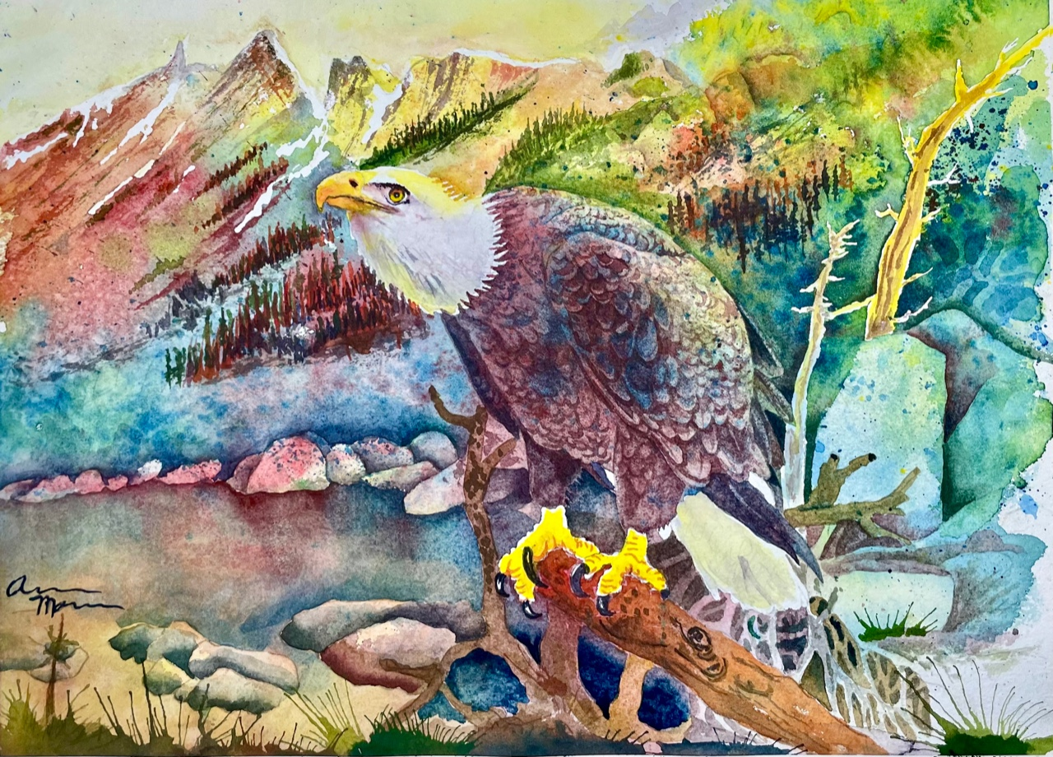
Aaron Mann

Slide 18
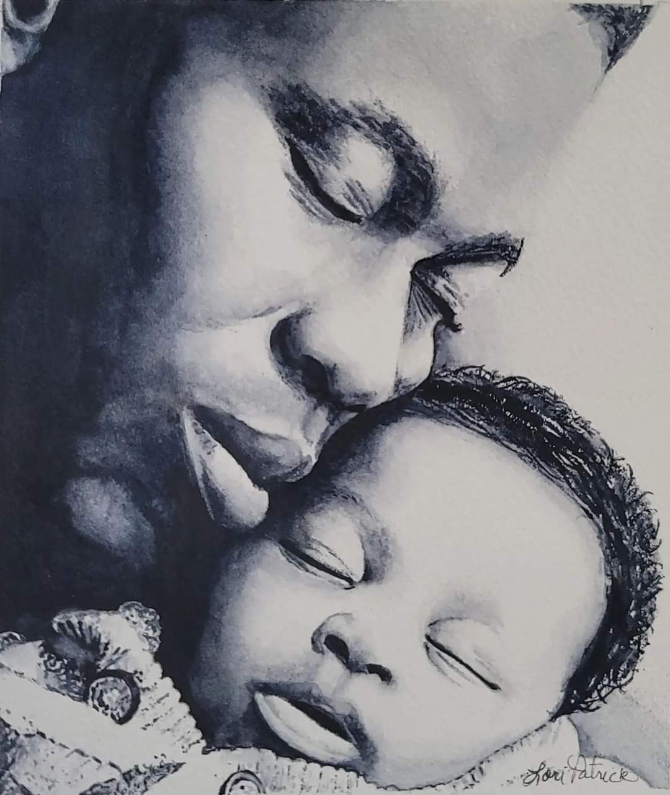
Lori Patrick

Slide 19
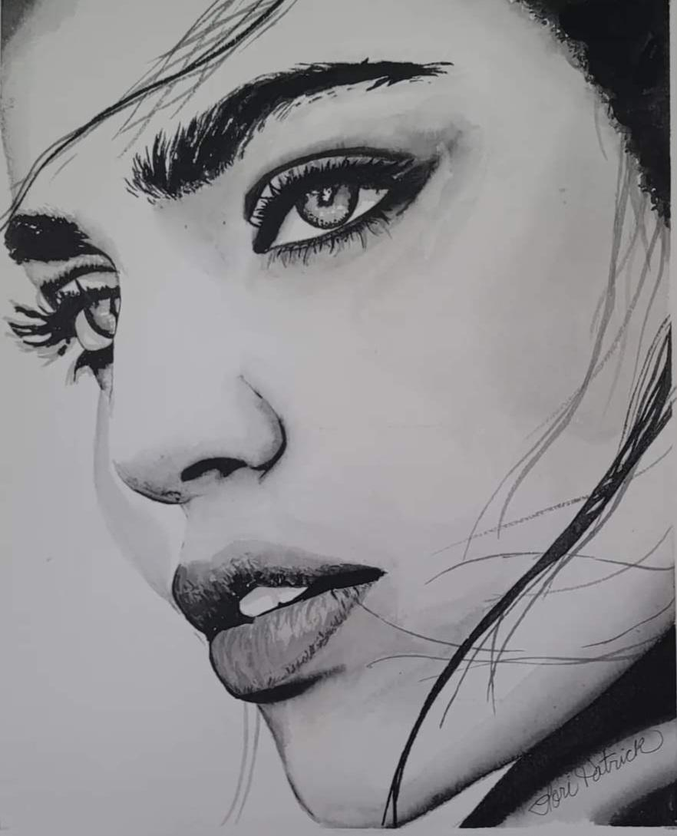
Lori Patrick

Slide 20
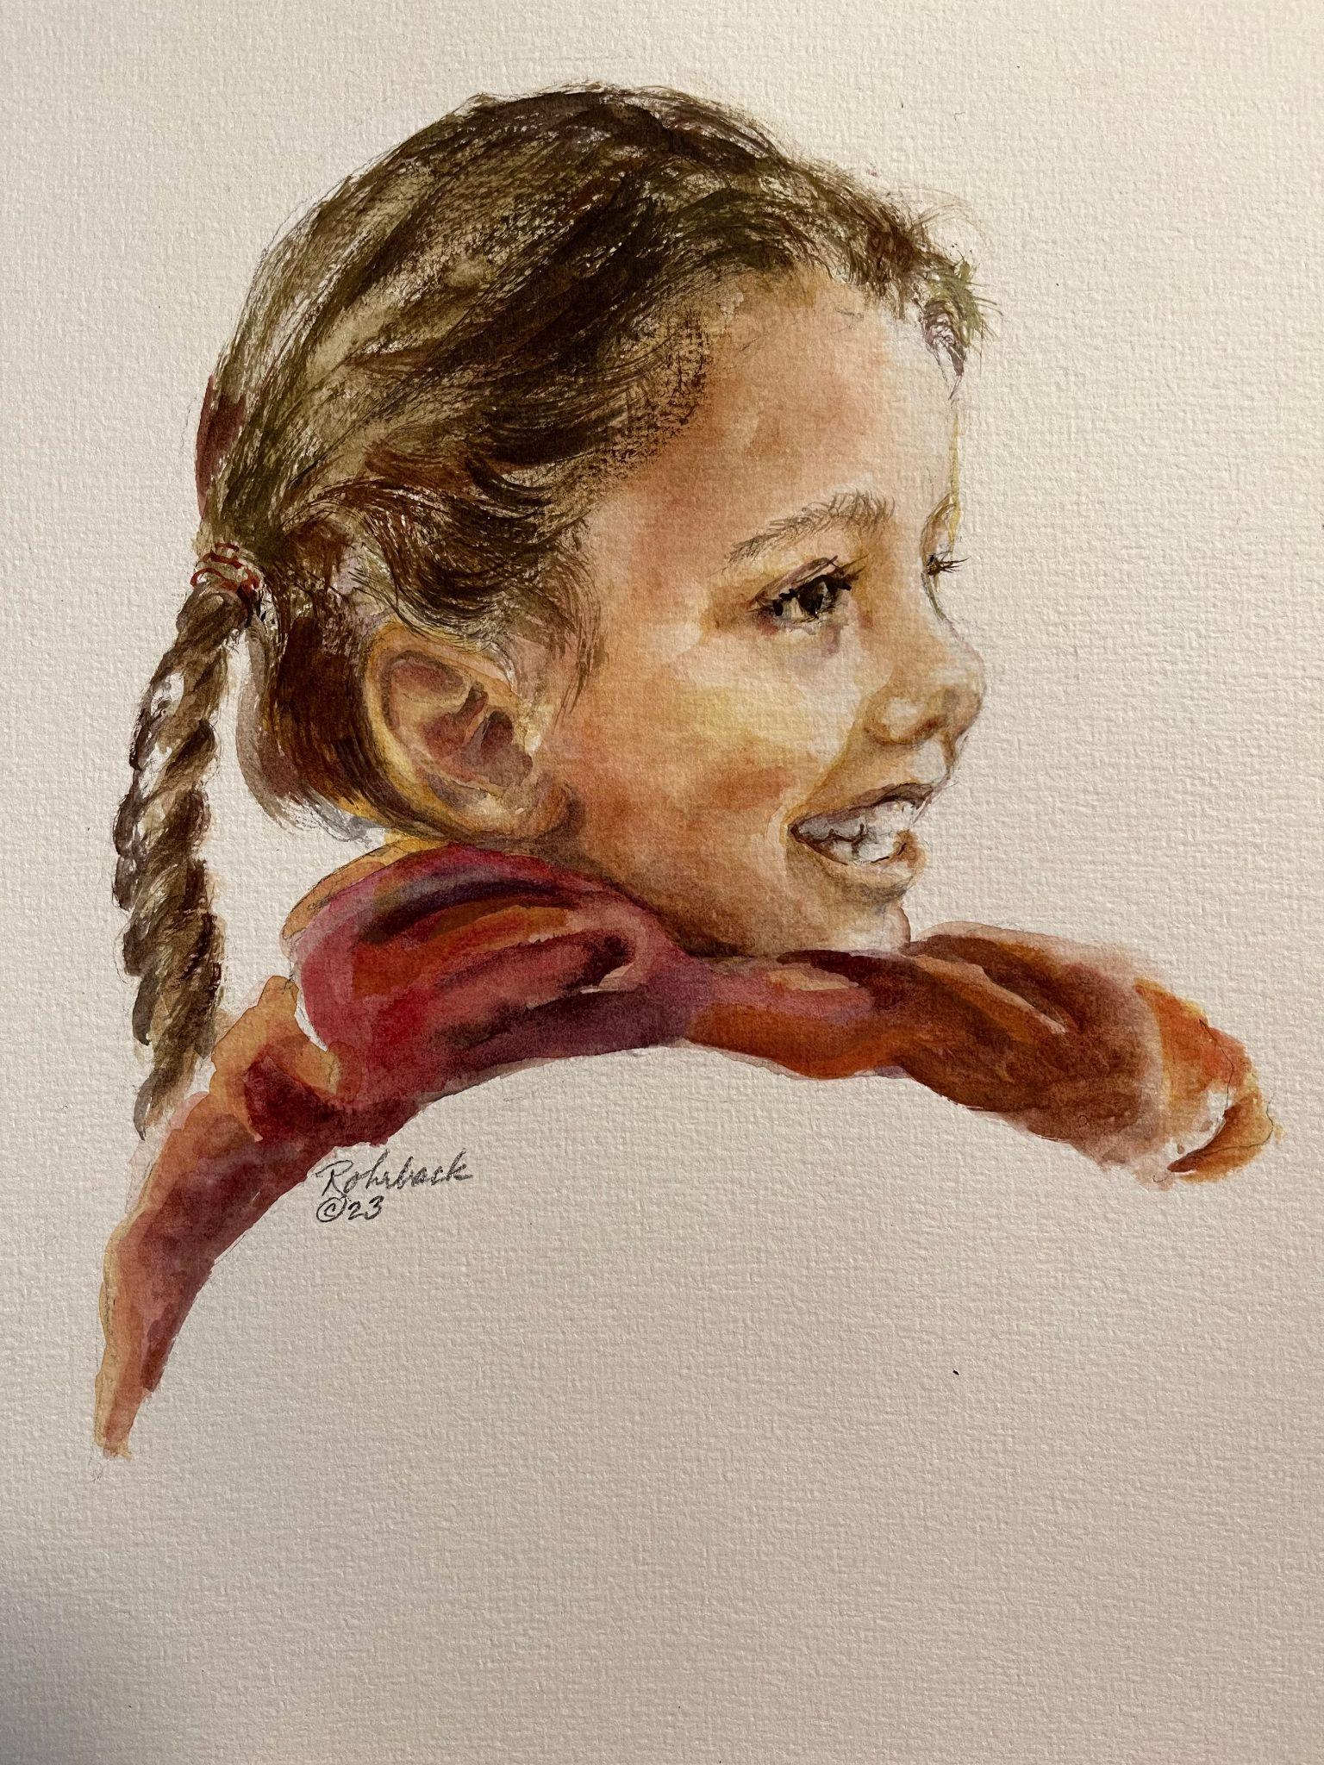
Susan Rohrback

Slide 21
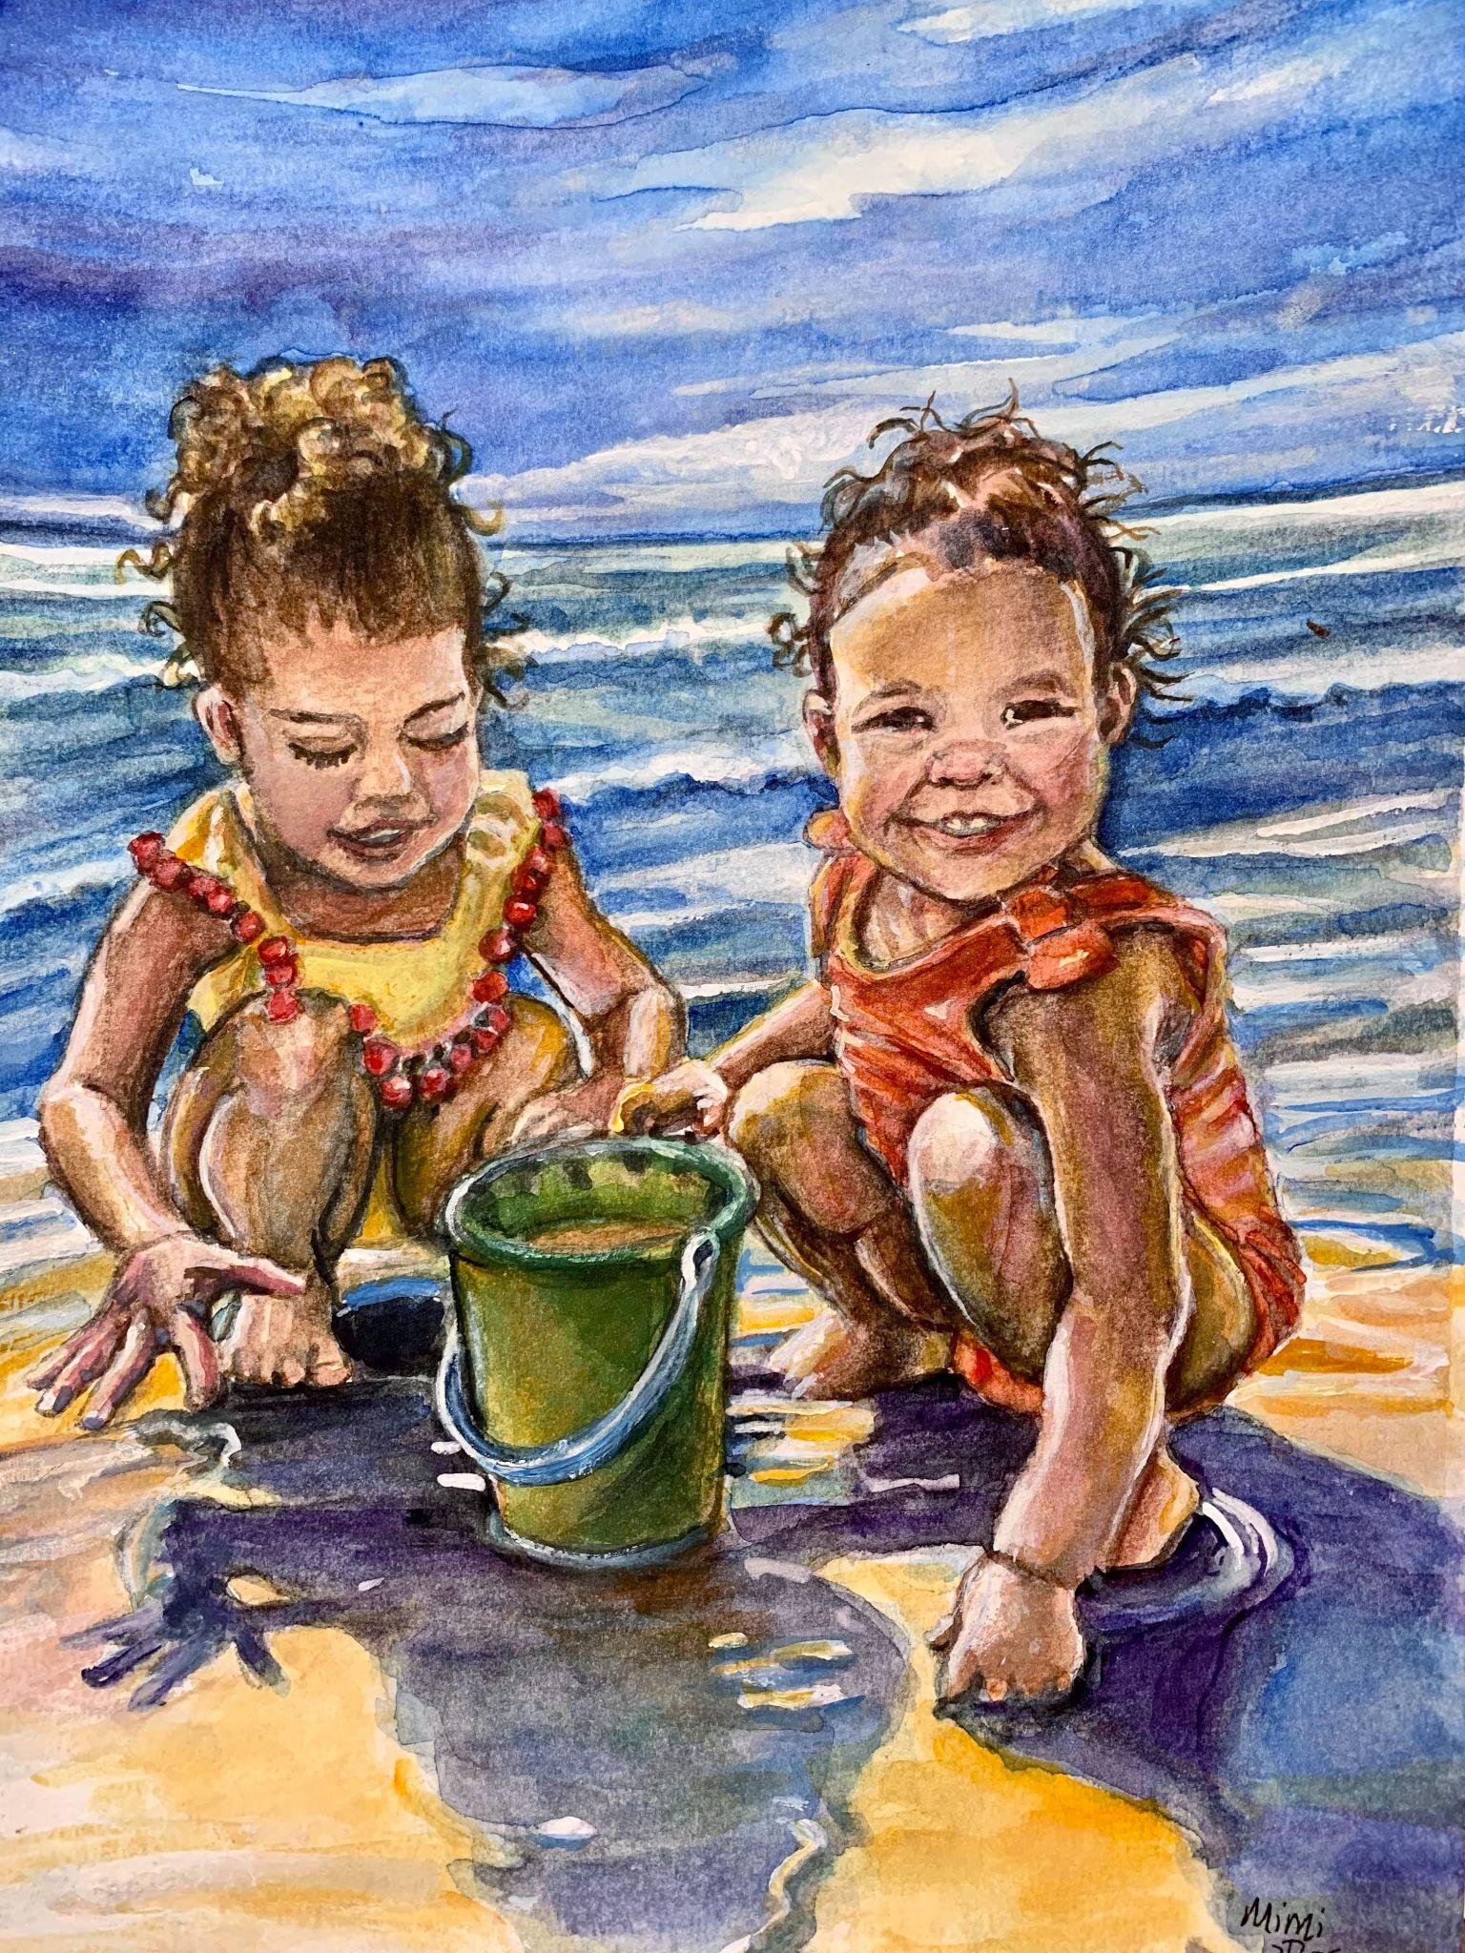
Mimi Ross

Slide 22
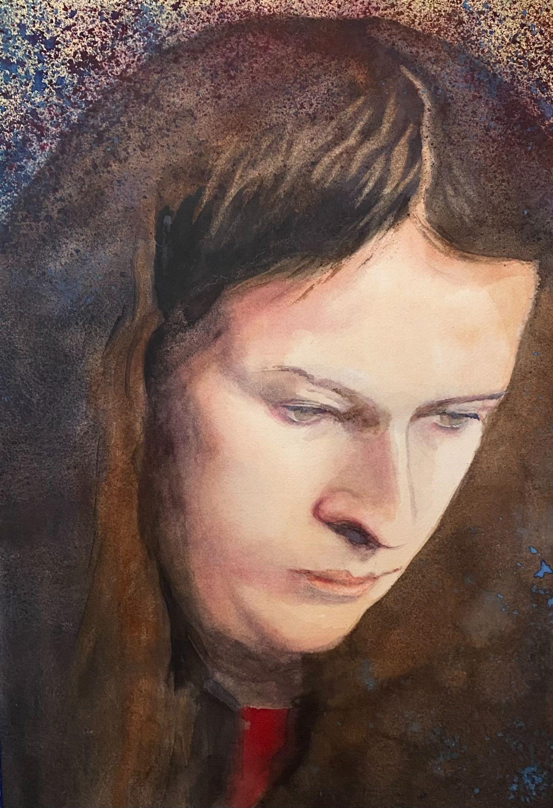
Gregory Saue, SWS

Slide 23
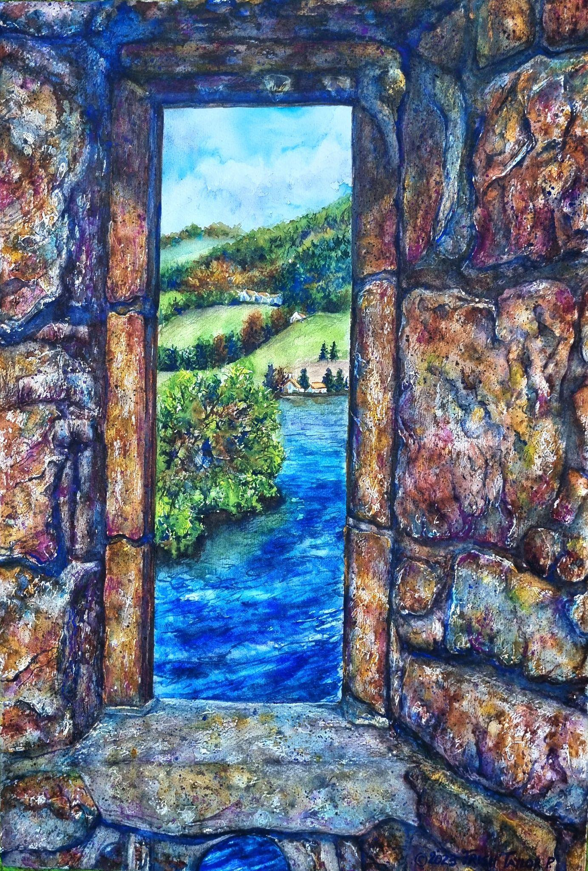
Patricia Taylor

Slide 24
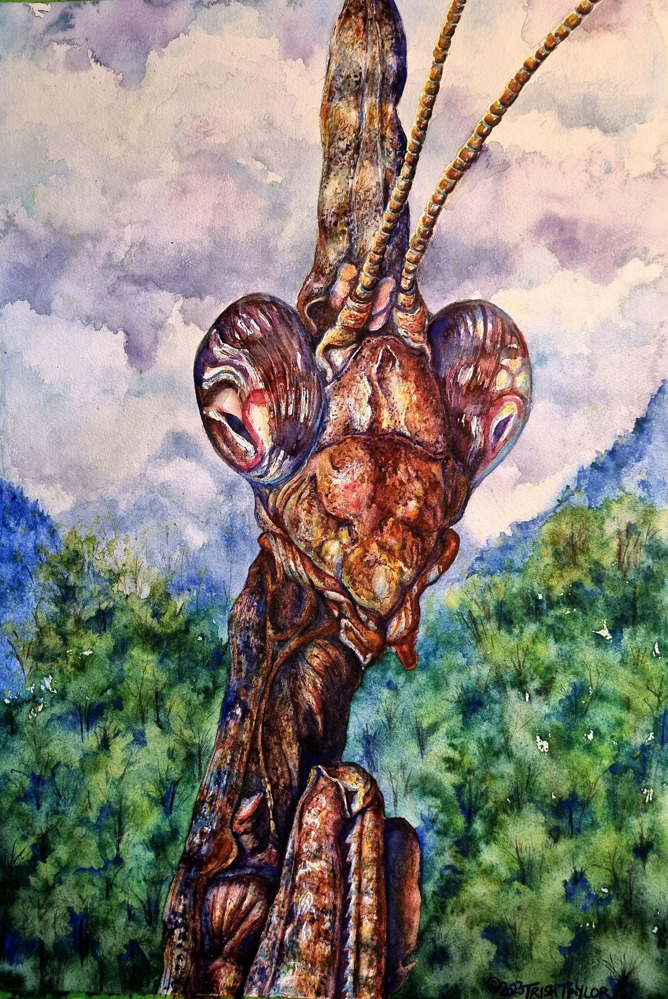
Patricia Taylor

Slide 25
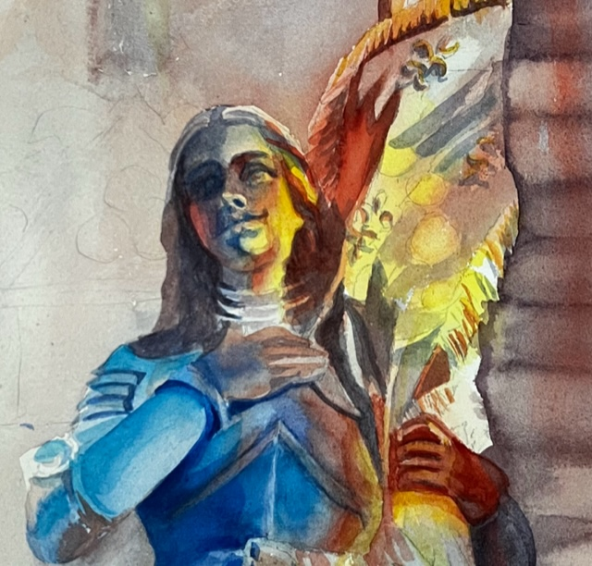
Sherri Thies, SWS

Slide 26
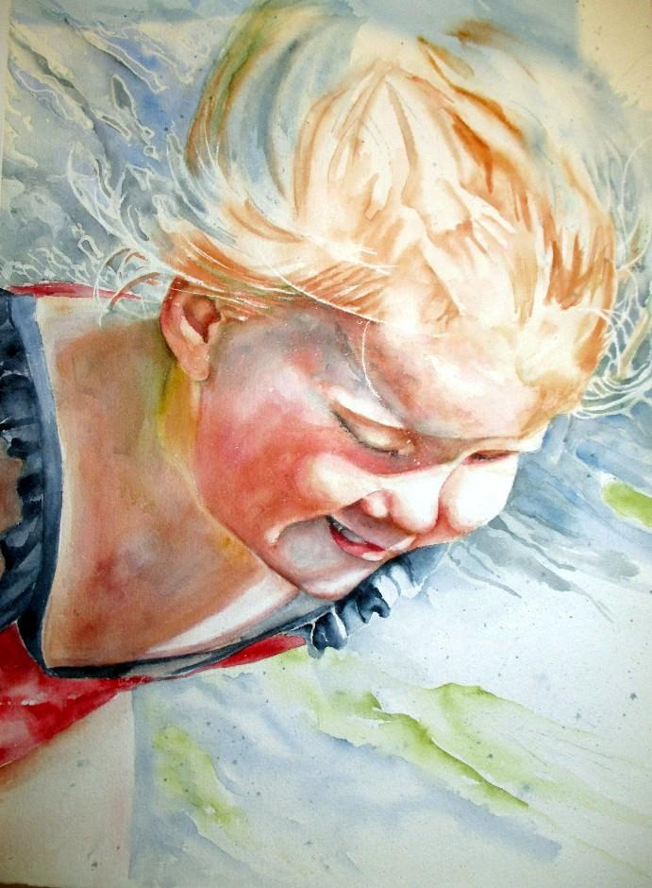
Vicki West, SWS

Slide 27
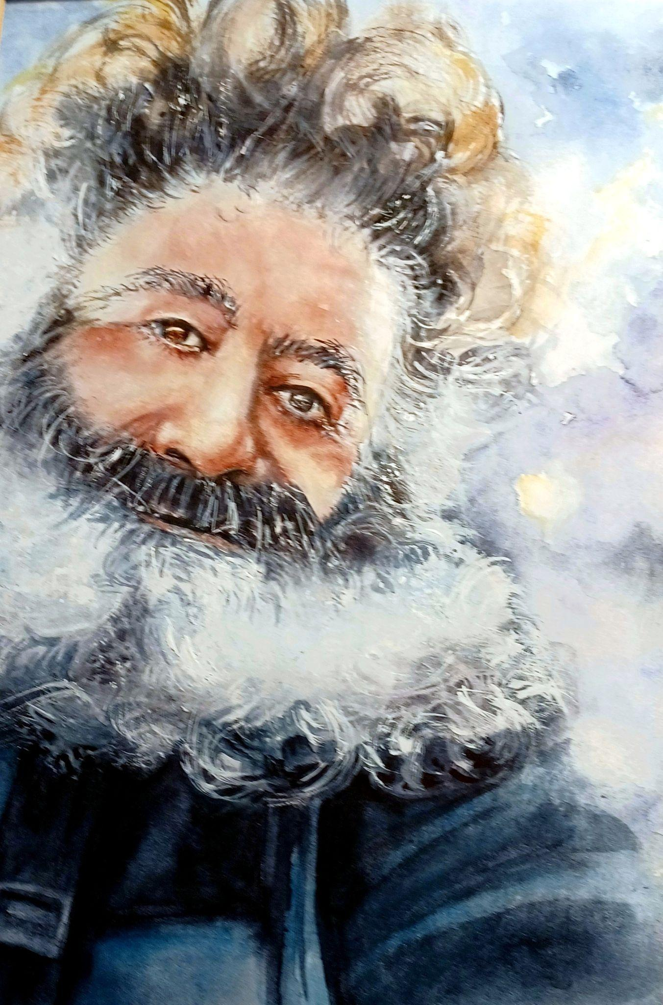
Vicki West, SWS

Slide 28
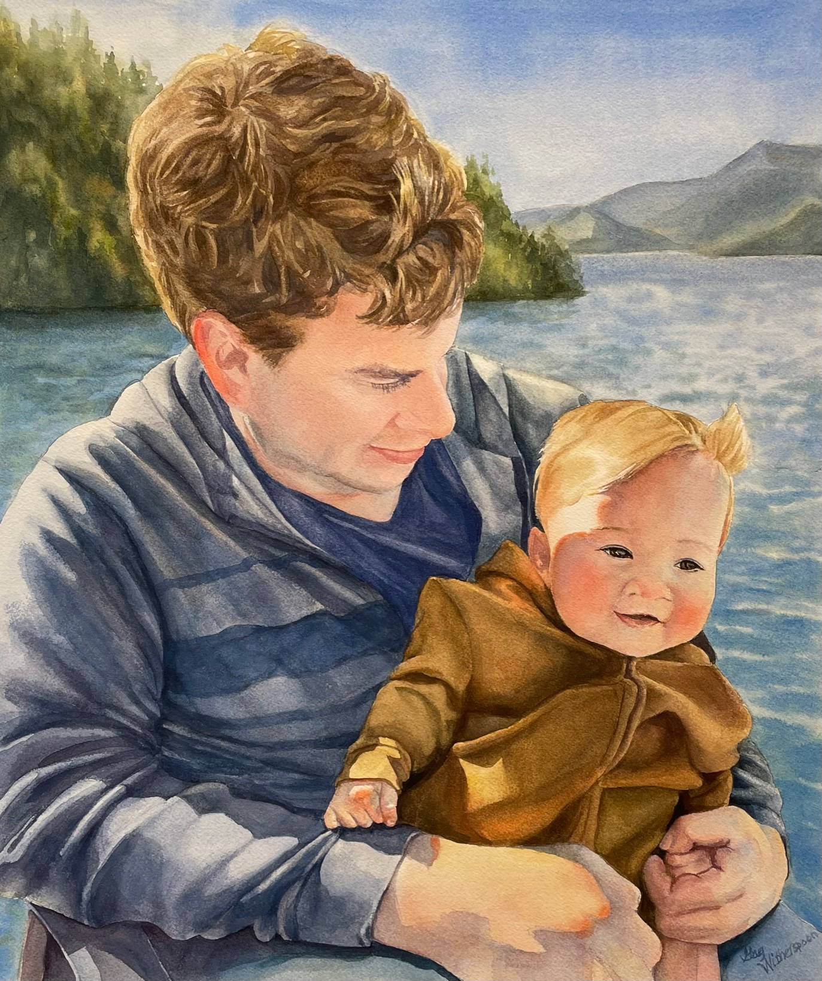
Gay Witherspoon, SWS

Slide 29
Challenge Paintings
for April 2023
No Challenge,
Review of Spring Show

