Slide 1
Challenge Paintings
for February 2023
Spring Theme,
Consider a Floral

Slide 2
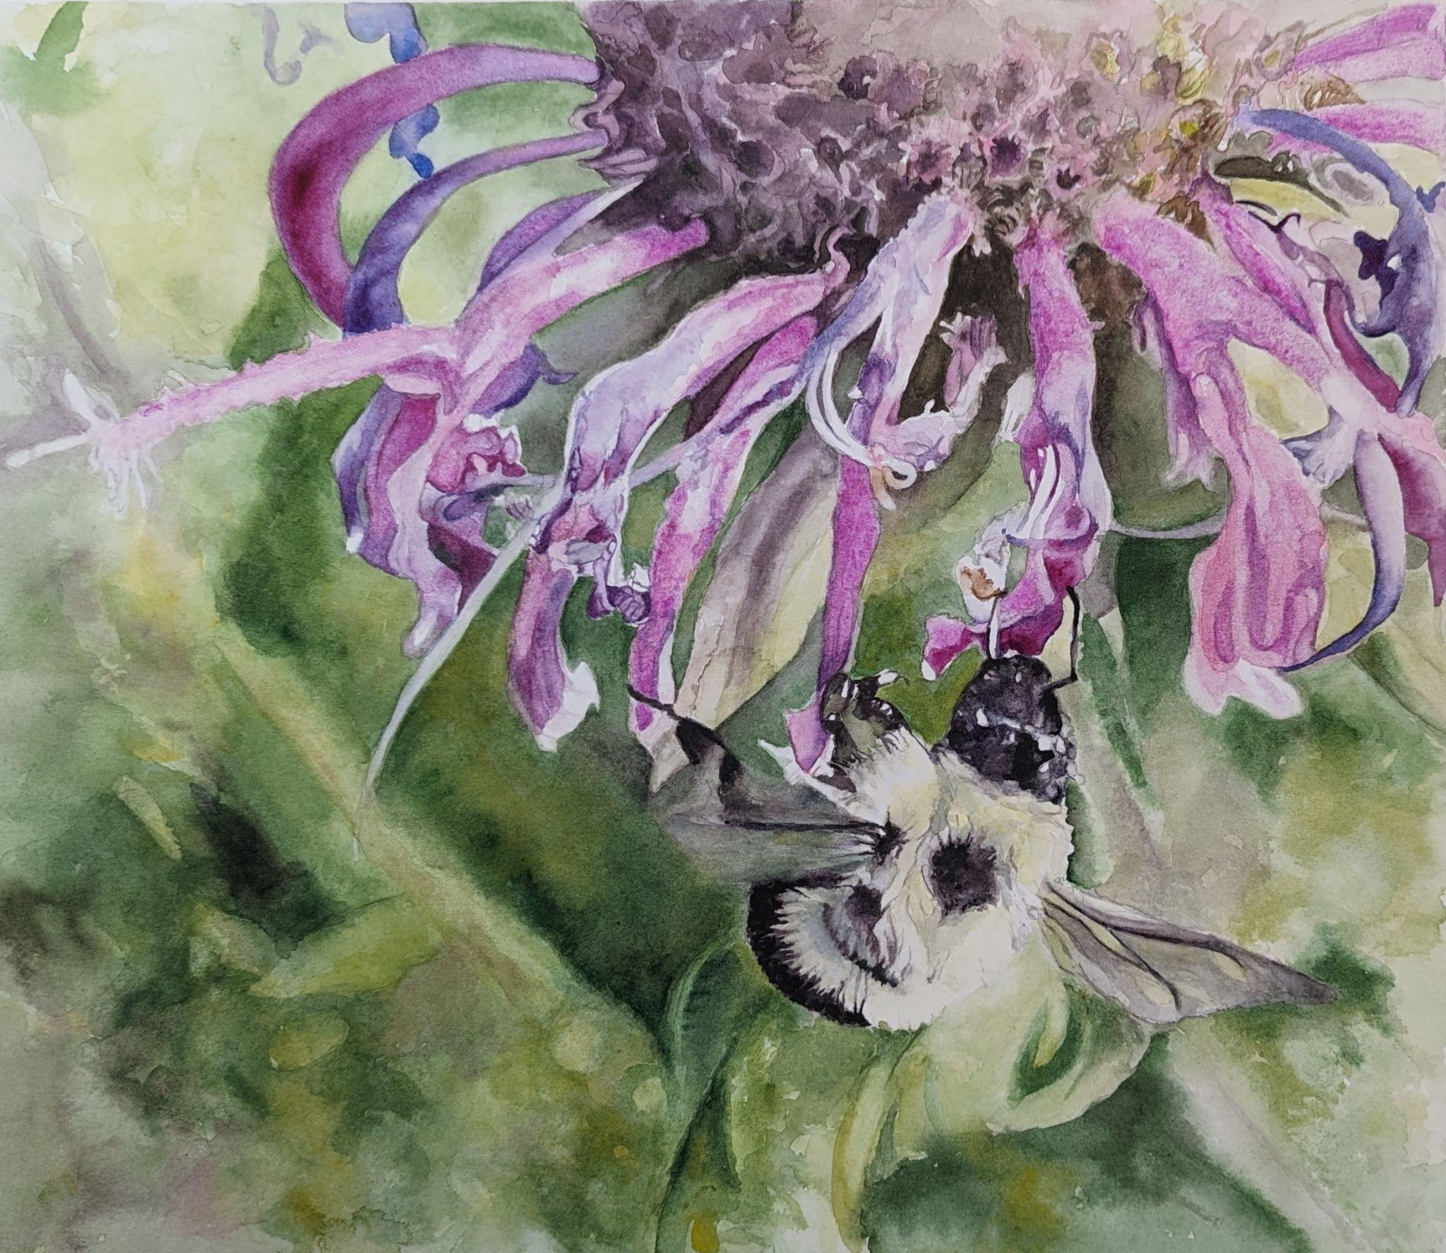
Linda Anderson

Slide 3
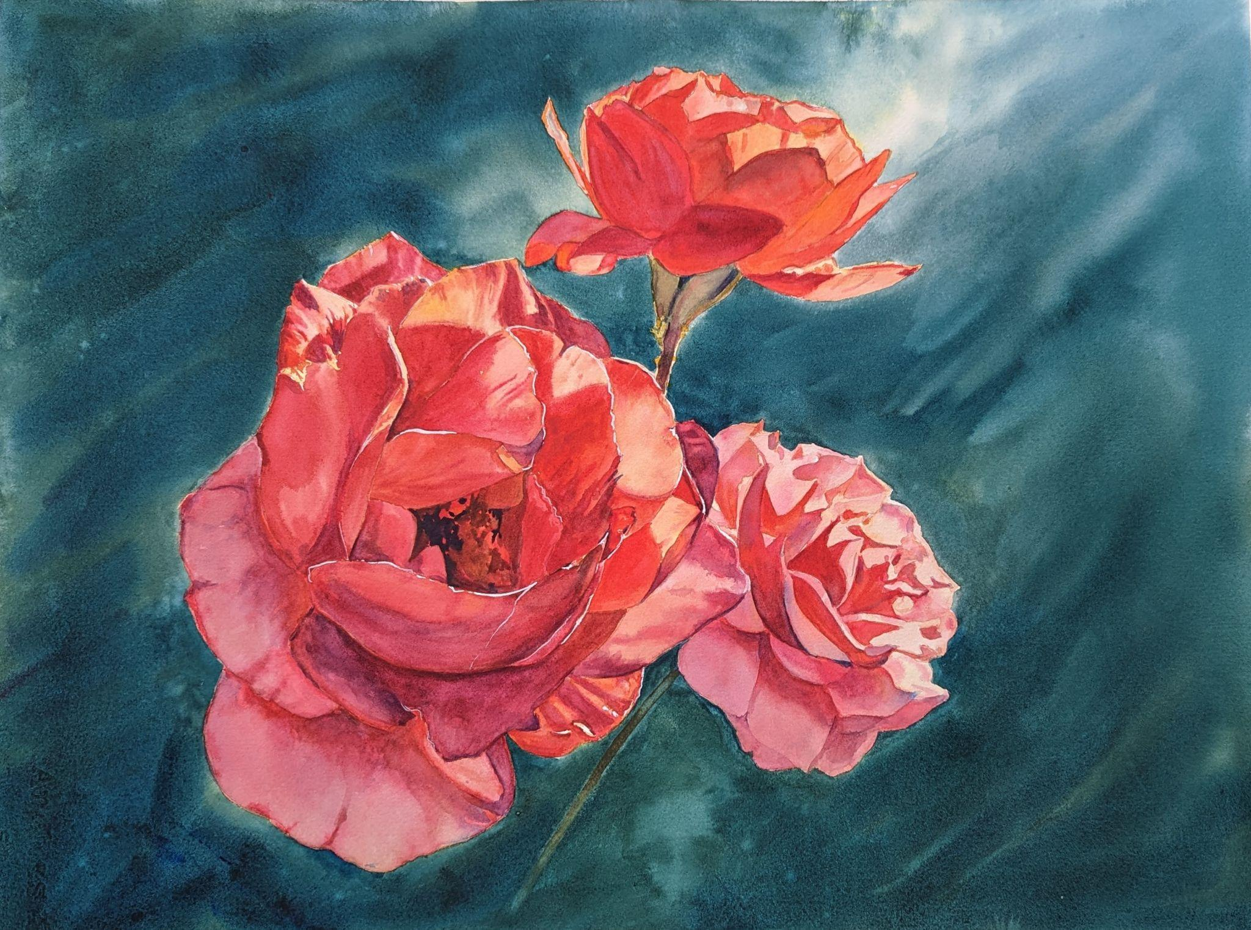
Kelly Burk, SWS

Slide 4
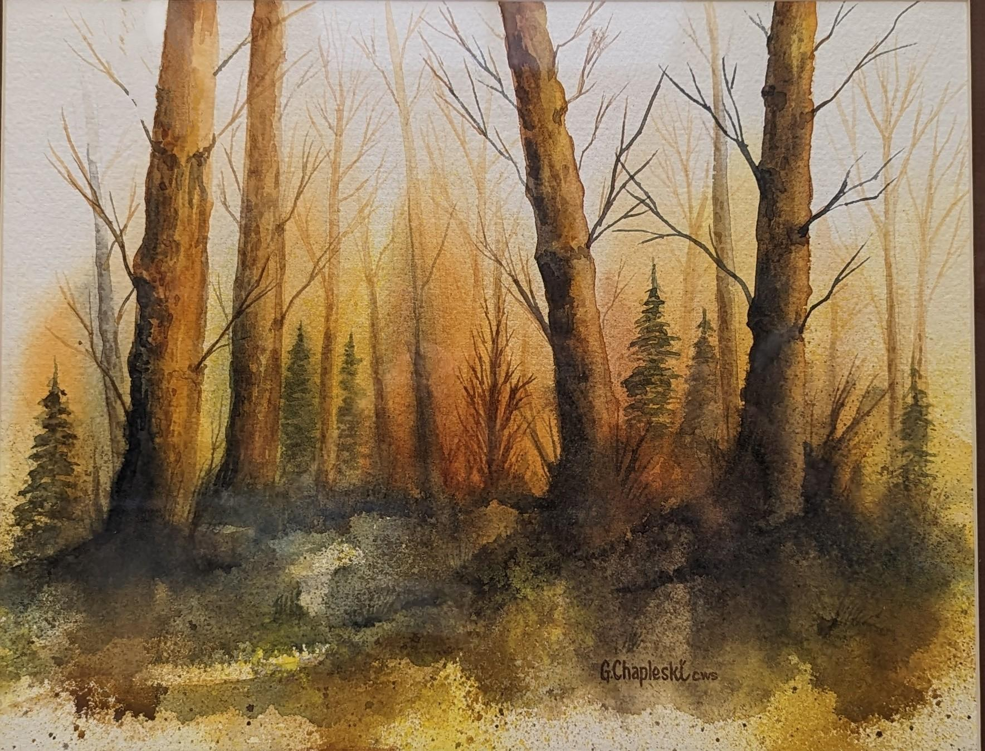
Greg Chapleski

Slide 5
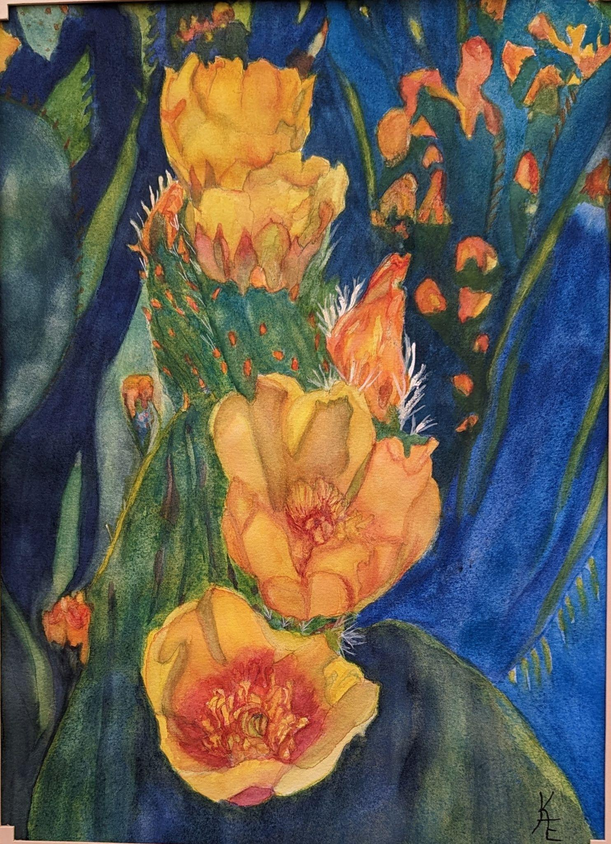
Kathi Eckerich

Slide 6
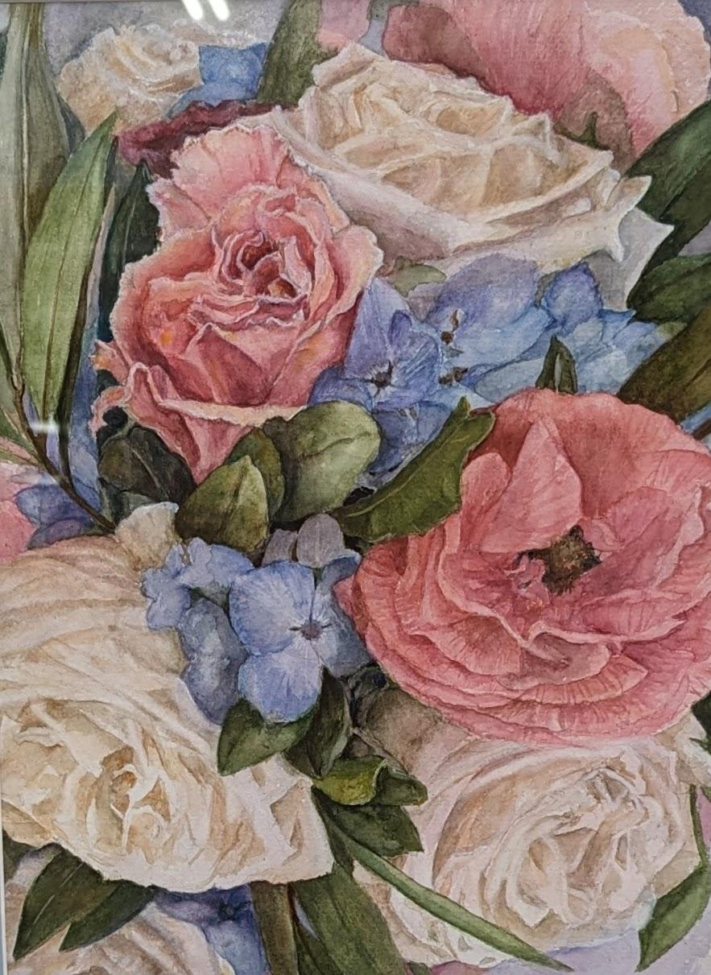
Gloria Fox, SWS

Slide 7
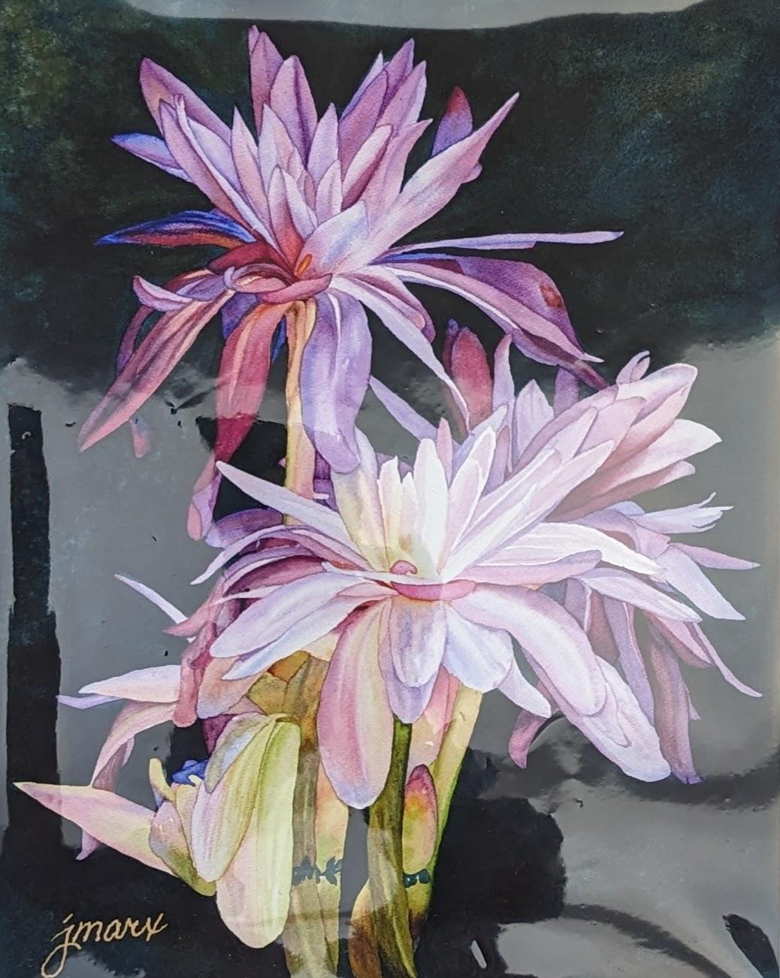
Jeannine Marx Fruci, SWS

Slide 8
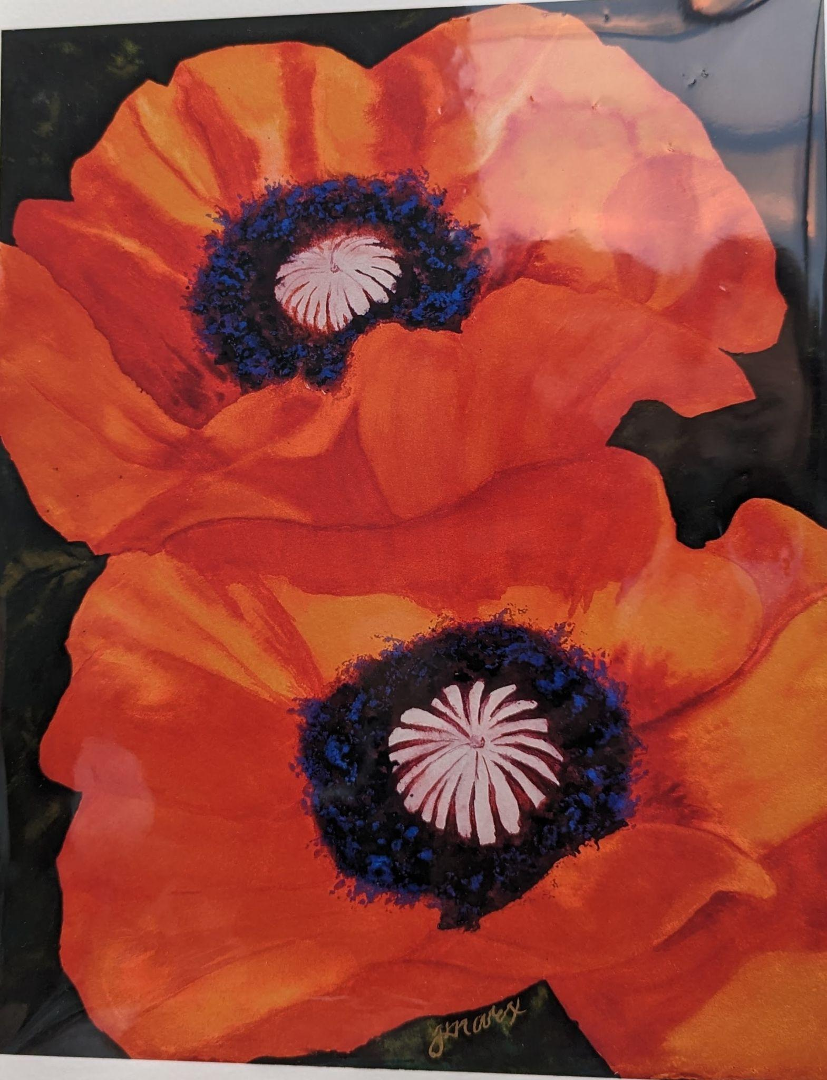
Jeannine Marx Fruci, SWS

Slide 9
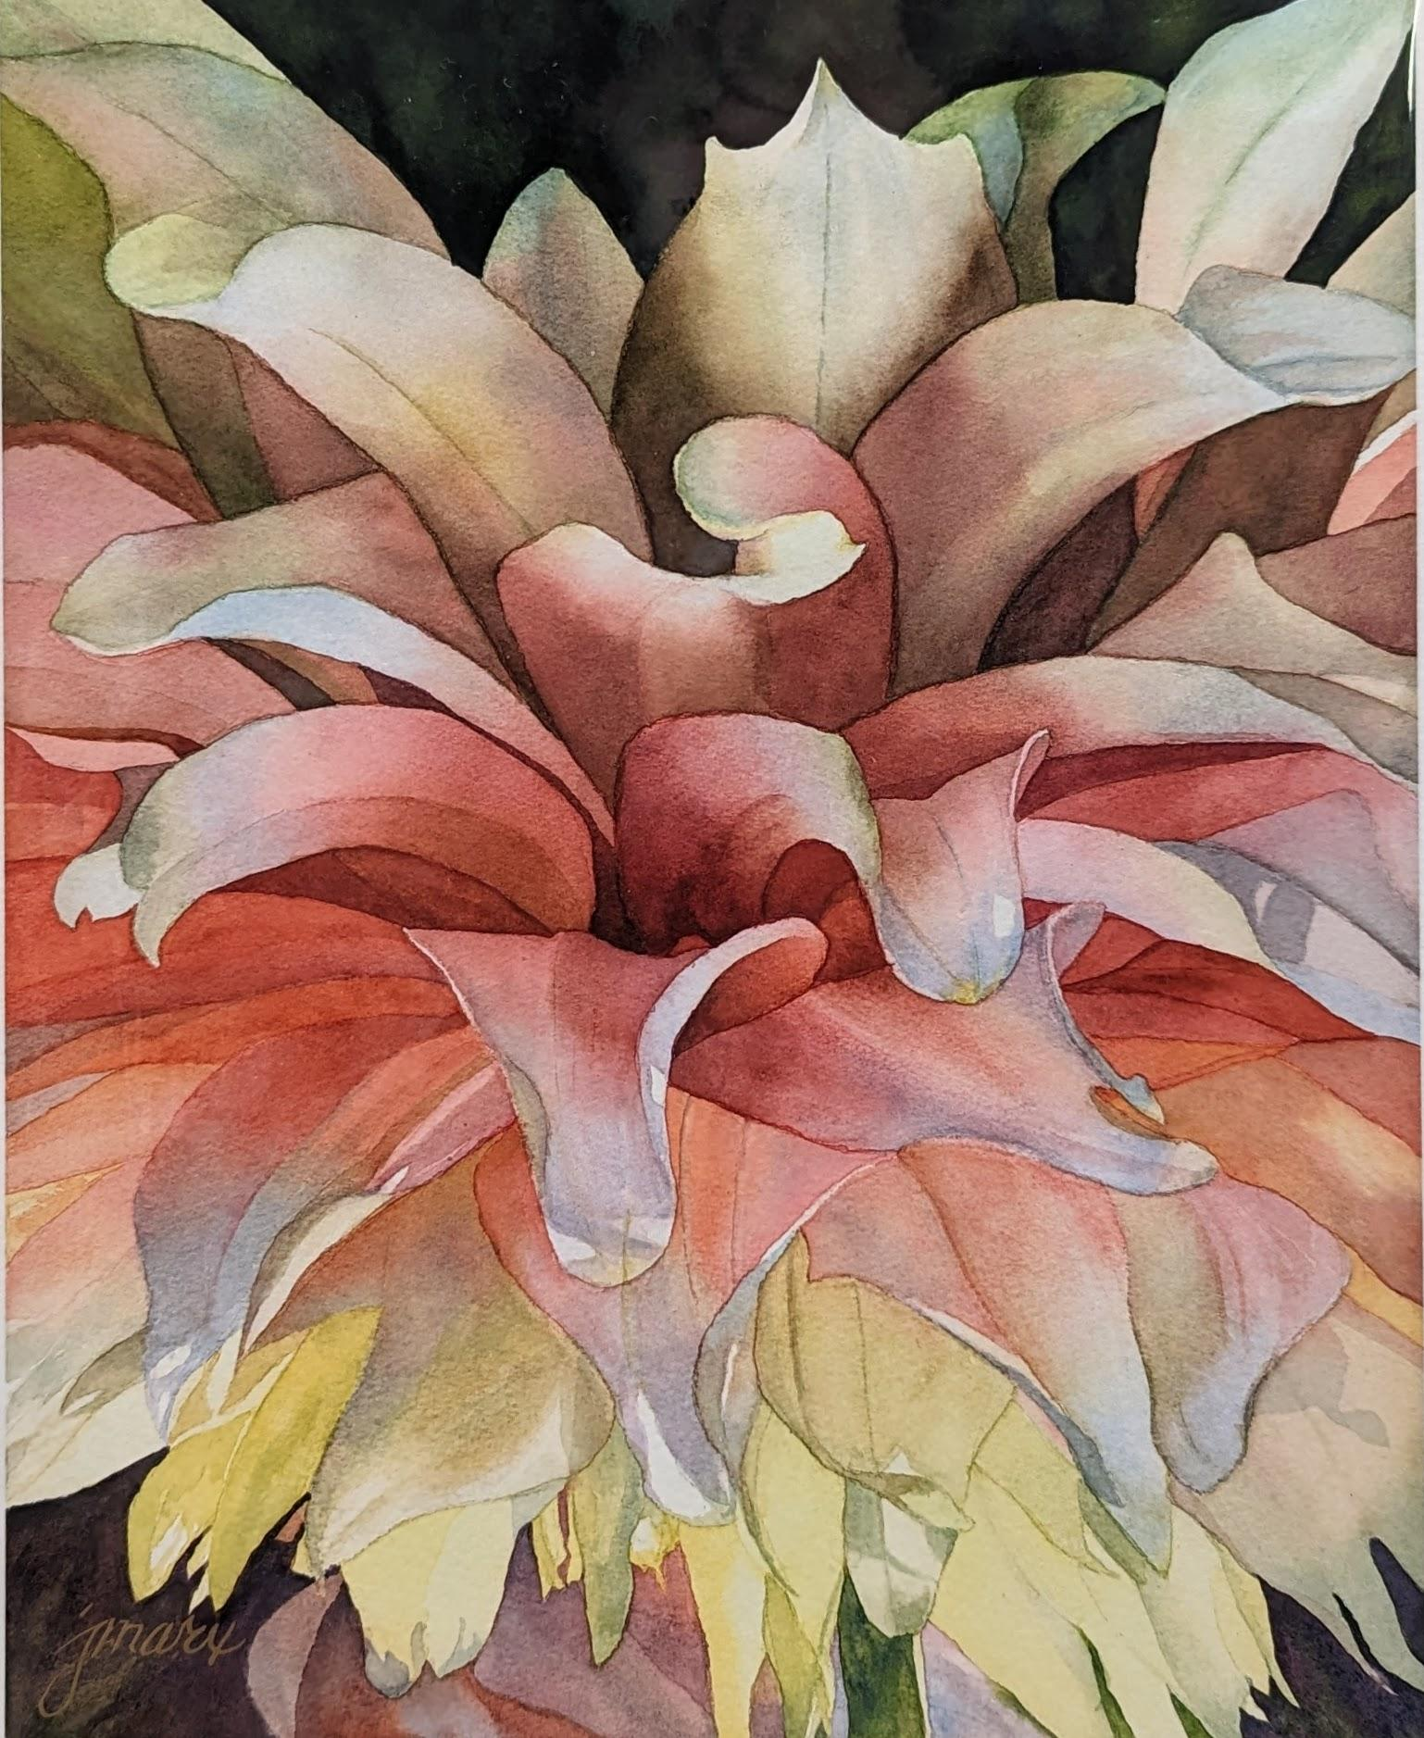
Jeannine Marx Fruci, SWS

Slide 10
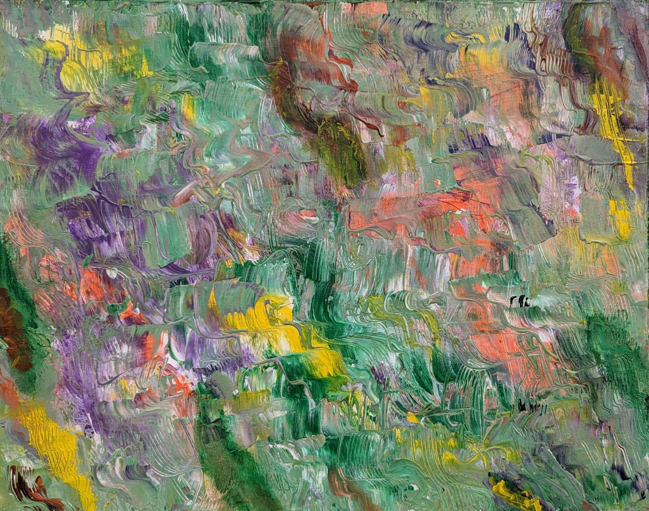
Nancy Huck

Slide 11
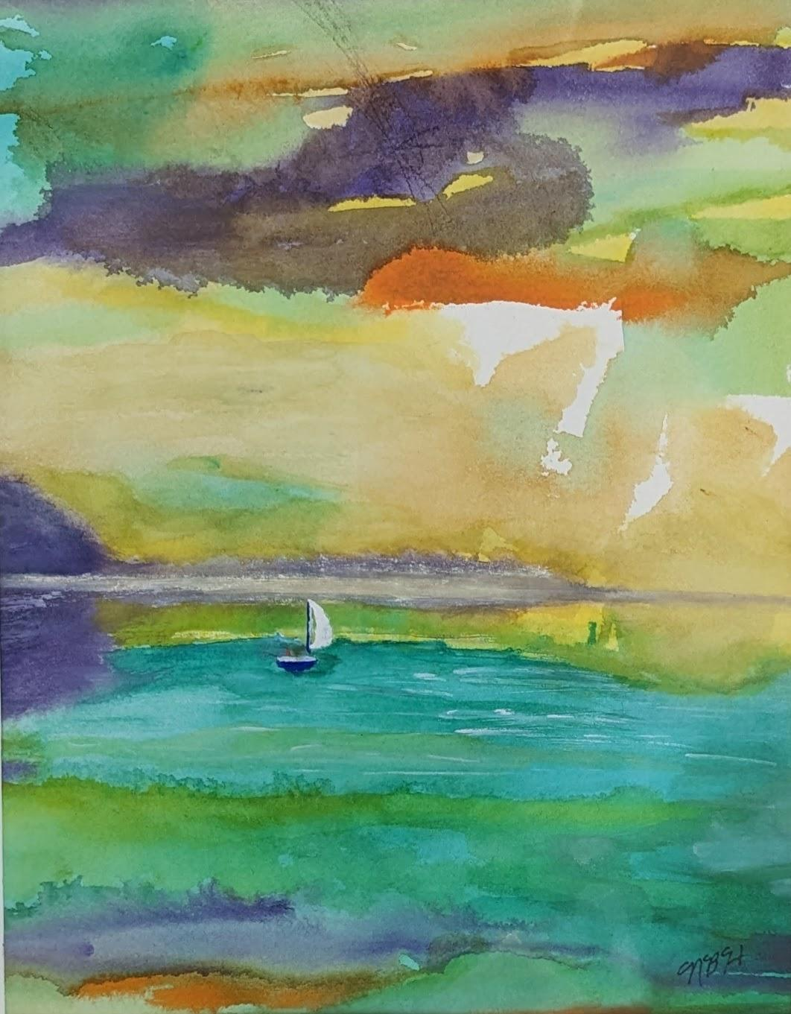
Nancy Huck

Slide 12
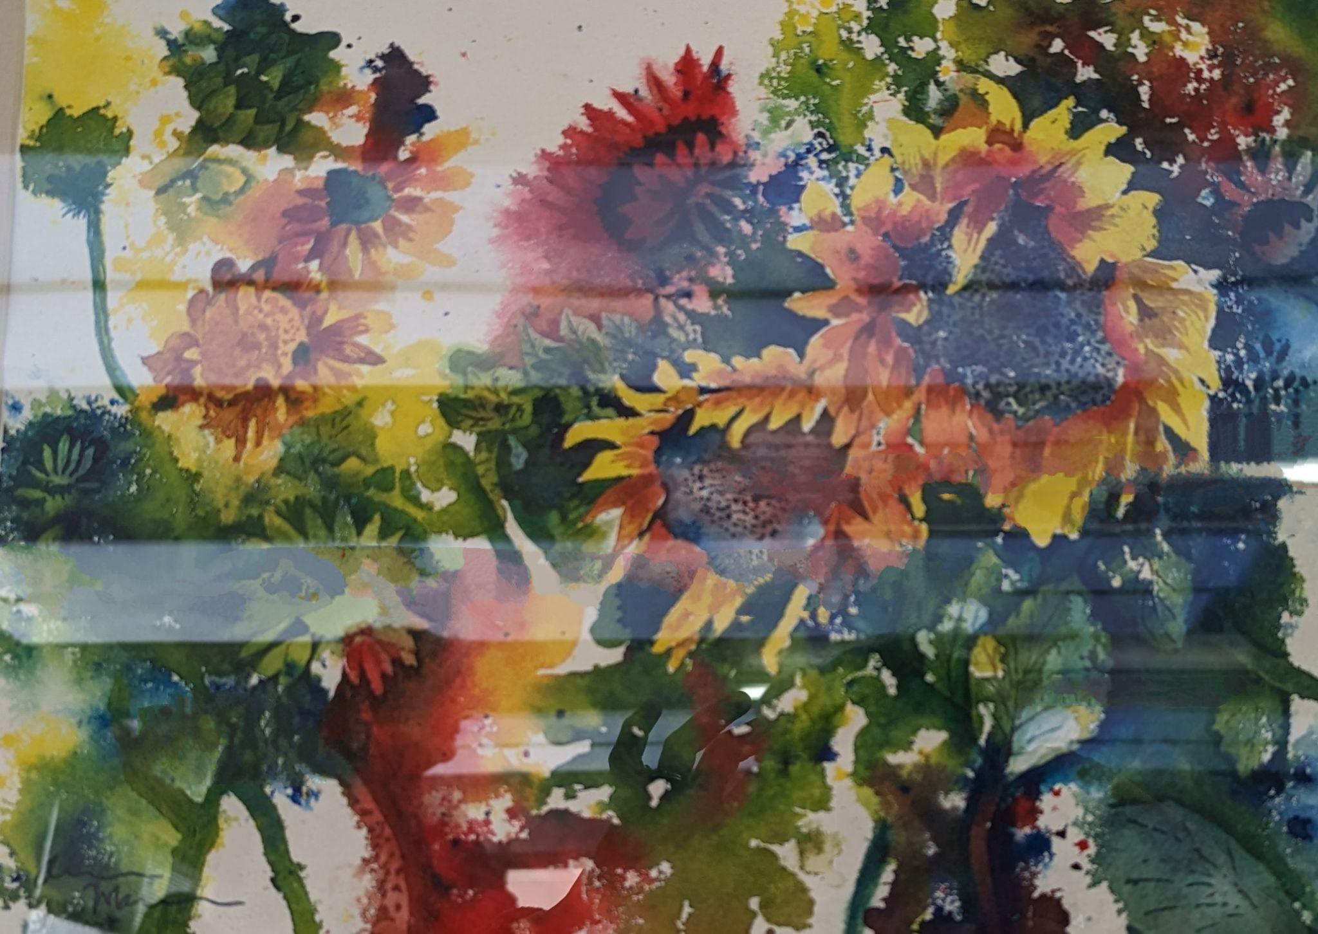
Aaron Mann

Slide 13
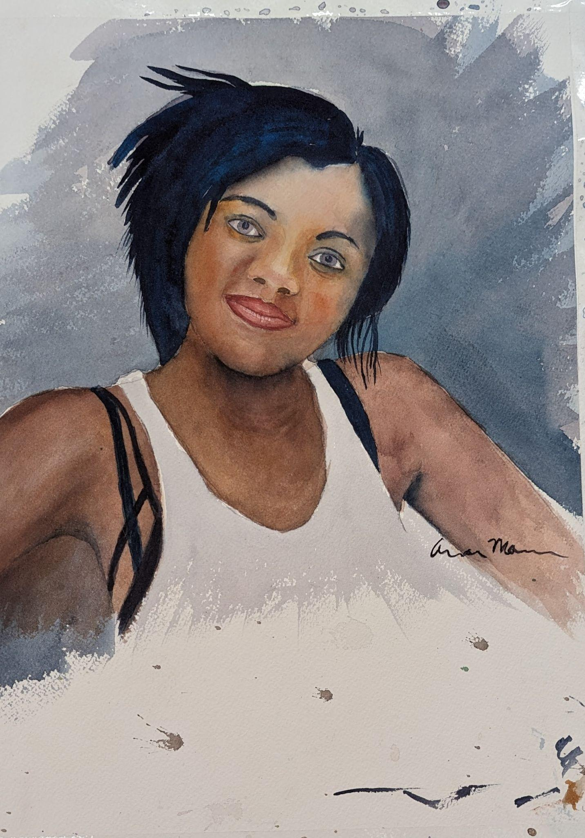
Aaron Mann

Slide 14
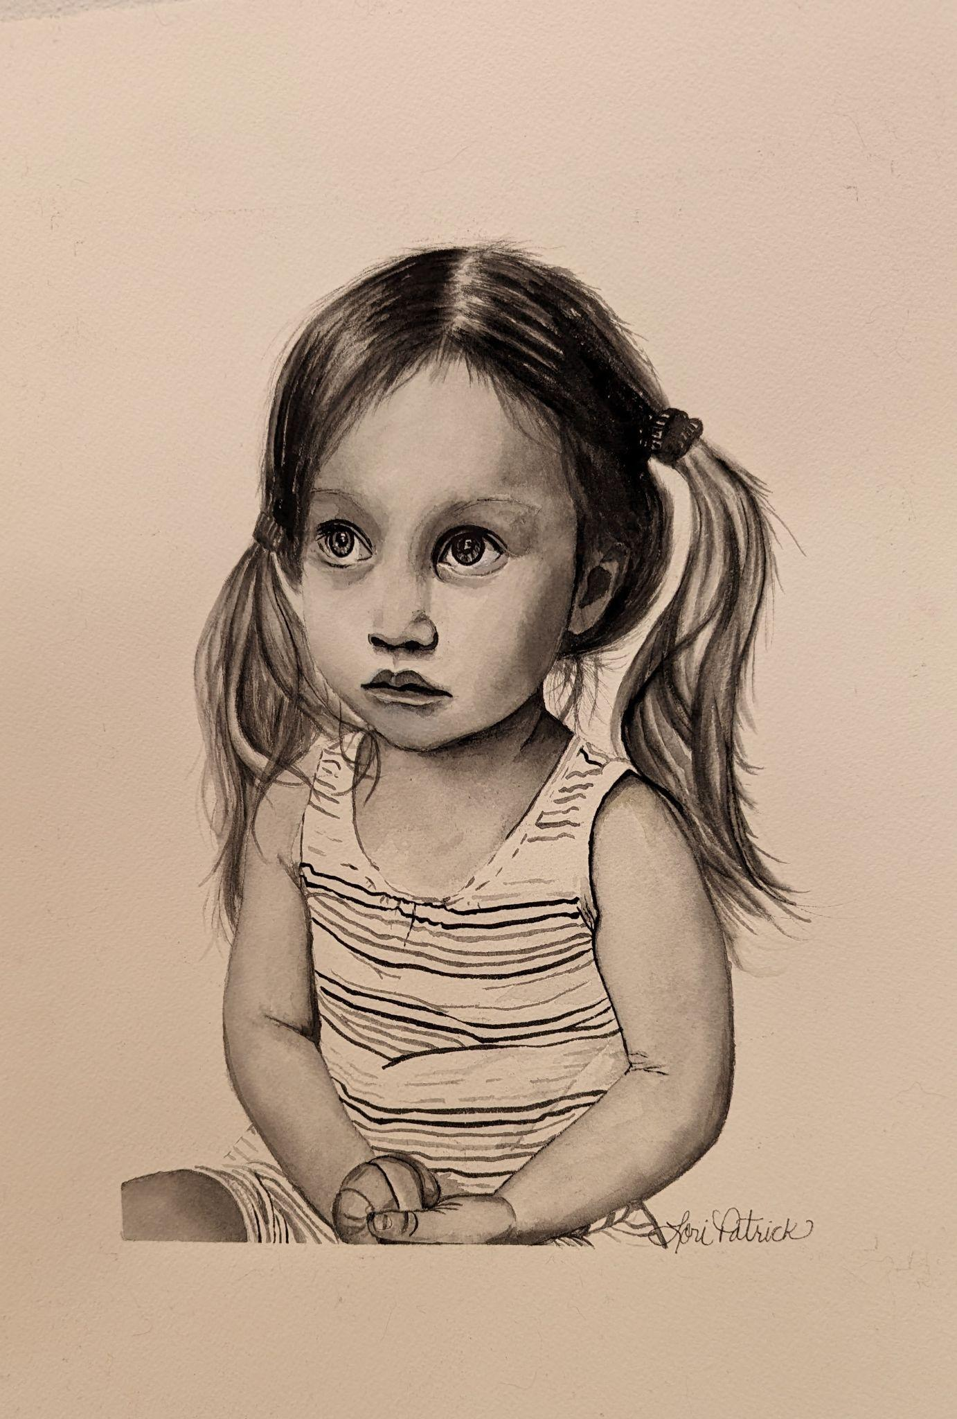
Lori Patrick

Slide 15
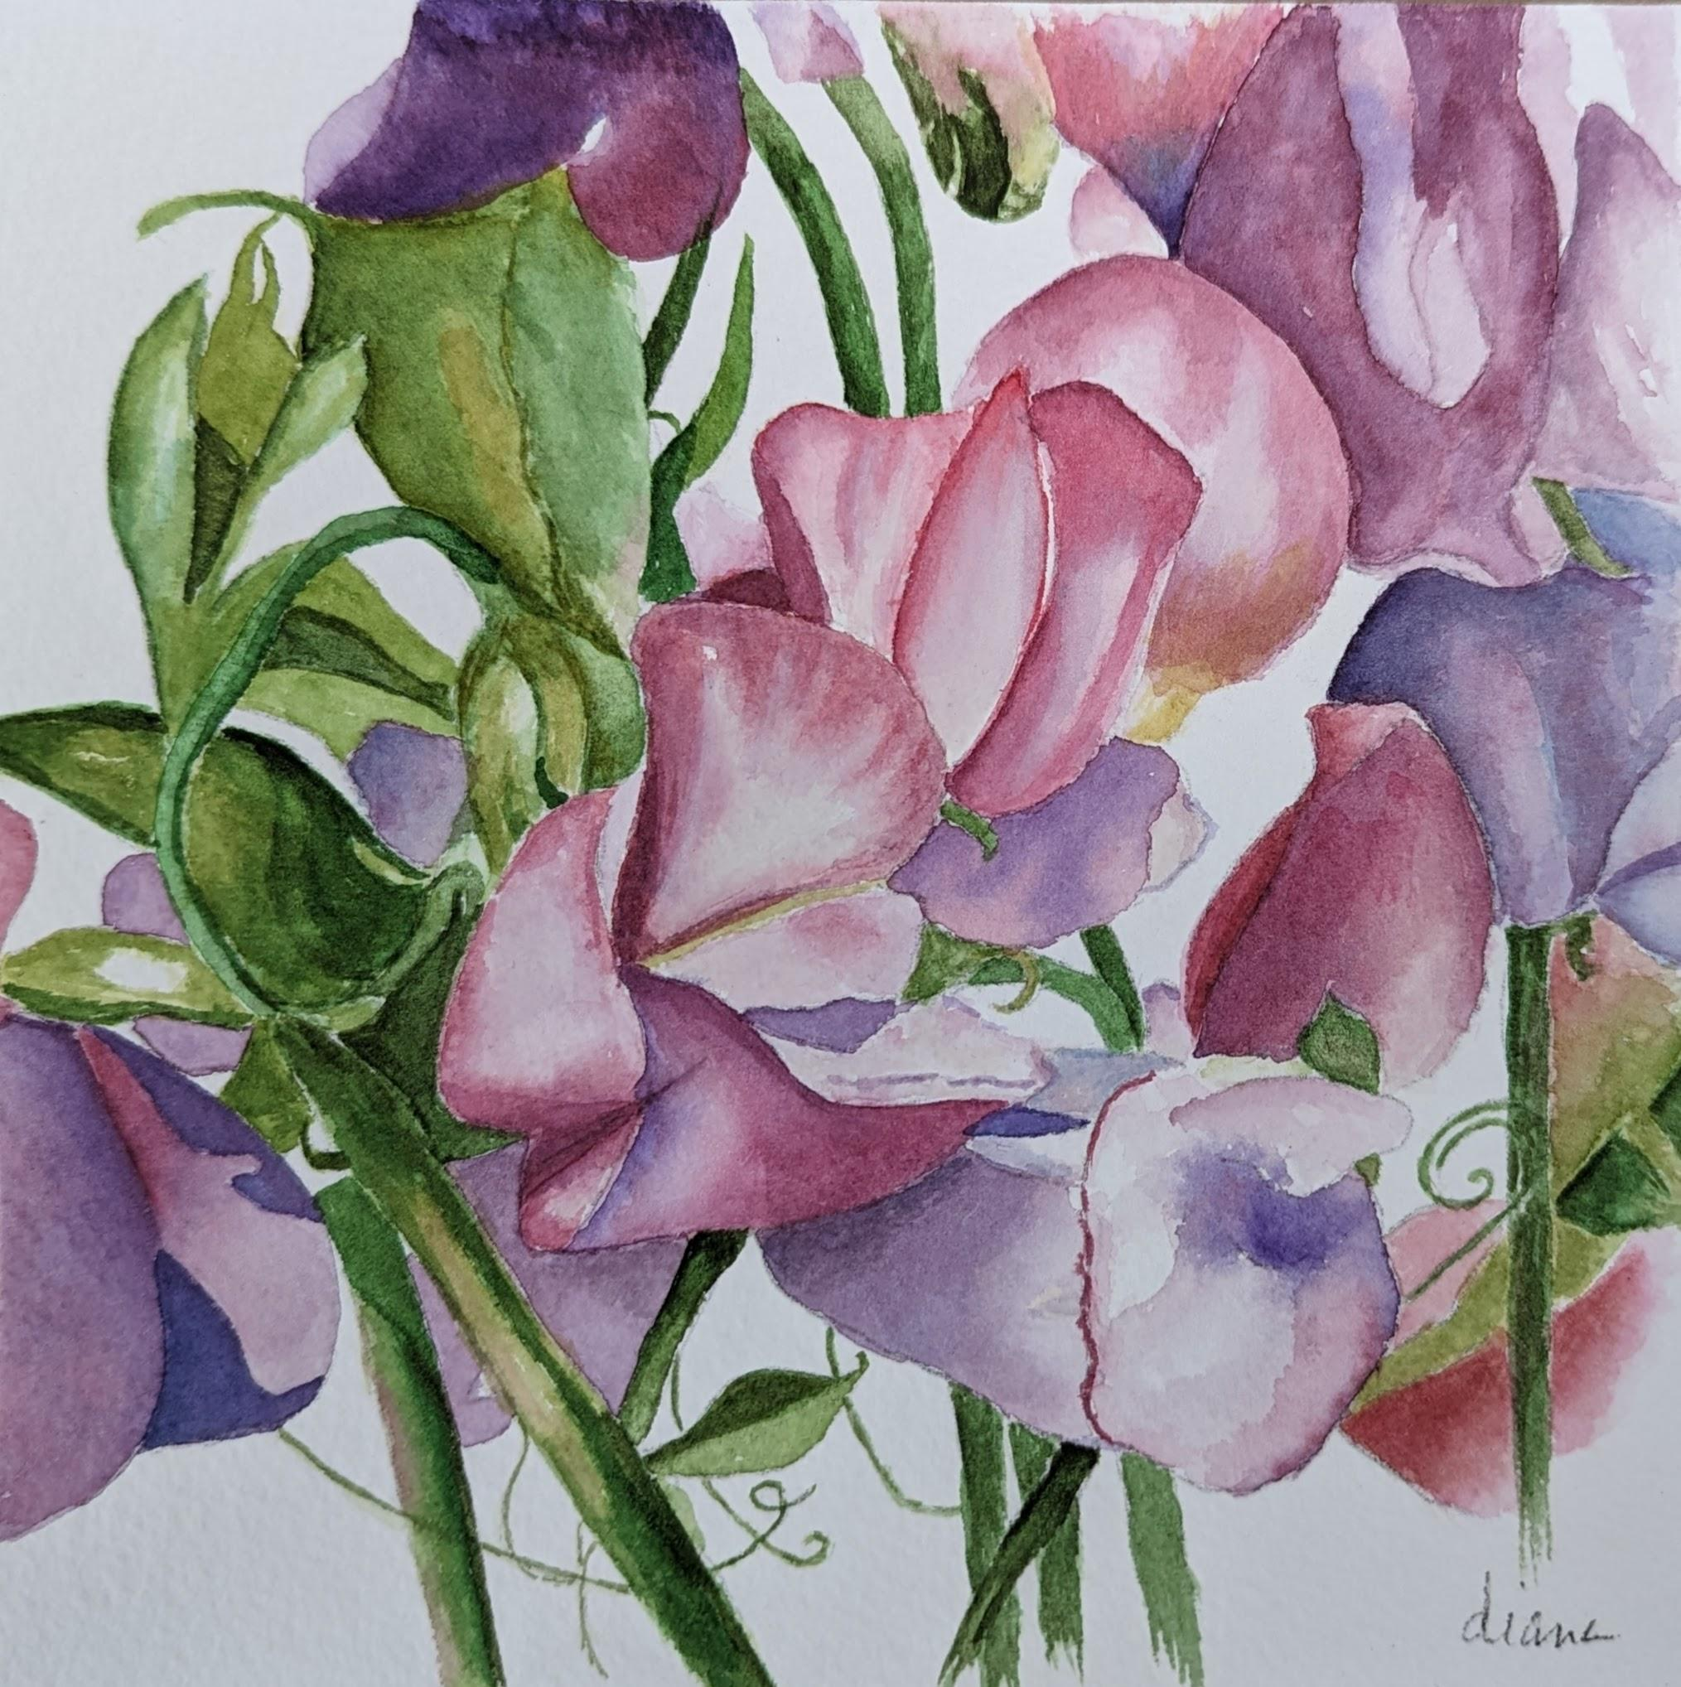
Diane Postlewait

Slide 16
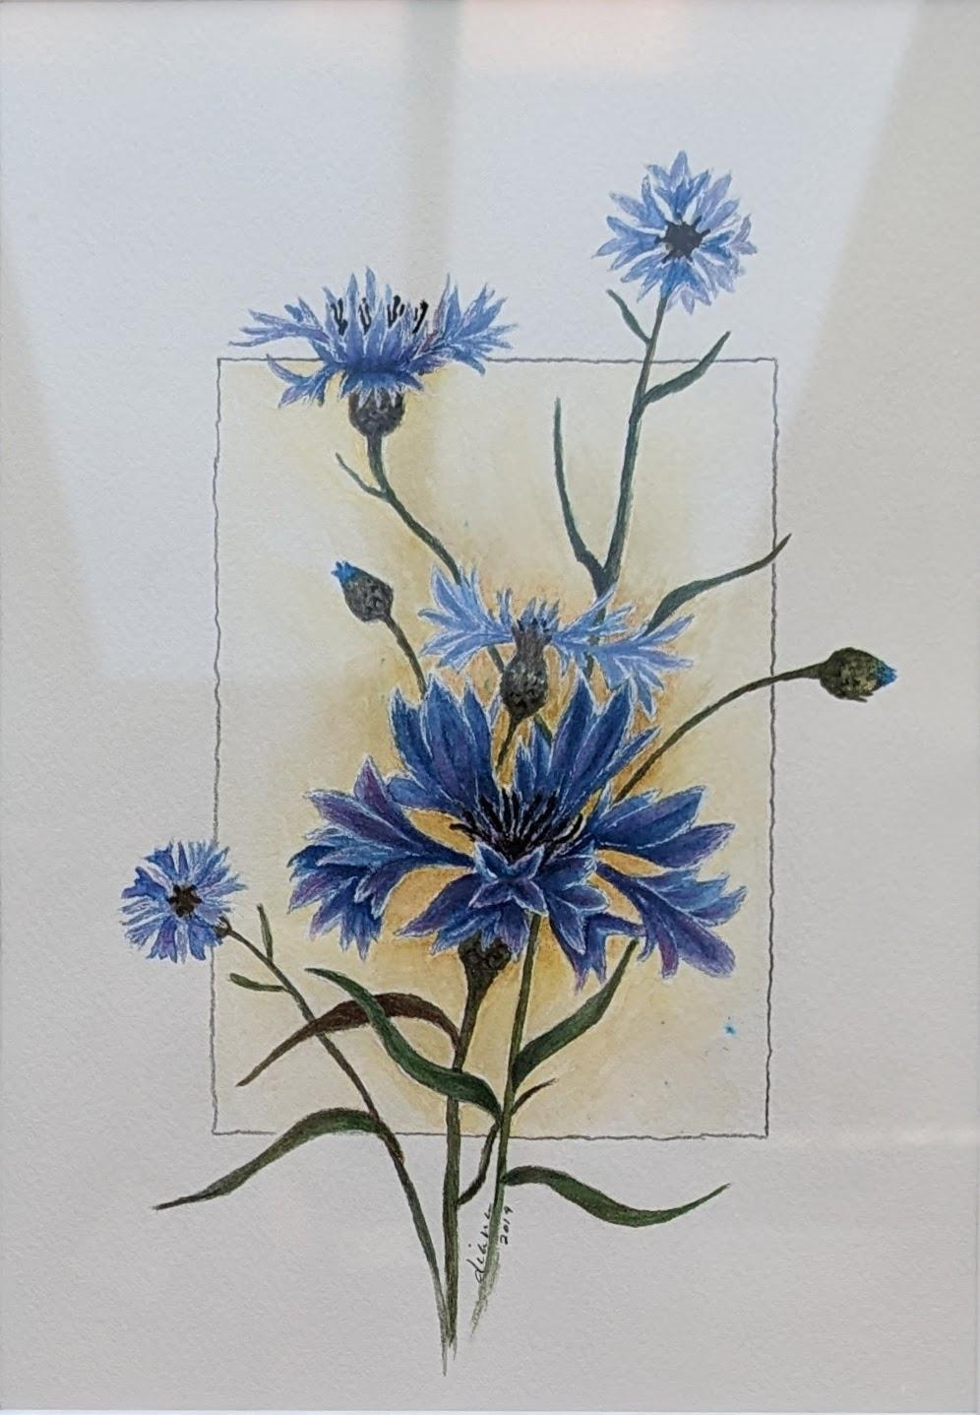
Diane Postlewait

Slide 17
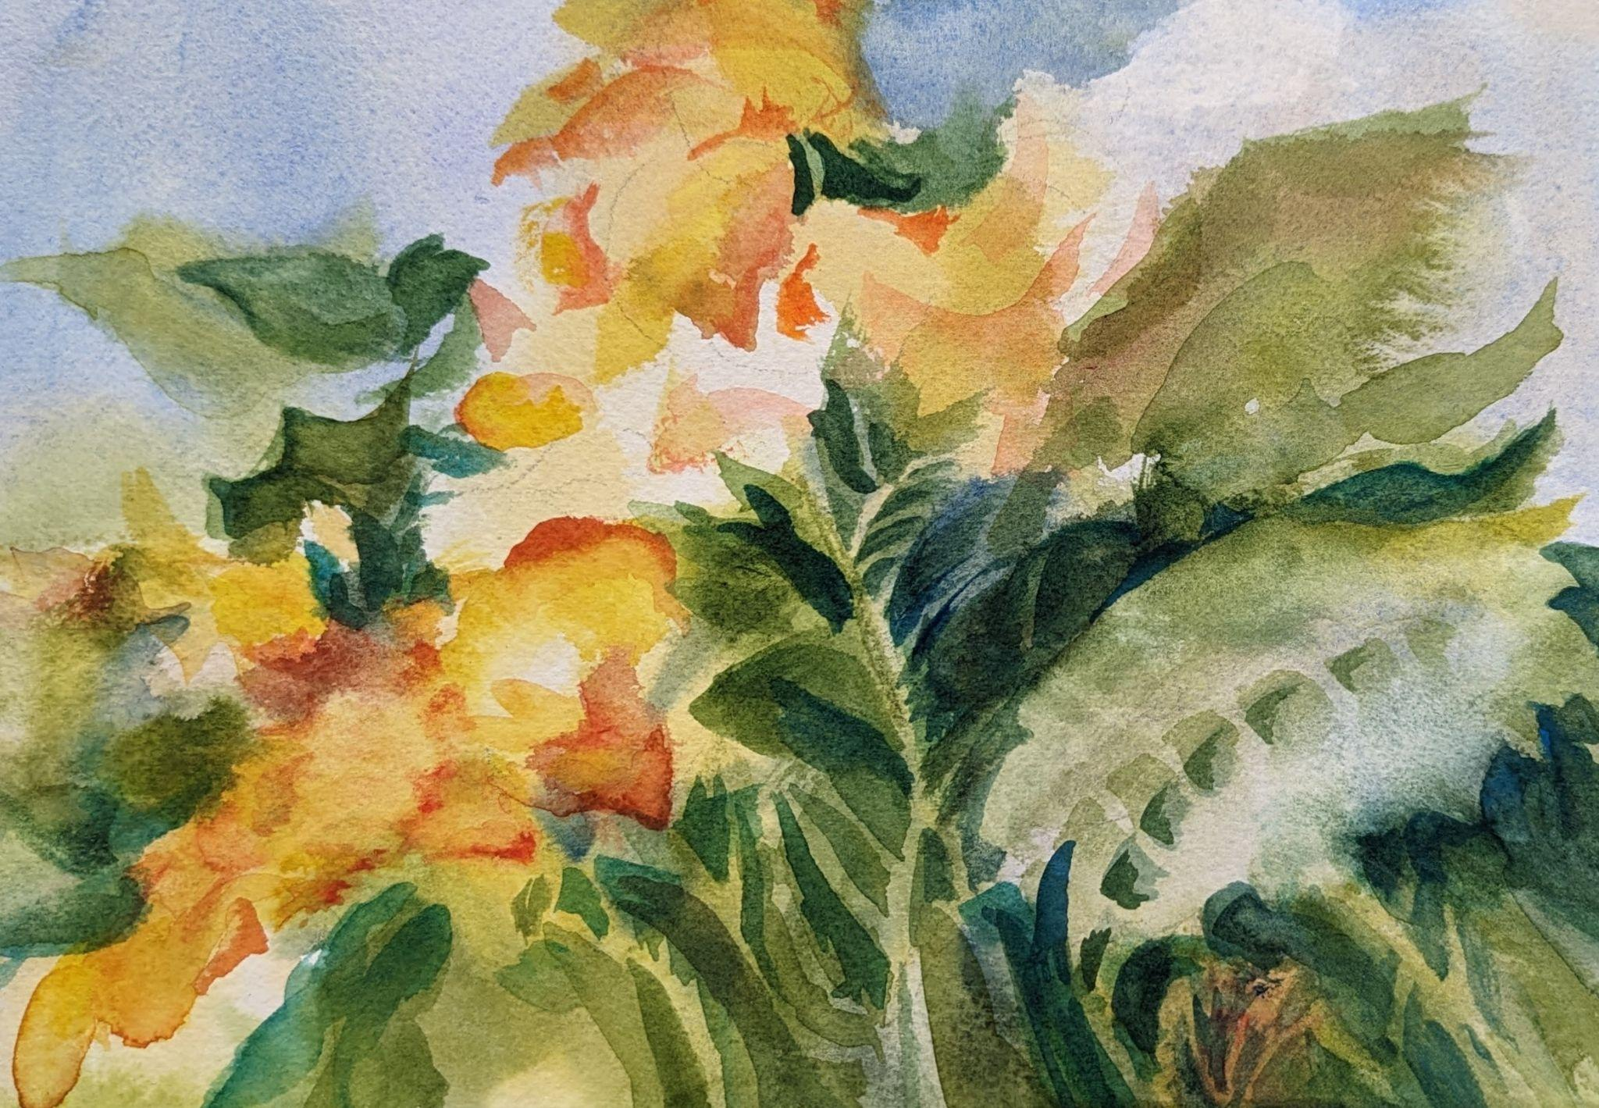
Sheri Thies, SWS

Slide 18
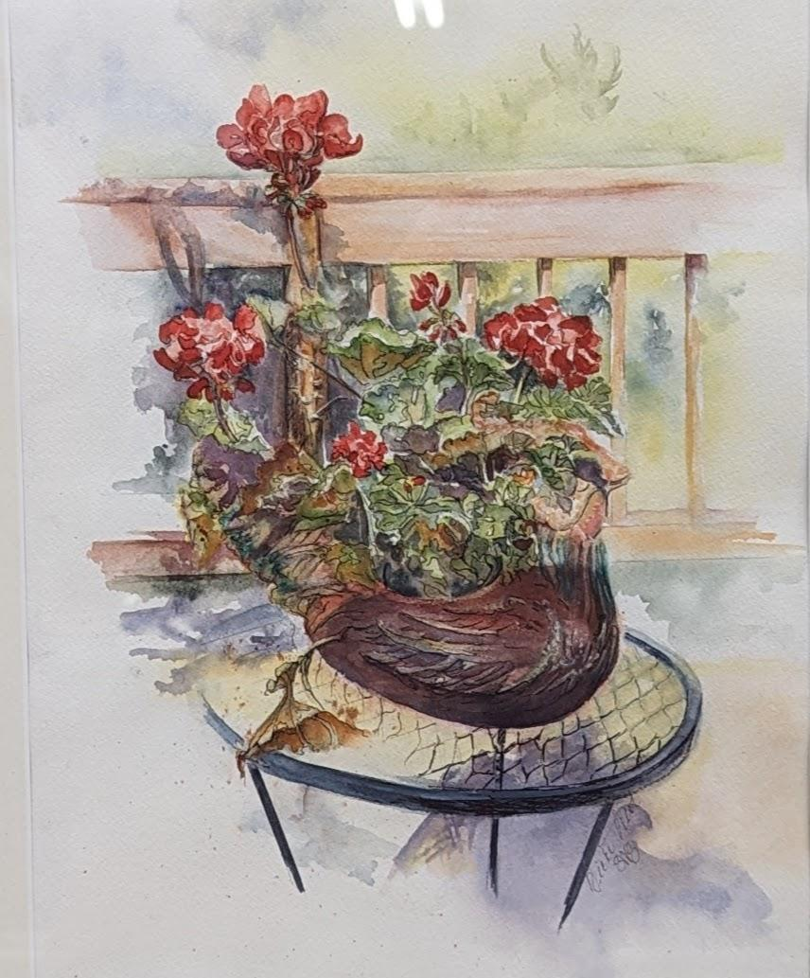
Vicki West, SWS

Slide 19
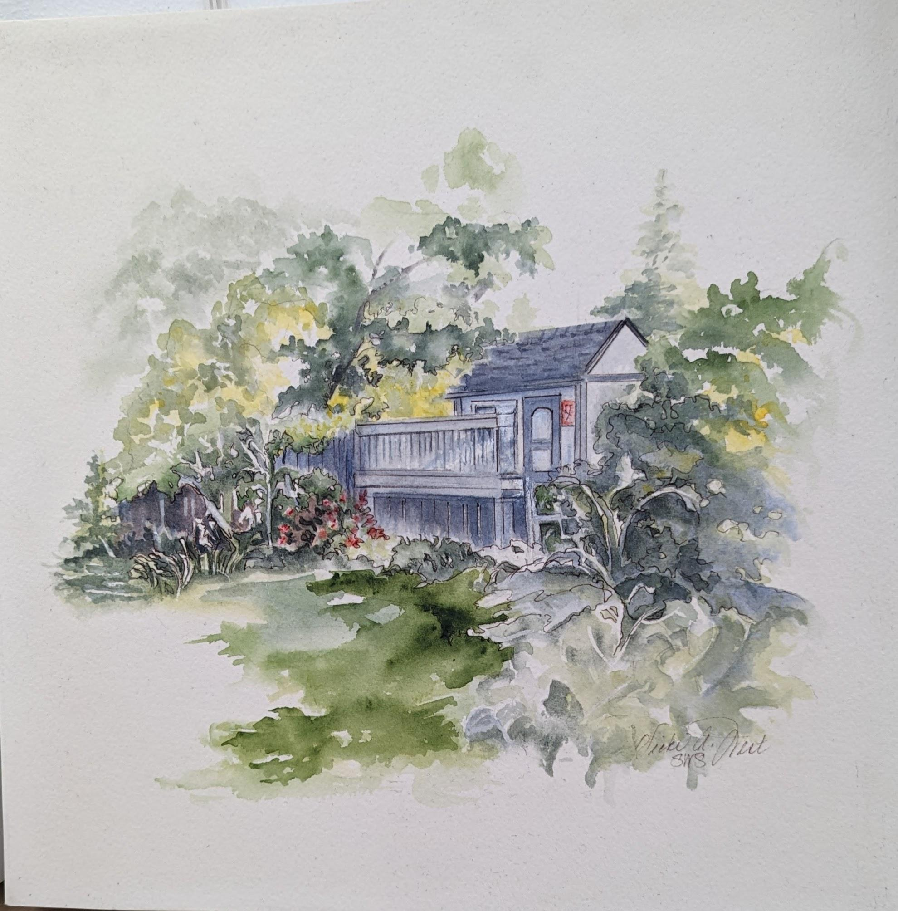
Vicki West, SWS

Slide 20
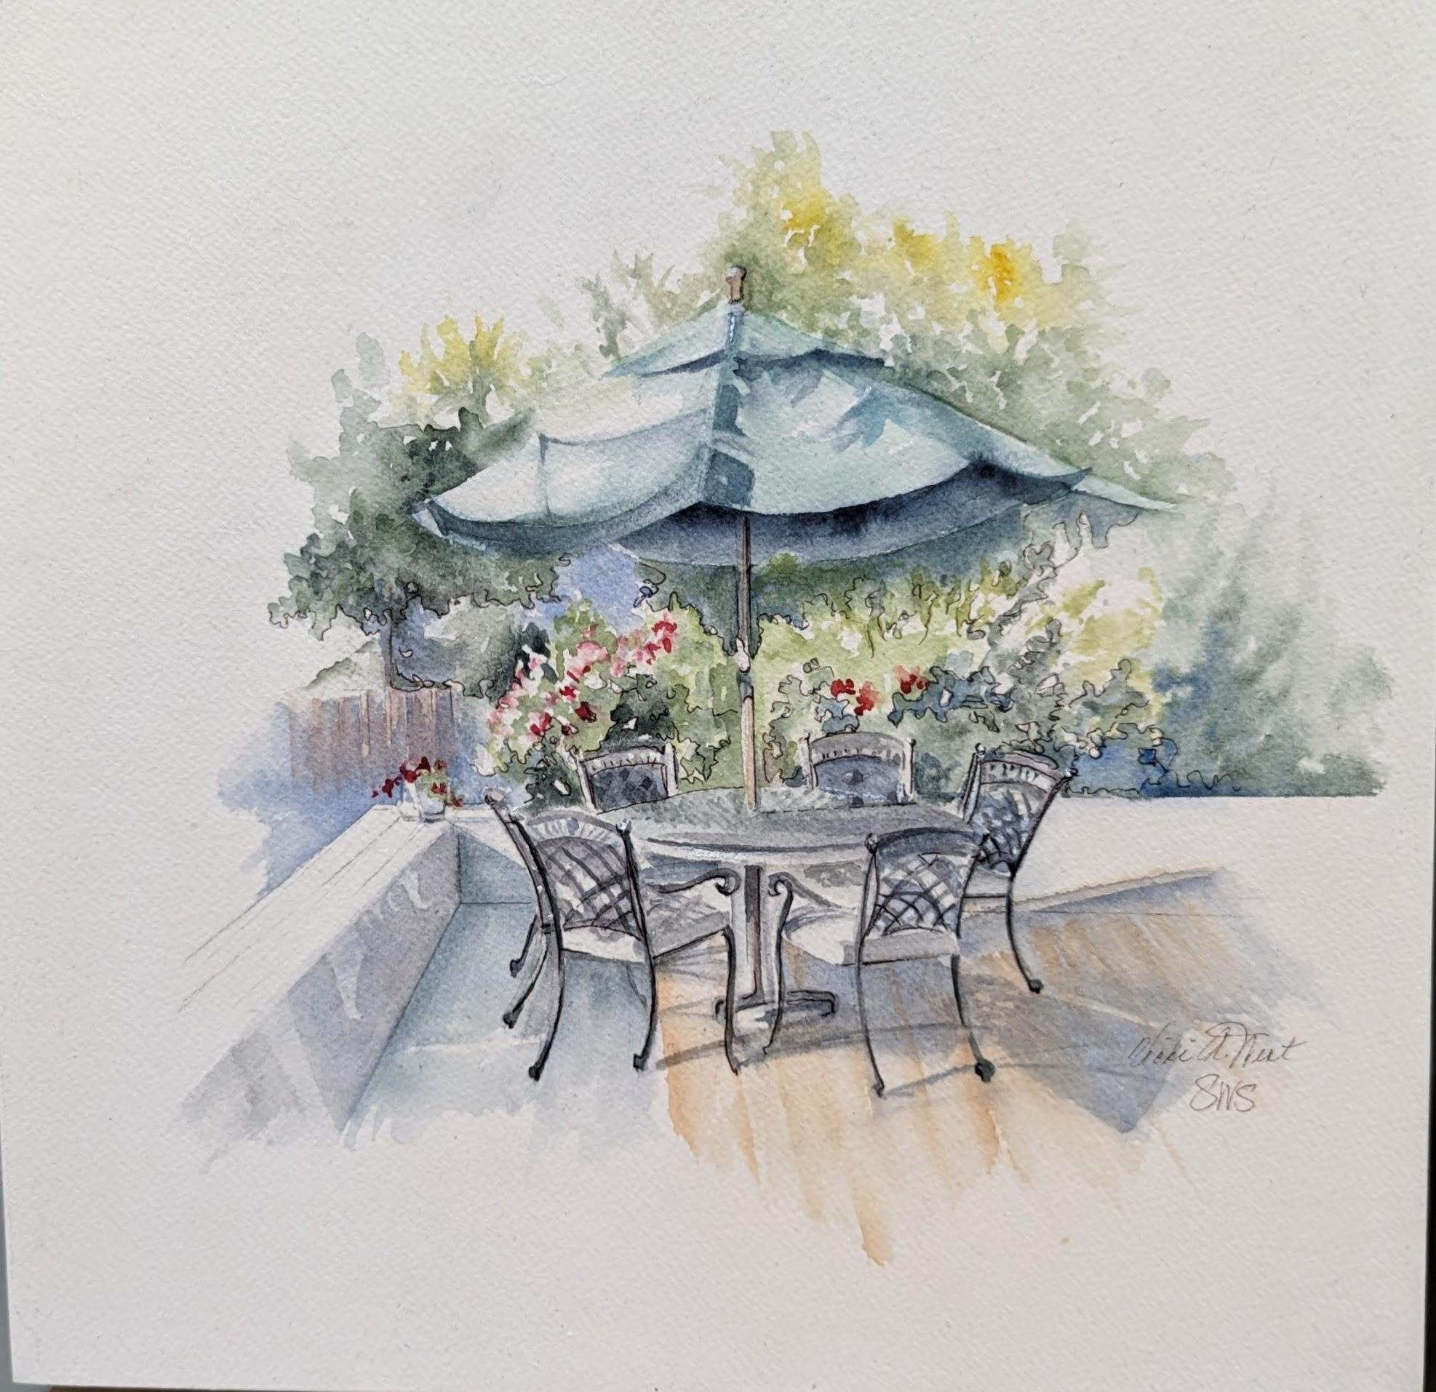
Vicki West, SWS

Slide 21
Challenge Paintings
for March 2023
Consider a Portrait,
Person or Animal

